Slide 1
Fall 2021 AP CS A
Lesson 12.1
Dr. O’Brien
Herbert H. Lehman High School
6 December 2021
Notes:
VOCAB:
nested loop

Slide 2

Do now
Be sure to… find a seat at a desk. Get out your notebook. Copy the date and goal.
Answer the questions below in your notebook with a complete sentence. Be prepared to share out.
how to solve it
Understand the task:
Read the problem carefully.
What should be the outcome (an answer, program, algorithm).
Make a plan:
Come up with a strategy to solve a problem
How does this problem resemble problems you’ve seen before.
Execute the plan:
Work through your strategy step by step
Review your work:
Does your solution make sense?
If not go back to (2). Do it again!!
What did you find most challenging about working through the free response problem on Friday?
Describe the four steps of Polya’s “how to solve it” method.
How did we use Polya’s method to solve the free response problem?
What should you do if you aren’t sure how to implement part of your algorithm in Java?
Notes:
ANSWERS WLL vary. STUDENTS likely to have had trouble understanding the problems, knowing where to start. Polya’s method is helpful for breaking a problem down and understanding it.

Slide 3
Announcements:
Test on Wednesday.
Complete practice quiz on CodeHS
Review your answers from last week’s practice test
Review your notes!!!!

Slide 4
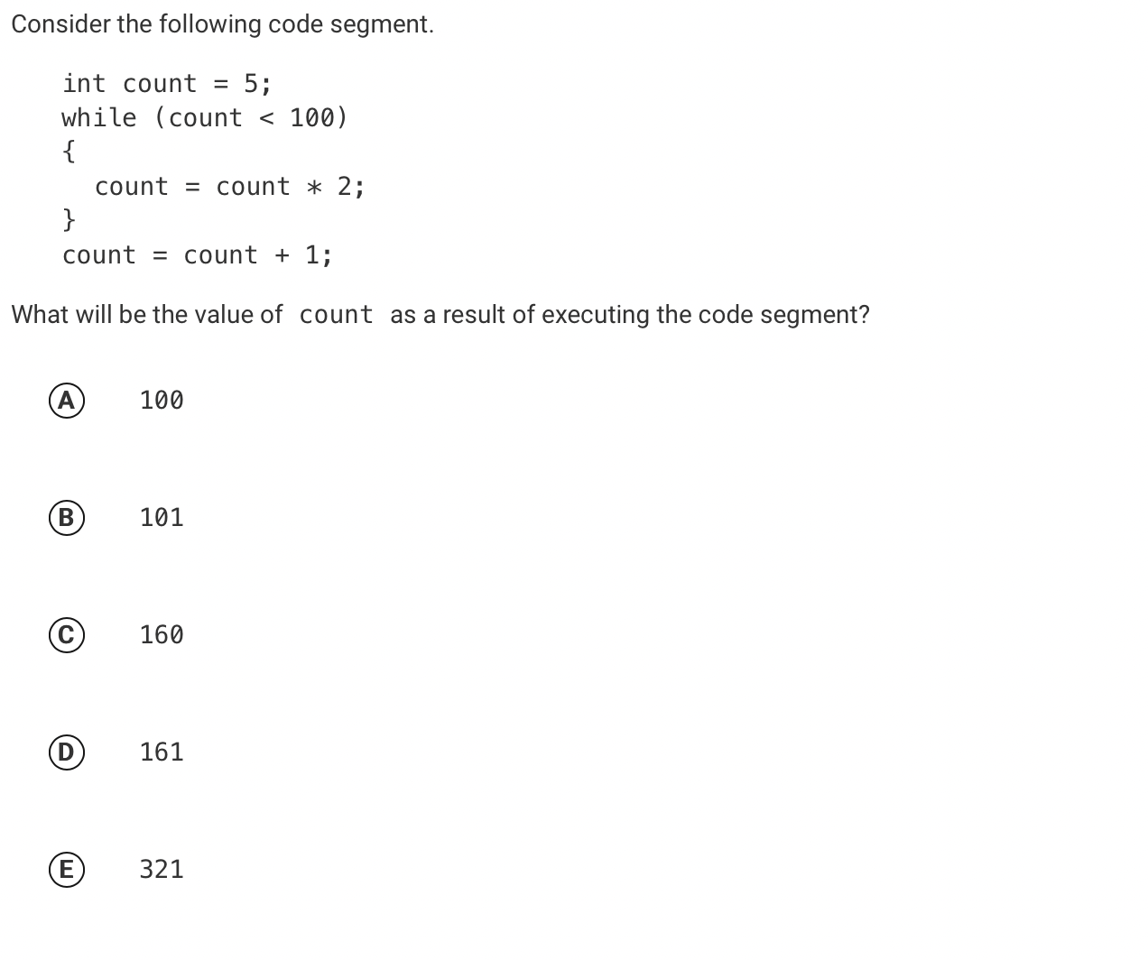
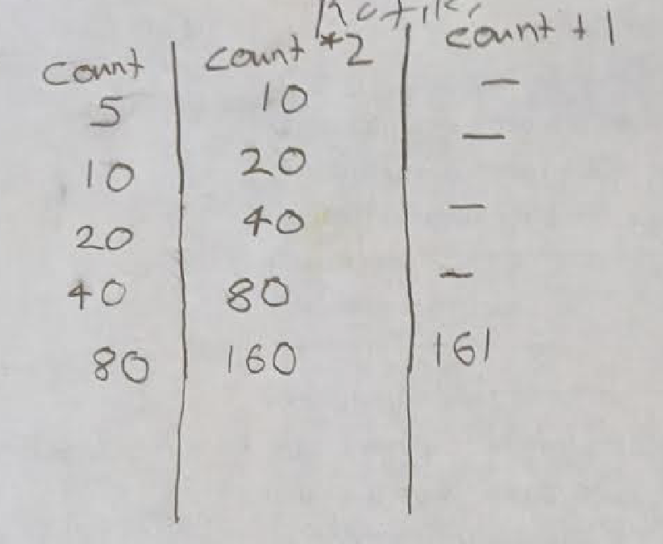
Review: Pre-test problem #1
be sure to: Examine Rafiki’s code tracing table. In your notebook, answer the following questions: 1. What answer does it predict? 2. How is it useful for answering solving the problem?
Notes:
It predicts the final count will be 161.
It’s useful because it keeps track of the value for ‘count’ at each iteration in the loop.
+why does the loop stop when count=160? because the test is count <100.
+How does Rafiki’s table compare to the one you made? What do you like about it? ANSWERS WILL VARY. Rafiki’s is very explicit, does a good job if picking the appropriate variables to keep track of.

Slide 5
Review: Pre-test problem #1
be sure to: Check if your answer was correct. Explain how to get the right answer in your notebook. Be prepared to share out.
Notes:
D: 161.

Slide 6
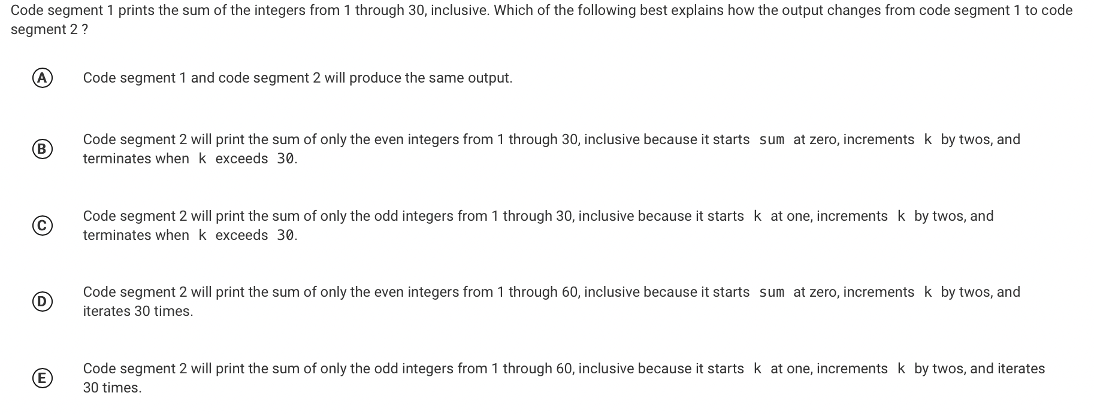
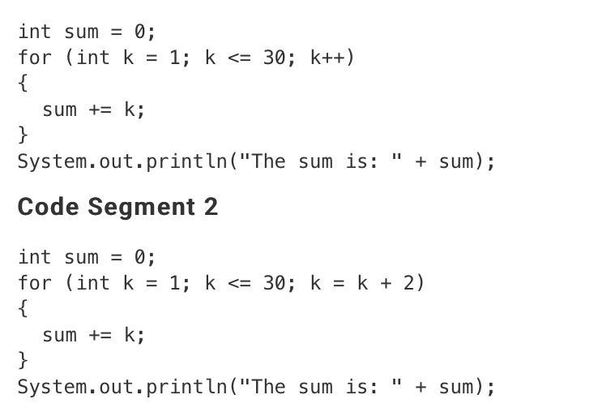
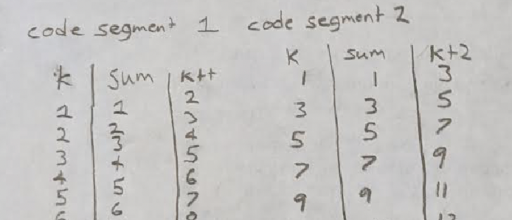
Review: Pre-test problem #2
be sure to: Answer the questions below in your notebook. Be prepared to share out:
1. How does Rafiki’s code tracing table help us solve this problem?
2. What will be the correct answer?
Notes:
+how does Rafiki’s help? it shows us that code segment two is only summing teh odd numbers.
See handwritten notes for details, including a code tracing table.
+Why don’t we need to complete a full code tracing table to solve this? We should write out the code tracing table long enough to establish a pattern. Once the pattern is clear, we can stop.

Slide 7
Review: Pre-test problem #2
be sure to: Check if your answer was correct. Explain how to get the right answer in your notebook. Be prepared to share out.
Notes:
C
See handwritten notes for details, including a code tracing table.
+Why don’t we need to complete a full code tracing table to solve this

Slide 8
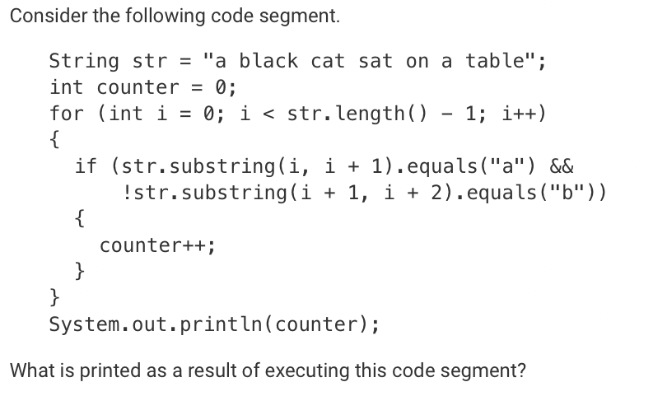
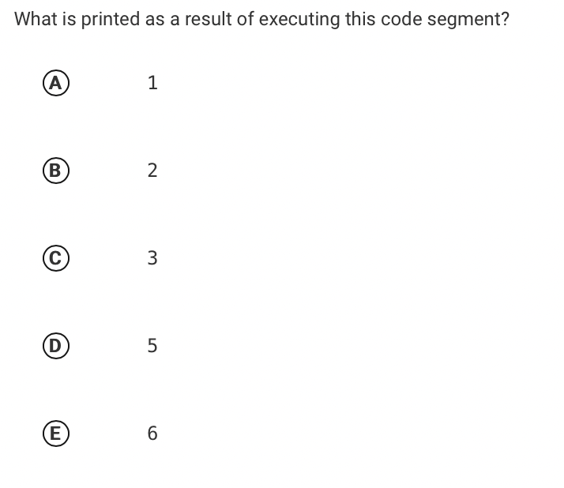
Review: Pre-test problem #3
be sure to: how to get the right answer in your notebook. Be prepared to share out.
Notes:
5. All instanes of “a” except the last one. Note that a blank space. counts as a character

Slide 9
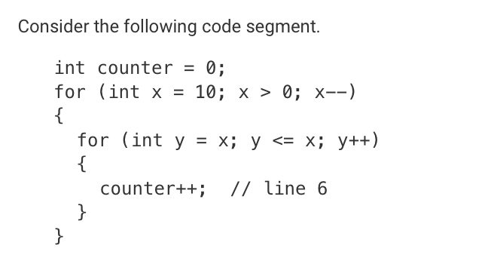
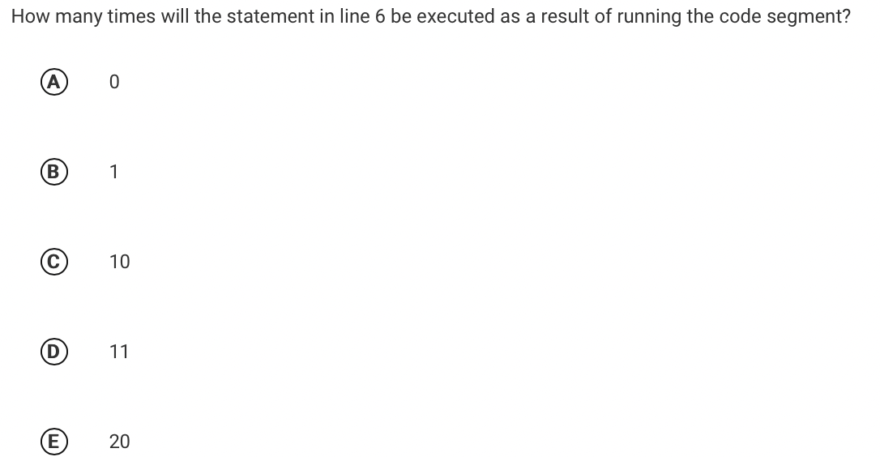
Review: Pre-test problem #5
be sure to: Check if your answer was correct. Explain how to get the right answer in your notebook. Be prepared to share out.
Notes:
10. If y is initialized as x in the inner loop, it will only be less than or equal to x on the first iteration, so it only runs once for each iteration in the outer loop, of which there are ten iterations in total.

