Slide 1
Fall 2021 Pre-calculus
Lesson 7.1
Dr. O’Brien
Lehman High School
November 1, 2021
Notes:
students need calculator
Root of a polynomial

Slide 2
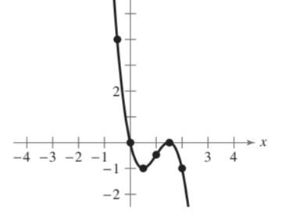
do now
be sure to: Get out your binder. Copy goal and answer do now questions below. Show all work or write a complete sentence for each answer:
What can you identify about this polynomial based on its graph (think about: leading coefficient, highest exponent, real roots!)? Identify 3 things.
How can it be useful to identify properties of a polynomial from its graph?
Notes:
At least 2 real roots. Odd numbered exponent, neg leading coefficient.
We want to know what kind of graph makes sense. Helps us check our work.

Slide 3
framing
what: sketch accurate graphs of polynomials
why: higher order polynomial equations can be used to model things in science, engineering, and more!
where to: more on finding real roots for polynomials
Notes:
Today we’re applying leading coefficient test and strategies for finding real roots to actually sketching some graphs

Slide 4
Review
For any polynomial f with a highest exponent n:
f has at most n real roots.
The graph for f has at most n-1 relative extrema (relative minima or maxima)
Vocab:
Root of a polynomial: any value of x where $f(x)=0$.
Notes:
Make sure this is in your notes from friday (if not check in w/ neighbor)

Slide 5
Problem set
be sure to: Copy notes below. Do all work in notebook. Show all work. Work at volume 0 for first 4 minutes, then check in with a neighbor.
Sketch the graph of
$$3x^{4}-4x^{3}$$
Draw the graph:
Apply leading coefficient test:
Find the real roots of the polynomial
Plot a few additional points:
x | -1 | 0.5 | 1 | 1.5
f(x)
Notes:
It will rise on the right and left hand. Even exponent with a positive leading coefficient
=x^3(x-4) = 0, so x = 0, 4. +how can there be only two real roots? Remember AT MOST n real roots. Detail: repeated roots for exponent 3.
F(x)= 7, -.3,-1,1.69 +do we have to use these 4 inputs. No, use whatever makes sense given the real roots.
Sketch on board after plotting points.
PSET BANNER ON TOP DISPLAYS AFTER GOING THROUGH EXAMPLE AS A GROUP. SLIDE STAYS U FOR STUDENTS WHO COME IN LATE.

Slide 6
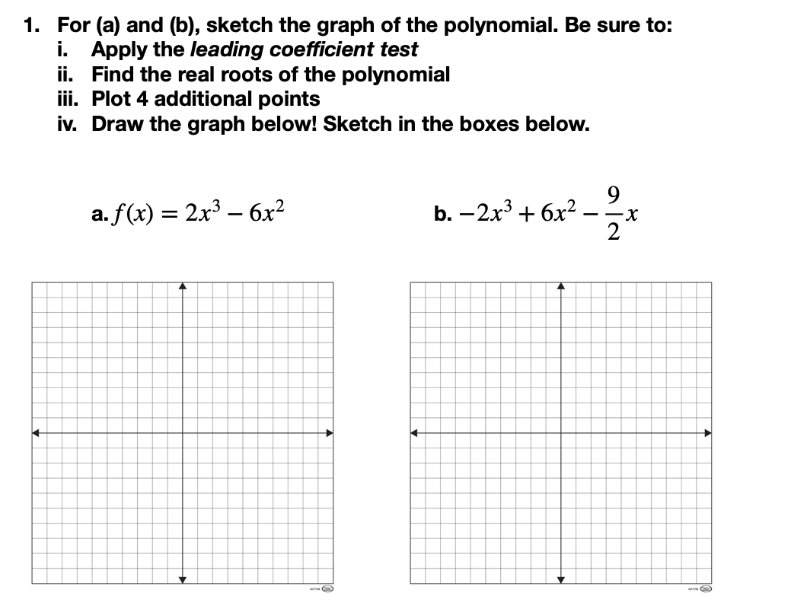
Notes:
see answer key

Slide 7

Notes:
The graph has a negative leading coefficient and an odd highest exponent, so it should decreases as x gets larger. This means that after a certain point

Slide 8
d
exit ticket
be sure to: Answer on a sheet of loose leaf paper. Show all work or write a complete sentence for each answer:
For $f(x)=x^{5}-2x^{4}+x^{3}-2x^{2}$, describe
the left- and right-hand behavior, using the leading coefficient test
how many real roots can this function have?
Sketch a graph (if time)

