Slide 1
Fall 2021 Pre-calculus
Lesson 7.3
Dr. O’Brien
Lehman High School
November 3, 2021
Notes:
Quadratic formula

Slide 2
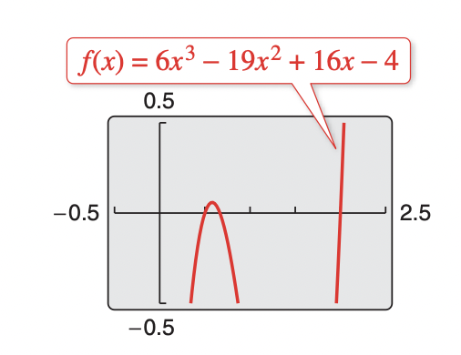
do now
be sure to: Get out your binder. Copy goal and answer do now questions below. Show all work or write a complete sentence for each answer:
simplify $f(x)=\frac{2x-4}{2}$
Make a prediction: What do you think the roots will be of this funky looking equation to the right, based on the graph?
Why is it useful to be able to make predictions, even if we haven’t solved a problem yet?
Notes:
f(x) = x-2
answers vary, but x = 2, and two values between 0.5 and 1.
Because it helps us have an intuition about what answers make sense. This is a useful skill to develop because it helps us check our work.

Slide 3
framing
what: apply long division to find roots of higher order polynomials
why: higher order polynomial equations can be used to model things in science, engineering, and more!
where to: Review then unit test!

Slide 4
Exam next Tuesday Nov., 9th!
We’ll review tomorrow, Friday, and Monday
Topics to be covered:
Combining functions
arithmetic combinations
composition of functions
Polynomials:
Applying leading coefficient test,
finding roots,
and sketching quadratics and higher order polynomials
long division of polynomials
Notes:
Make sure this is in your notes from friday (if not check in w/ neighbor)

Slide 5
Vocabulary
Quadratic formula:
For any quadratic equation
$ax^{2}+bx+c=0$
you can find the roots x using the quadratic formula:
$$x=\frac{-b±\sqrt{b^{2}-4ac}}{2a}$$
Notes:
Copy in glossary

Slide 6
Mini-lesson: Long division of polynomials
be sure to: Keep your binder out. Make sure goal is copied (if you come in late). In your notebook copy notes on board and answer any stop ’n’ jots.
Let’s say you want to find the roots for $f(x)$ to the right. Looking at the graph you notice that one of the roots is $x=2$. This means that $f(x)=(x-2)q(x)$ (A) Where $q(x)$ is some other equation you want to find. Notice that $q(x)=\frac{f(x)}{x-2}$ (B)
Stop ’n’ Jot: Why do equations
(A) and (B) make sense?
We want to calculate:
$$q(x)=\frac{6x^{3}-19x^{2}+16x-4}{x-2}$$
How the heck do we do that!?!?!?!
Notes:
S’n’J: because if x is a root this means that (x-2) is a factor of f(x). This also means there’s something else we can multiply (x-2) to get f(x). We can then rearrange this equation to get (B).

Slide 7
Mini-lesson: Long division of polynomials
be sure to: Keep your binder out. Make sure goal is copied (if you come in late). Copy notes on board and answer any stop ’n’ jots.
Notes:
BOTTOM BANNER DISAPPEARS, THEN TOP BANNER APPEARS.
see hand written notes for examples 1,2,3.
see hand written notes for examples 1,2,3.
Notes will be on slides throughout period, as example for students!
+

Slide 8
Mini-lesson: Long division of polynomials
be sure to: Get out your binder. Copy goal and answer do now questions below. Show all work or write a complete sentence for each answer:
Problem set
be sure to: Copy notes below. Do all work in notebook. Show all work. Work at volume 0 for first 4 minutes, then check in with a neighbor.
Notes:
BANNER DISAPPEARS, THEN pset BANNER APPEARS.
see hand written notes for examples 1,2,3.
Notes will be on slides throughout period, as example for students!
+

Slide 9
Use the long division of polynomials to calculate: $q(x)=\frac{6x^{3}-19x^{2}+16x-4}{x-2}$ Show all work!
Now that you’ve found $q(x)$, plug in the quadratic formula to find the other roots. Again, show all work!
Review your work. Do your answers make sense given the graph above? Explain why or why not!
Quadratic formula:
For any quadratic $ax^{2}+bx+c$ you can find the roots x using the quadratic formula:
$$x=\frac{-b±\sqrt{b^{2}-4ac}}{2a}$$

Slide 10
d
exit ticket
be sure to: Answer on a sheet of loose leaf paper. Show all work or write a complete sentence for each answer:
Divide x³ −2x² −9 by x−3.

