Slide 1
Fall 2021 AP CS A
Lesson 5.5
Dr. O’Brien
Herbert H. Lehman High School
Notes:
STANDARDS REFERENCED:
CSTA 11-12th grade standards: 3B-AP-12: Compare and contrast fundamental data structures and their uses.
NY State: 9-12.CT.7
Design or remix a program that
utilizes a data structure to maintain
changes to related pieces of data.
9-12.CT.6
Demonstrate how at least two classic algorithms work and analyze the trade-offs related to two or more algorithms for completing the same task.

Slide 2
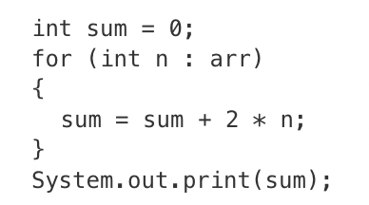
Do now
be sure to: Get out your binder. Copy goal and answer do now questions below. Show all work or write a complete sentence for each answer:
Consider the code segment to the right, where arr is a one-dimensional array of integers.
Rewrite this program using a standard for loop so that it produces the same output.
Notes:
int sum = 0;
for (int i = 0; i <len.arr; i++){
sum = sum +2*arr[i];
}
System.out.print(sum)

Slide 3
framing
what: recognize and identify common algorithms that utilize array traversals
why: These algorithms are widely used and will prove useful in the future!
where to: Getting some practice utilizing these algorithms

Slide 4
Vocab
be sure to: Keep your notebook open. These definitions should be in your Glossary. If not Copy each definition, in your Java Glossary.
Algorithm
A step-by-step procedure for solving a problem
Statement execution count
The number of times a statement is executed by a program.

Slide 5
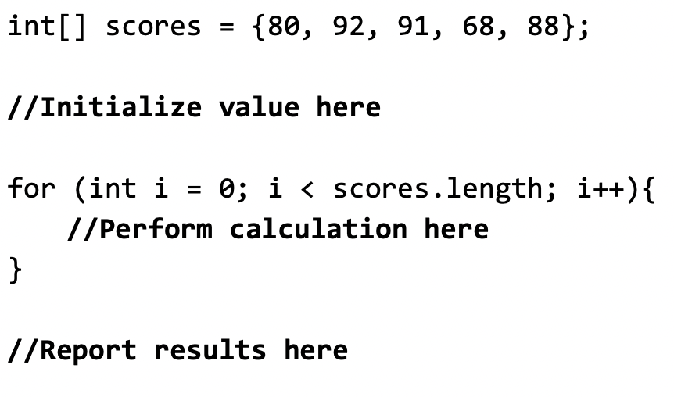
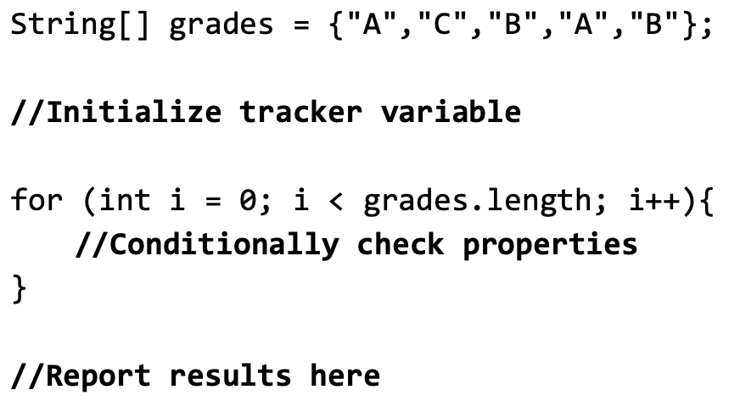
Mini-lesson: Types of algorithms
be sure to: Take notes and answer questions in your notebook.
Basic format for mathematical
computations:
Basic format for checking values:

Slide 6
Mini-lesson: Types of algorithms (continued)
be sure to: Take notes and answer questions in your notebook.
Reordering arrays: These are a big more complicated. They require:
Create a new temp array that is the same size as the original
Copy elements from the original array to the new array in the order that you want
When finished, copy the temp array back over on top of the original array to replace it.

Slide 7
Coding to learn: live coding
be sure to: Log in to Workstation. Follow along, but try to stay one step ahead!
Mathematical analysis: We already saw one example in lesson 5.2 (calculating the mean). Let’s try finding the maximum value in an array.
Finding values: Let’s find out how many of a given item show up in an array.
Reordering arrays: Let’s shift the elements in an array to the right by one.
Notes:
+see LessonFive.java for fully implemented code.
Mathematical analysis: We already saw one example in lesson 5.2 (calculating the mean). Let’s try finding the maximum value in an array.
+What should the condition be inside of the if statement? is the current max val less than the current item, if so then that item becomes the max val.
Finding values: Let’s find out how many of a given item show up in an array.
+what goes wrong if we make the condition for this loop i < arr.length? we run into an array index out of bounds error in the last iteration. How can we fix this? instead make it i < arr.length - 1
+What’s still missing? the first element in the array will still be empty. deal with this edge case by: temp[0] = arr[arr.length-1];
Reordering arrays: Let’s shift the elements in an array to the right by one.

Slide 8
Reflection: Thinking about thinking
be sure to: Answer each question below with a complete sentence.
Explain the procedure (in natural language) of how to reorder an array.
What is an “edge case”?
How can you account for edge cases?
Notes:
+Explain the procedure (in natural language) of how to reorder an array.
Create a new temp array that is the same size as the original, copy elements from the original array to the new array in the order that you want and then copy the temp array back over on top of the original array to replace it.
+What is an “edge case”?
An edge case is a situation that requires special handling. A loop may leave out an edge case in order to avoid an error.
+How can you account for edge cases?
Edge cases can be handled after the loop!

Slide 9
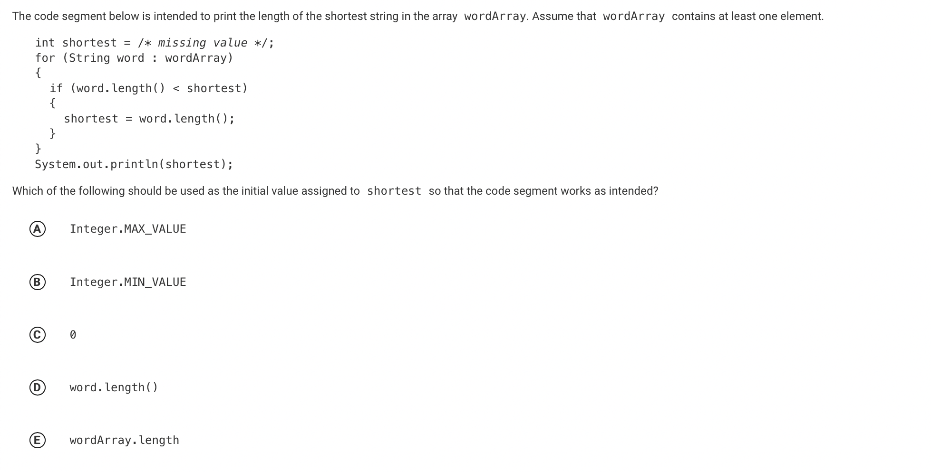
exit ticket
be sure to: Answer the question below on a sheet of loose leaf paper and write a sentence justifying your answer.
text
Notes:
string length is counted in integers. The edge case here is the longest possible countable string, which is the max value of integers, so A is the correct answer.

