Slide 1
Fall 2021 Precalc
Lesson 2.3
Dr. O’Brien
Herbert H. Lehman High School
9 February 2022

Slide 2
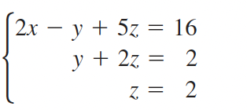
Do Now
Be sure to…Get out your notebook/binder. Read the paragraph below carefully, then answer the questions below. Show all work and check your results!
Describe the system to the right using precise mathematical language.
Solve for $x$, $y$, and $z$.
Notes:
This is a system of linear eqs written in row echelon form.
y =

Slide 3
B24 rules
Welcome to our new room, B24! Please read the information below:
When you come in, please find a seat at a desk (if one’s available) or one of the six closest desks to the screen. Do not sit in the back of the classroom. We’ll conduct the do now and mini lesson from here.
When I dismiss you for independent work, find a sit at one of the computer workstations.
No food or drink by the computers.
At the end of the period, you’ll be directed to assemble for the exit ticket/debrief. Log out of your computer, and quietly return to a seat near the front.

Slide 4
framing
what: use the elimination to solve multivariate systems of equations
why: Systems of equations are useful in situations where variables must more than two conditions.
where to: representing systems of equations as matrices

Slide 5
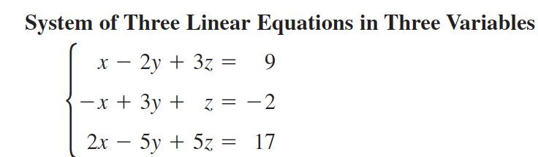
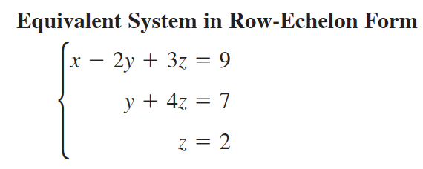
Row-echelon form (review)
To solve systems with more than two variables, we want to transform the system into row-echelon form:
A system is in row-echelon form if it has a stair-step pattern and each equation has a leading coefficient of 1.

Slide 6
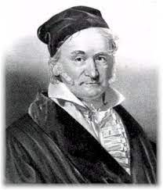
Row operations
Gaussian elimination involves three operations:
Exchange equations
Multiply one of the equations but some number (but not zero)
Add one equation to a multiple of another equation
Johann Gauss, the guy who came up with this algorithm

Slide 7
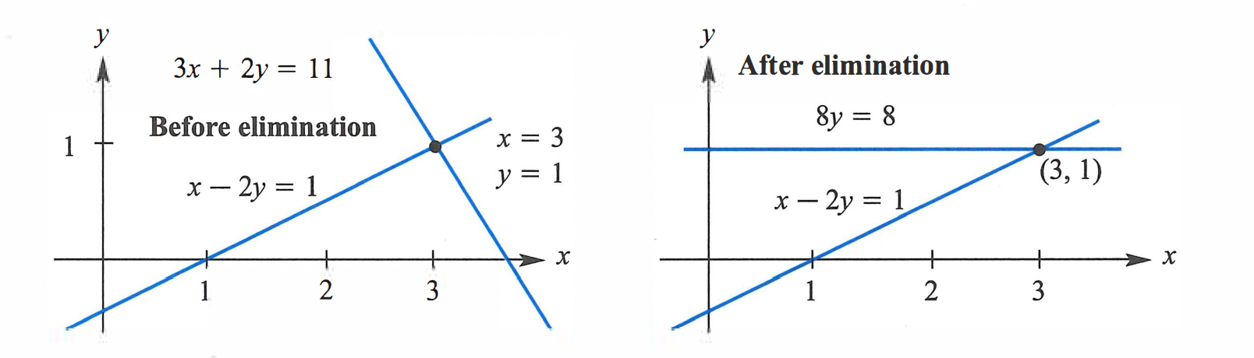
mini-lesson
Let’s use elimination to solve this system:
Exchange equations
Multiply one of the equations but some number (but not zero)
Add one equation to a multiple of another equation
$$x-2y=1$$
$$3x+2y=11$$
Notes:
see pg. 490 of textbook for solution.

Slide 8
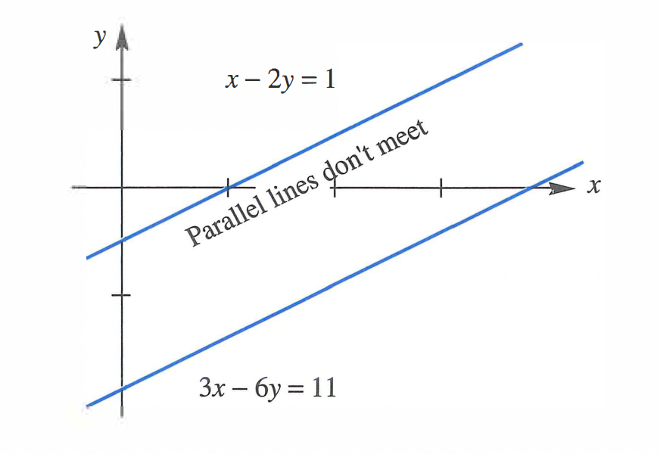
mini-lesson
Let’s use elimination to solve this system:
$$x-2y=1$$
$$3x-6y=11$$
Exchange equations
Multiply one of the equations but some number (but not zero)
Add one equation to a multiple of another equation
Notes:
see pg. 490 of textbook for solution.

Slide 9
mini-lesson
Let’s use elimination to solve this system:
$$x-2y=1$$
$$3x-6y=3$$
Exchange equations
Multiply one of the equations but some number (but not zero)
Add one equation to a multiple of another equation
Notes:
see pg. 490 of textbook for solution.

Slide 10
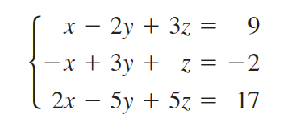
mini-lesson
Let’s use elimination to solve this system:
Exchange equations
Multiply one of the equations but some number (but not zero)
Add one equation to a multiple of another equation

Slide 11
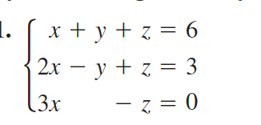
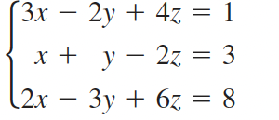
mini-lesson
With a partner, try to solve these systems using Gaussian elimination:
a.
Exchange equations
Multiply one of the equations but some number (but not zero)
Add one equation to a multiple of another equation
b.

Slide 12
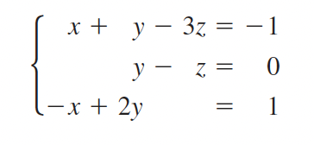
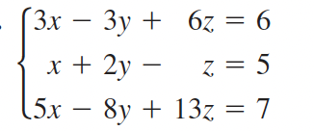
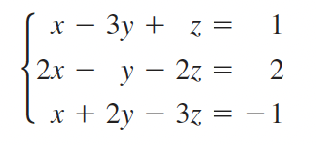
Independent work
1. Use elimination and back substitution to solve the systems below:
a.
b.
c.

Slide 13
Reflection
How is elimination different from substitution?
Why is it useful to reduce systems of equations to row-echelon form?
Notes:
possible exit tickets

Slide 14
wrapping up!
be sure to: read the directions below!
Make sure there isn’t any litter near your workstation.
If you borrowed headphones, sign them back in.
Make sure you are logged out of your computer!
Remain in your seat until the bell rings.

