Slide 1
Fall 2021 Python
Lesson 6.1
Dr. O’Brien
Herbert Lehman High School
Oct. 25, 2021

Slide 2
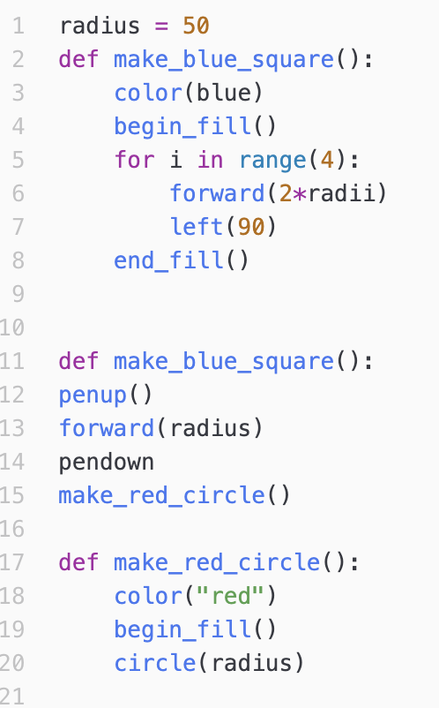

Do now
be sure to: find seat near the board. Get out your binder and answer the do now questions below. Show all work or answer each question with a complete sentence.
How many errors can you find in this code, assuming you want to make the shape below?
What are some debugging strategies you use?
Notes:
line 3: no “ “ around blue
line 6: radii not defined
line 11: “:” unnecessary
line 11 make_blue square defined before it’s called
line 13: no parens after pendown
line 15: make_red_circle() called before it’s defined
line 21: no end_fill

Slide 3
Reminders:
Coaches should...
Answer student questions.
Provide hints.
Coaches shouldn’t...
Talk to one student for for than a few minutes.
Touch other students keyboards. Ever.
Just tell students exactly what to do.
MP1 requirements:
Complete all CodeHS Lessons, Unit 2
Complete Assessment #1
Complete Turtle Art project (Assessment #2)
Notes:
Mp1 ends this week! Some of you really need to focus.

Slide 4
The rest of the day
be sure to: find your assigned seat. Log in to CodeHS. Begin work!
Group A
Find your assigned seat (ask Dr. O’Brien)
Read through the MP1 requirements below.
Begin work! Raise your hand quietly if you have any questions
Group B
Take seat at front desk.
Keep out notebook and pen.
People in group B: Jatlmir G.
Alexis L.
Melvin M.
Kevin R.
Naz T.
MP1 requirements:
Complete all CodeHS Lessons, Unit 2
Complete Assessment #1
Complete Turtle Art project (Assessment #2)
Notes:
Make sure students are working quietly. See problem guides for specific Python activities.
Frequently asked questions:
+I don’t know what to do!?! Make sure to carefully read the instructions. Take notes when watching the video.
+What are you trying to make tracy do?
+how can I figure out why my code doesn’t work? Try getting out a piece of paper, and following your commands yourself. What do you draw. Where do things go wrong?
+What do I do if I forget a command? See the docs section of CodeHS.

Slide 5
The rest of the day
be sure to: find your assigned seat. Log in to CodeHS. Begin work!
Group A
Find your assigned seat (ask Dr. O’Brien)
Read through the MP1 requirements below.
Begin work! Raise your hand quietly if you have any questions
Group B
Take seat at front desk.
Keep out notebook and pen.
People in group B: Emanie C
Emmanuel I
Elijah L
Brenda Q
MP1 requirements:
Complete all CodeHS Lessons, Unit 2
Complete Assessment #1
Complete Turtle Art project (Assessment #2)
Notes:
Make sure students are working quietly. See problem guides for specific Python activities.
Frequently asked questions:
+I don’t know what to do!?! Make sure to carefully read the instructions. Take notes when watching the video.
+What are you trying to make tracy do?
+how can I figure out why my code doesn’t work? Try getting out a piece of paper, and following your commands yourself. What do you draw. Where do things go wrong?
+What do I do if I forget a command? See the docs section of CodeHS.

Slide 6
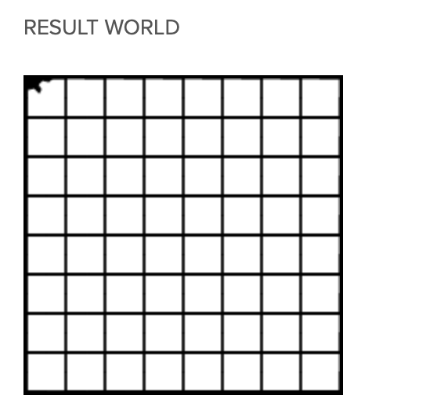
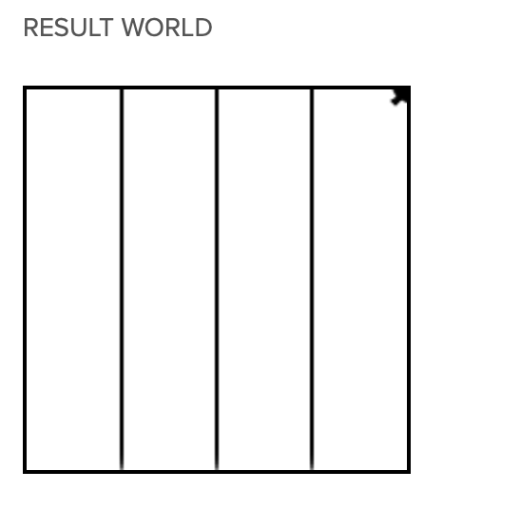
Assessment #1: hospital
What similarities do you notice between these two result worlds?
How can you use your code from 2.4 to finish the assessment?
Lesson 2.4: four columns
Assessment #1
Notes:
+How does the 2.4 problem resemble the Assessment #1 problem? They both involve making columns, repeating the same action.
+hdw use the code from 2.4? You can reuse your code you just need to make the columns smaller and add horizontal columns
+ how do you draw columns? (illustrate on board).

Slide 7

Warm up (answer in notebook)
Examine the picture to the right:
Do you think a computer was used to create this image? Explain why or why not.
In what ways might computers be useful to create art? Explain in at least one complete sentence.
Notes:
+for students are starting the art project (this and subsequent slides):
+In what ways might computers be detrimental to creating art?
+What sorts of computational structures are needed to create an image like the one
This is something called ‘algorithmic art’.

Slide 8


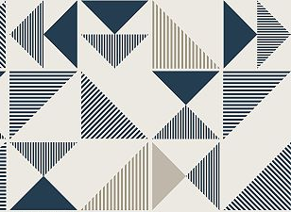
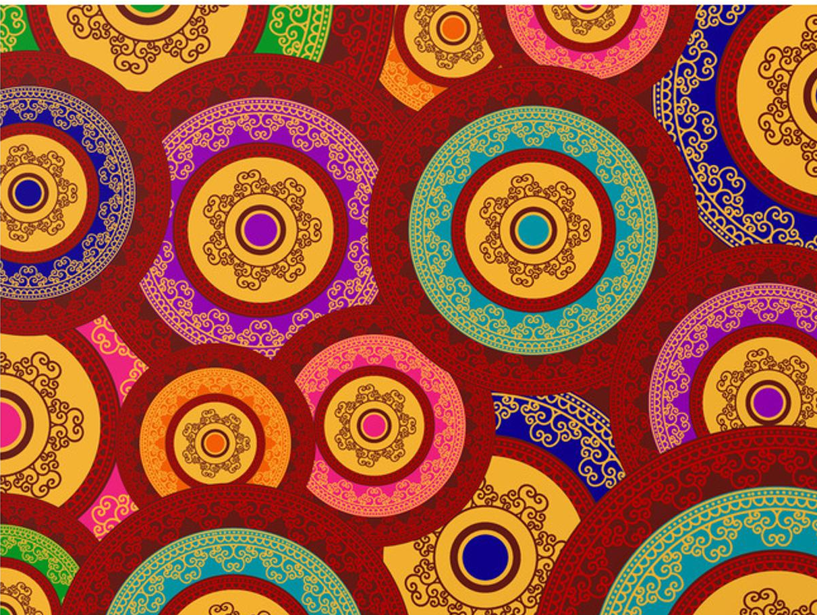
Making art with Turtle Graphics
Part 1: Find/Create an image
You need an image to reproduce using Turtle Graphics.
For any image, be sure to include some sort of pattern that can be reproduced using Python & Turtle Graphics (Check w/ Dr. O'Brien if you're not sure).
Notes:
Examples are on the right.
You’ll need to use color, functions, and loops in your project.

Slide 9
Making art with Turtle Graphics
Part 1: Find/Create an image
two options:
1. Create your own image, take a picture and post it in your google doc.
2. Find an image online. If you find the image online, write a paragraph explaining why you think it's appropriate, along with what you like about it. Paste image and description into your Google Doc.
Complete part 1 by the end of period !!!!

Slide 10
Making art with Turtle Graphics
Part 2: recreate image using turtle graphics
Your image should include all of the techniques we've learned in class
You need the following:
a. Use loops
b. use of functions
c. use of artistic effects (of course!)

