Slide 1
Fall 2021 Python
Lesson 5.5
Dr. O’Brien
Herbert Lehman High School
Oct. 22, 2021

Slide 2
Do now
be sure to: find seat near the board. Get out your binder and answer the do now questions below. Show all work or answer each question with a complete sentence.
What was your experience like having two coaches in the room yesterday?
Do you think the coaches did a good job of meeting their expectations?
Coaches should...
Answer student questions.
Provide hints.
Coaches shouldn’t...
Talk to one student for for than a few minutes.
Touch other students keyboards. Ever.
Just tell students exactly what to do.
Notes:
A. Answers will vary.
* why is it important for the coach to NEVER touch another students keyboard? Your helping the student, not doing it for them. A coach and sports doesn’t go out and play the game for the team.
See create.kahoot.com for kahoot slides (last 10 minutes of period)

Slide 3

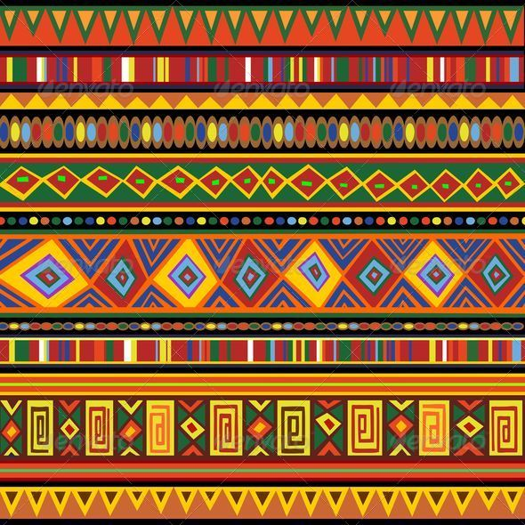
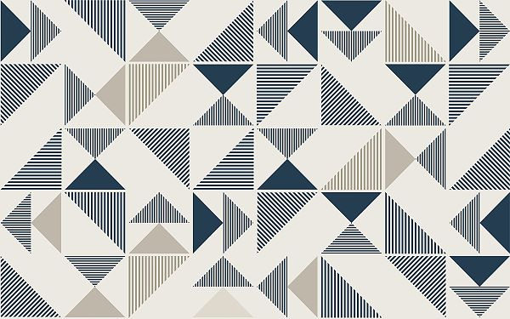
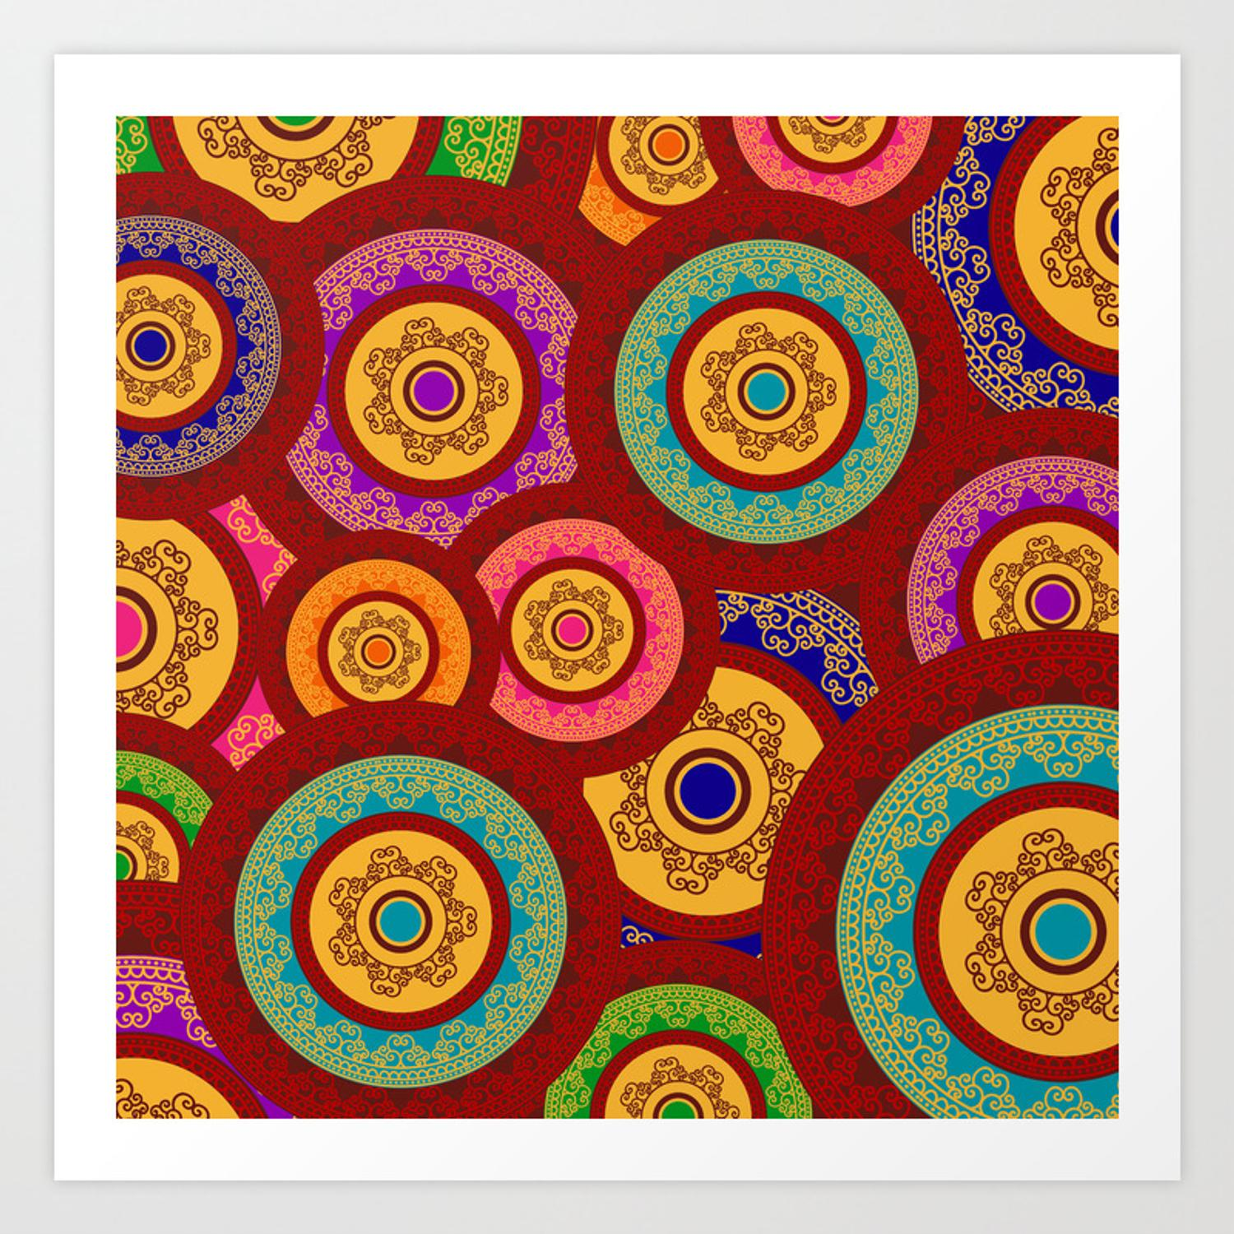
The rest of the day
be sure to: find your assigned seat. Log in to CodeHS. Begin work!
MP1 requirements:
Try to complete all CodeHS Lessons, Unit 2
Complete Assessment #1
Complete Turtle Art project (Assessment #2)
Find your assigned seat (ask Dr. O’Brien)
Read through the MP1 requirements to the right.
Begin work! Raise your hand quietly if you have any questions
Notes:
Make sure students are working quietly. See problem guides for specific Python activities.
Frequently asked questions:
+I don’t know what to do!?! Make sure to carefully read the instructions. Take notes when watching the video.
+What are you trying to make tracy do?
+how can I figure out why my code doesn’t work? Try getting out a piece of paper, and following your commands yourself. What do you draw. Where do things go wrong?
+What do I do if I forget a command? See the docs section of CodeHS.

Slide 4
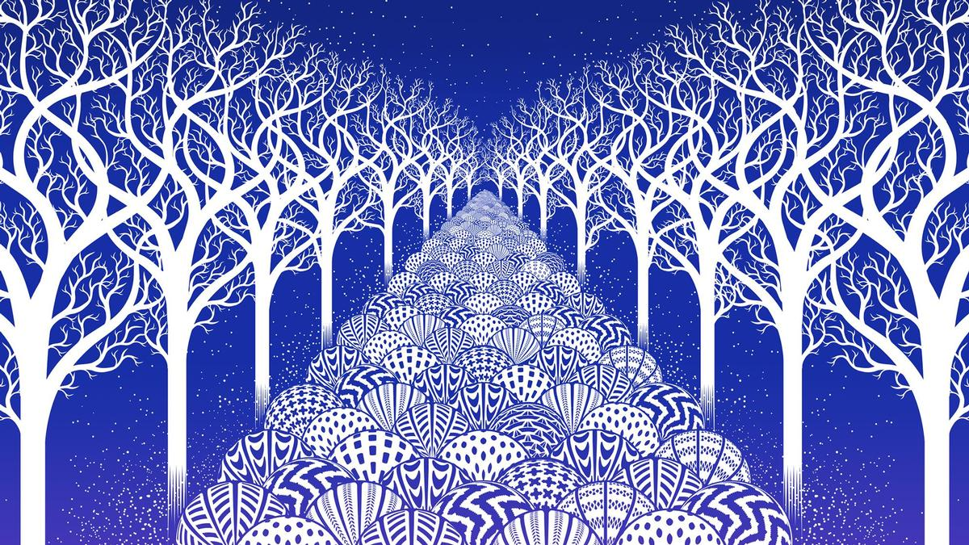
Warm up (answer in notebook)
Examine the picture to the right:
Do you think a computer was used to create this image? Explain why or why not.
In what ways might computers be useful to create art? Explain in at least one complete sentence.
Notes:
+for students are starting the art project (this and subsequent slides):
+In what ways might computers be detrimental to creating art?
+What sorts of computational structures are needed to create an image like the one
This is something called ‘algorithmic art’.

Slide 5
Making art with Turtle Graphics
Part 1: Find/Create an image
You need an image to reproduce using Turtle Graphics.
For any image, be sure to include some sort of pattern that can be reproduced using Python & Turtle Graphics (Check w/ Dr. O'Brien if you're not sure).
Notes:
Examples are on the right.
You’ll need to use color, functions, and loops in your project.

Slide 6
Making art with Turtle Graphics
Part 1: Find/Create an image
two options:
1. Create your own image, take a picture and post it in your google doc.
2. Find an image online. If you find the image online, write a paragraph explaining why you think it's appropriate, along with what you like about it. Paste image and description into your Google Doc.
Complete part 1 by the end of period !!!!

Slide 7
Making art with Turtle Graphics
Part 2: recreate image using turtle graphics
Your image should include all of the techniques we've learned in class
You need the following:
a. Use loops
b. use of functions
c. use of artistic effects (of course!)

