Slide 1
Fall 2021 Precalc
Lesson 5.4
Dr. O’Brien
Herbert H. Lehman High School
10 March 2022
Notes:
VOCAB
identity matrix

Slide 2
Do now…Get out your notebook/binder. Write down the date and goal. Be Sure to carefully answer the question on the board to the left.
Notes:
See handwritten lesson plan for answer.
Both evaluate to a 2x2 identity matrix (NOTE students probably won’t know this term yet. See next slide.
Will vary. Might wonder why are we learning this?

Slide 3
framing
what: use matrix inverses to solve systems of linear equations
why: this is where we see why matrix inverses are really useful.
where to: use Gauss Jordan elimination to find the inverse of a matrix.

Slide 4
B24 rules
Welcome to our new room, B24! Please read the information below:
When you come in, please find a seat at a desk (if one’s available) or one of the six closest desks to the screen. Do not sit in the back of the classroom. We’ll conduct the do now and mini lesson from here.
When I dismiss you for independent work, find a sit at one of the computer workstations.
No food or drink by the computers.
At the end of the period, you’ll be directed to assemble for the exit ticket/debrief. Log out of your computer, and quietly return to a seat near the front.

Slide 5
Mini-lesson
Follow along on the board! Info below should be in your notes (copy if it’s not there already)
Identity matrix
An $n×n$ matrix with 1s on its main diagonal and zeros everywhere else. Denoted by $I$. Multiplying any compatible matrix $A$ by $I$ results in the original matrix A.
Be sure to… copy the information below in your notes:
If we know the inverse $A^{-1}$ for an invertible matrix $A$, then we can solve for $X$, the variable matrix.
A matrix is invertible if it has an inverse.
Matrix inverse
$A$ is an $n×n$ square matrix.
$I_{n}$ is an $n×n$ identity matrix.
If there is a matrix $A^{-1}$ such that
$A×A^{-1}=A^{-1}×A=I_{n}$
Then $A^{-1}$ is called the inverse of $A$.
Notes:
SEE HAND WRITTEN LP.

Slide 6
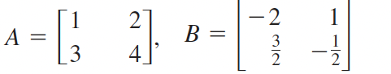
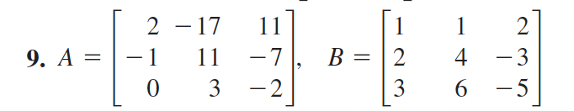
Independent work
Be sure to… answer the question below in your notes:
For (a-c) below, show that B is the inverse of A.
Use matrix multiplication to solve the system of equations below (hint: (1b) will be useful).
a.
b.
$$2x-17y+11z=1$$
$-x+11y-7z=0$
$3y-2z=0$
Notes:
answer to 2: [ 1 2 3]
go over 2 for end of class.
+Why is (1b) useful, because we have shown that B from (1b) is the inverse of A, so we know that X = B* [1 0 0]. = [1 2 3 ]

Slide 7
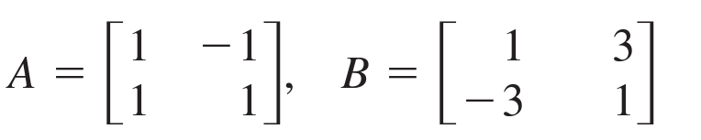
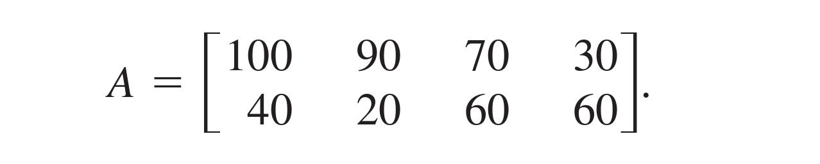
Independent work
Make up a story about what matrix A and matrix B below could represent. Then solve and interpret the product AB.
Your company makes two kinds of sunglasses (aviator and cat eyed) at four locations. The sales in the las month are represented in matrix A below. If the aviator glasses sell for $100 and the cat eyed glasses for $110, use matrix multiplication to calculate your sales at each location.

Slide 8
wrapping up!
be sure to: read the directions below!
Make sure there isn’t any litter near your workstation.
If you borrowed headphones, sign them back in.
Make sure you are logged out of your computer!
Remain in your seat until the bell rings.

