Slide 1
Fall 2021 Precalc
Lesson 17.4
Dr. O’Brien
Herbert H. Lehman High School
20 January 2022

Slide 2
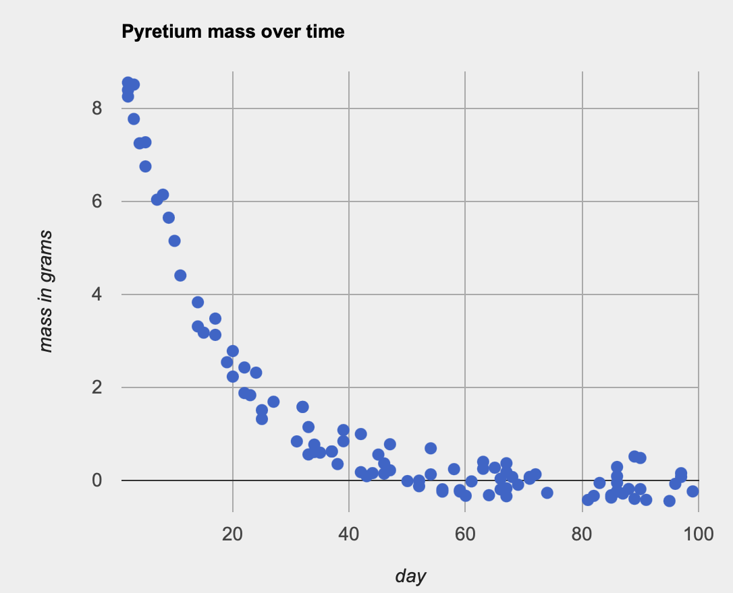
Do Now
Be sure to…Get out your notebook/binder. Read the paragraph below carefully, then answer each question with a complete sentence.
In chemistry class Omesh discovered Pyretium, a new radioactive element, and named it after your favorite programming language. He’s measured the weight of his Pyretium sample over the past hundred days. The data is represented in the graph to the right.
In your own words, describe what the graph is saying.
What do you notice about this data?
What questions do you have about the data?
Make a prediction: What kind of function do you think should be used to represent this data?
Notes:
The x axis of the graph represents days 0 to 100, the y access represents the mass (~weight) of a sample of Pyretium.
The data is rapidly decreasing, so the mass of Pyretium is shrinking.
Answers will vary. Student’s might notice that the data is very messy (the measurements jump around a lot, even if close together). This is common in science, due to experimental error. Students also might wonder how measurements of mass can be less than 0.
answers will vary. alot of students might think it’s some kind of quadratic.
3 minute quick write -> read first two questions aloud ->1 minute turn and talk -> group share out.

Slide 3
B24 rules
Welcome to our new room, B24! Please read the information below:
When you come in, please find a seat at a desk (if one’s available) or one of the six closest desks to the screen. Do not sit in the back of the classroom. We’ll conduct the do now and mini lesson from here.
When I dismiss you for independent work, find a sit at one of the computer workstations.
No food or drink by the computers.
At the end of the period, you’ll be directed to assemble for the exit ticket/debrief. Log out of your computer, and quietly return to a seat near the front.

Slide 4
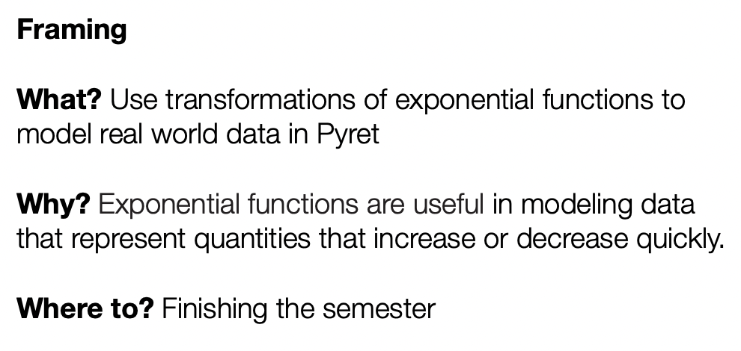

Slide 5
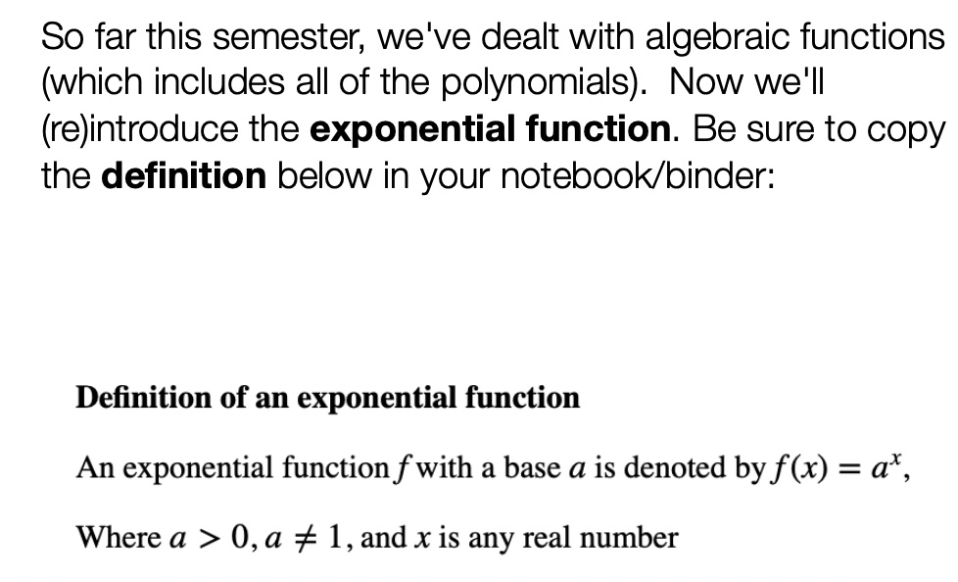
Vocabulary
After you’re done copying,
Please log in to your workstation.
Notes:
Copy the definition

Slide 6
Desmos activity
Be sure to…
Copy the definition of an exponential function on the right in your notes.
Log into your work station. Open on the Desmos activity Exponential Functions in Pyret in Google Classroom. Begin working on your own.
If you finish early, resume working an any unfinished assignment!
Be prepared to stop for a group discussion and to share out your answers.
Notes:
See Desmos notes for questions and answers.

Slide 7
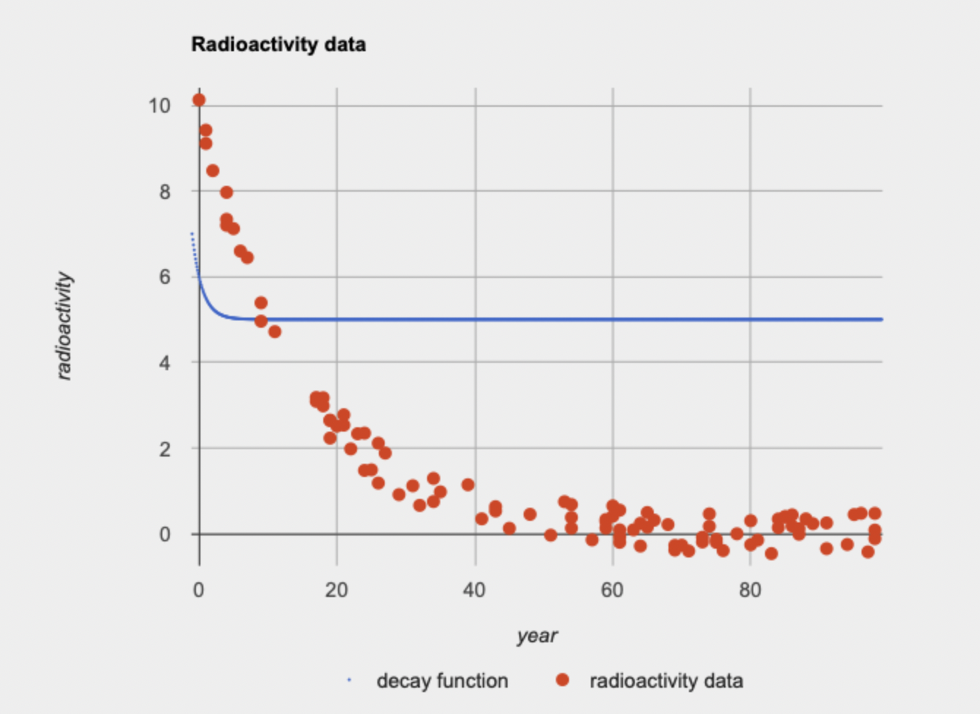
Desmos activity: review
What is the mass of your sample around day 0:
How do you think you need to transform the radioactive-decay() function so that it more accurately models your data?
When you implemented your function, how did you know the fit was right?
What do you predict the mass will be after 200 days?
Notes:
See Desmos notes for questions and answers.

Slide 8
wrapping up!
be sure to: read the directions below!
Make sure there isn’t any litter near your workstation.
If you borrowed headphones, sign them back in.
Make sure you are logged out of your computer!
Remain in your seat until the bell rings.

