Slide 1
Fall 2021 Precalc
Lesson 1.3
Dr. O’Brien
Herbert H. Lehman High School
4 February 2022

Slide 2
Do Now
Be sure to…Get out your notebook/binder. Read the paragraph below carefully, then answer the the system of equations below. Show all work and check your results!
A small business invests $10,000 to produce a new kind of super hot tortilla chip. Each package costs $0.65 to produce and is sold for $1.20.
How do we write functions to represent revenue and cost?
Notes:
R(x) = 0.65x + 10000
C(x) = 1.2x
+what does x represent? The number of bags of chips sold?

Slide 3
B24 rules
Welcome to our new room, B24! Please read the information below:
When you come in, please find a seat at a desk (if one’s available) or one of the six closest desks to the screen. Do not sit in the back of the classroom. We’ll conduct the do now and mini lesson from here.
When I dismiss you for independent work, find a sit at one of the computer workstations.
No food or drink by the computers.
At the end of the period, you’ll be directed to assemble for the exit ticket/debrief. Log out of your computer, and quietly return to a seat near the front.

Slide 4
framing
what: use substitution to solve real world problems.
why: Systems of equations are useful in situations where variables must satisfy two or more conditions. E.g. cost and revenue per units sold.
where to: Using elimination to solve any system of equations

Slide 5
Independent work:
Practice Problem 1
A small business invests $10,000 to produce a new kind of super hot tortilla chip. Each package costs $0.65 to produce and is sold for $1.20. How much has to be sold for the company to break even?
Write two functions $R(x)$ and $C(x)$ to represent revenue and cost.
What does $x$ represent in these functions?
Use substitution to determine how many chips need to be sold for the company to break even.
Practice Problem 2
You are deciding how to invest a total of $20,000 in two funds paying 5.5% and 7.5% simple interest. You want to earn a total of $1300 in interest annually.
Write a system of equations to represent this problem. Let $x$ and $y$ represent the amounts invested at 5.5% and 7.5% respectively.
How much of the $20,000 should you invest at 5.5% to earn $1300 in interest per year? Explain you reasoning.
Notes:
WRITE ON BOARD:
Be sure to…
Answer all questions. Show all work.
Be prepared to turn in for your first CLASSWORK GRADE.
Feel free to work together!
When finished, check with Dr. O’Brien. Then work on Pset #1.
see next two pages for preplanened qs and solutions

Slide 6
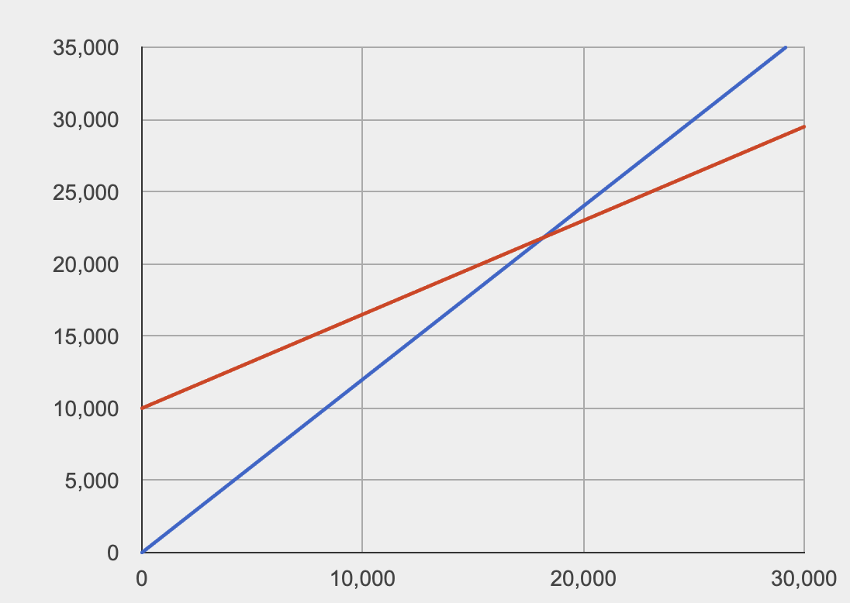
Practice problem #1
Be sure to…Follow along in your notes, but try to stay one step ahead.
A small business invests $10,000 to produce a new kind of super hot tortilla chip. Each package costs $0.65 to produce and is sold for $1.20. How much has to be sold for the company to break even?
Write two functions $R(x)$ and $C(x)$ to represent revenue and cost.
What does $x$ represent in these functions?
Use substitution to determine how many chips need to be sold for the company to break even.
Notes:
R(x) = 0.65x + 10000
C(x) = 1.2x
We want to know hwen C(x) = R(x) in other words
C(x) = 0.65x + 10000
C(x) = 1.2x
subsitution:
1.2x = 0.65x + 10000
0.55x = 10000
x = 10000/0.55 = 18181.8181818
About 1818 bags of chips need to be sold for the company to break even.

Slide 7
Practice problem #2
You are deciding how to invest a total of $20,000 in two funds paying 5.5% and 7.5% simple interest. You want to earn a total of $1300 in interest annually.
Write a system of equations to represent this problem. Let $x$ and $y$ represent the amounts invested at 5.5% and 7.5% respectively.
How much of the $20,000 should you invest at 5.5% to earn $1300 in interest per year? Explain you reasoning.
Notes:
x = amount invested in fund 1
y = amount invested in fund 2
x + y = 12000 (eq. 1)
0.09*x + 0.11*y = 1180
+HDW apply substitution to solve this system?
could go in either direction
y = 12000 - x
0.09x + 0.11(12000 - x) = 1180
0.09x + 1320 - 0.11x = 1180
-0.02x = -140
x = 7000
y = 12000 - 7000 = 5000
solution: (7000, 5000)

Slide 8
wrapping up!
be sure to: read the directions below!
Make sure there isn’t any litter near your workstation.
If you borrowed headphones, sign them back in.
Make sure you are logged out of your computer!
Remain in your seat until the bell rings.

