Slide 1
Fall 2021 Precalc
Lesson 2.2
Dr. O’Brien
Herbert H. Lehman High School
8 February 2022

Slide 2
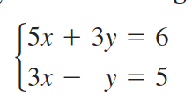
Do Now
Be sure to…Get out your notebook/binder. Read the paragraph below carefully, then answer the questions below. Show all work and check your results!
Use elimination to solve the system to the right.

Slide 3
B24 rules
Welcome to our new room, B24! Please read the information below:
When you come in, please find a seat at a desk (if one’s available) or one of the six closest desks to the screen. Do not sit in the back of the classroom. We’ll conduct the do now and mini lesson from here.
When I dismiss you for independent work, find a sit at one of the computer workstations.
No food or drink by the computers.
At the end of the period, you’ll be directed to assemble for the exit ticket/debrief. Log out of your computer, and quietly return to a seat near the front.

Slide 4
framing
what: use the elimination to solve multivariate systems of equations
why: Systems of equations are useful in situations where variables must more than two conditions.
where to: representing systems of equations as matrices

Slide 5
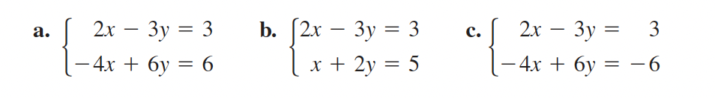
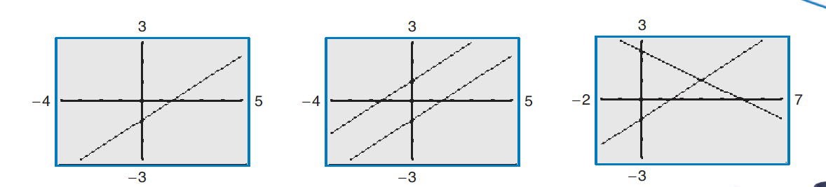
Warm up
match the system to the appropriate graph.

Slide 6
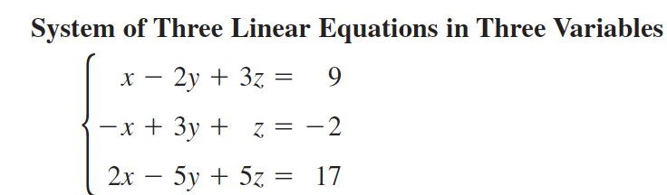
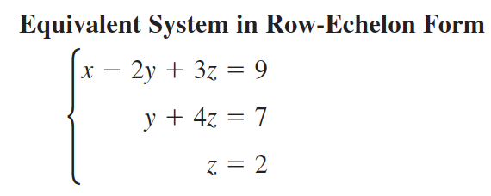
mini-lesson
To solve systems with more than two variables, we want to transform the system into row-echelon form:
A system is in row-echelon form if it has a stair-step pattern and each equation has a leading coefficient of 1.

Slide 7
mini-lesson
To see why, row-echelon form is useful. Let’s solve this system:

Slide 8
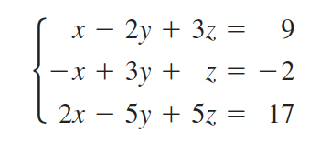
mini-lesson
Operations we can perform row operations on equations:
exchange two rows
multiply two rows by some number (not zero)
add a multiple of one row to another
Let’s use elimination to solve this system:
Notes:
+why are these called row operations? write system of eqs as a matrix. all we care about are the rows of numbers. Show augmented matrix but don’t call it that yet.

Slide 9
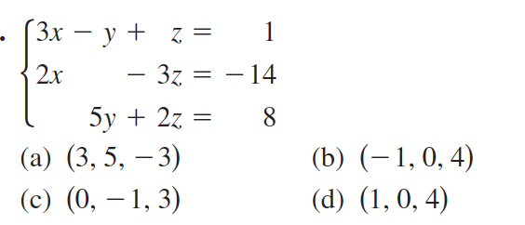
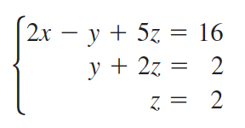
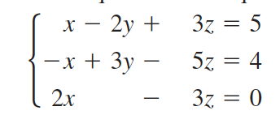
Independent work
1. Check whether (a-d) are solutions to this system:
2. Use back substitution to solve this system:
3. Perform row operations to transform to row-echelon form:
Notes:
(b).
y = 2 - (2*2) = -2 x = 16 + -2 + 10. / 2 = 12

Slide 10
Reflection
How is elimination different from substitution?
Why is it useful to reduce systems of equations to row-echelon form?
Notes:
possible exit tickets

Slide 11
wrapping up!
be sure to: read the directions below!
Make sure there isn’t any litter near your workstation.
If you borrowed headphones, sign them back in.
Make sure you are logged out of your computer!
Remain in your seat until the bell rings.

