Slide 1
Fall 2021 Pre-calculus
Lesson 6.5
Dr. O’Brien
Lehman High School
October 29, 2021
Notes:
students need calculator
Parabola
Vertex

Slide 2
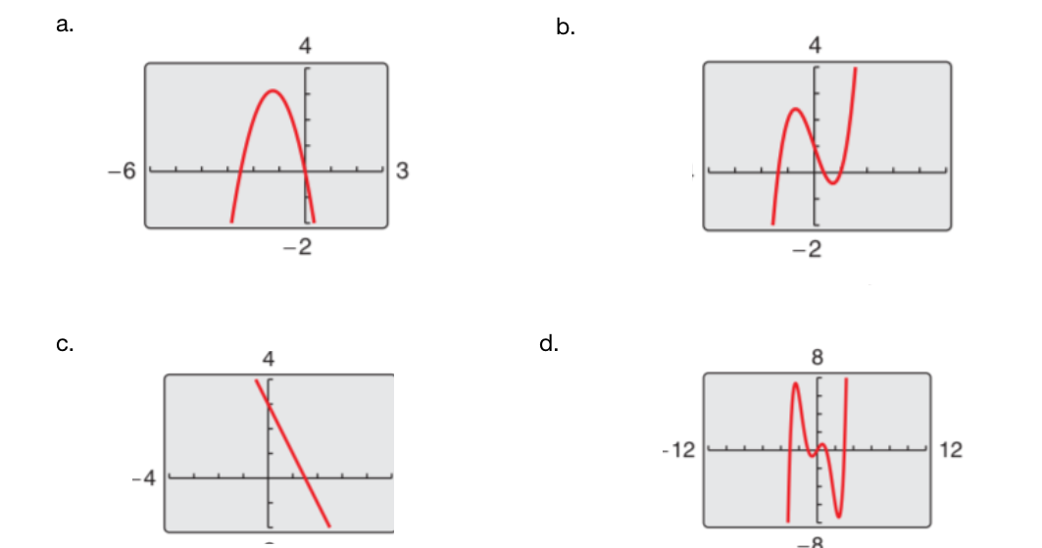
do now
be sure to: Get out your binder. Copy goal and answer do now questions below. Show all work or write a complete sentence for each answer:
What similarities do you notice between these graphs? Describe 2.
What differences do you notice between these graphs? Describe 3.
Notes:
they’re both polynomials, continuous (no gaps),
One has a 4, the other a 5. one goes up at both ends, the other goes up and done. One is even. the other is odd.

Slide 3
framing
what: find the roots and relative extrema of polynomials
why: higher order polynomial equations can be used to model things in science, engineering, and more!
where to: sketching more accurate graphs of higher order polynomials

Slide 4
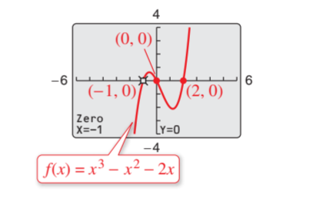

Let’s find the roots for $f(x)=x^{3}-x^{2}-2x$
For any polynomial f with a highest exponent n:
f has at most n real roots.
The graph for f has at most n-1 relative extrema (relative minima or maxima)
Vocab:
Root of a polynomial: any value of x where $f(x)=0$.
Problem set. Be sure to:
Do all work in notebook.
Show all work.
Work at volume 0 for first four minutes. Then you can check in with a neighbor
Notes:
See textbook page 104 for solution. Label each step.
How many relative extrema can this function have? Two at most.
+what are relative minima maxima? Vocab review

Slide 5
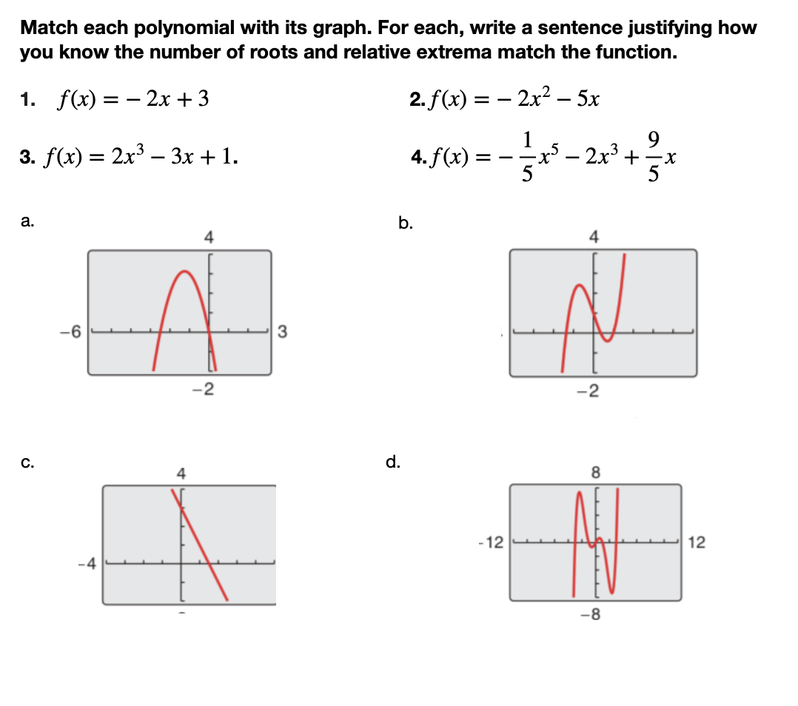
Notes:
see answer key

Slide 6
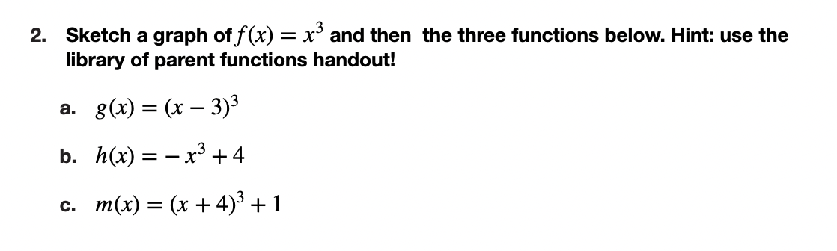

Slide 7
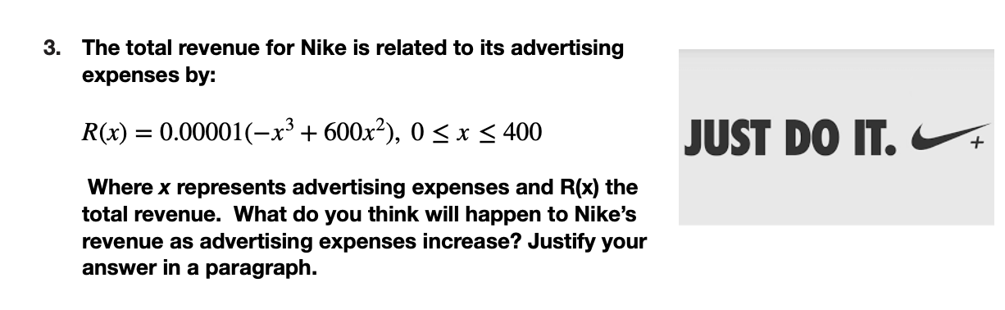

Slide 8
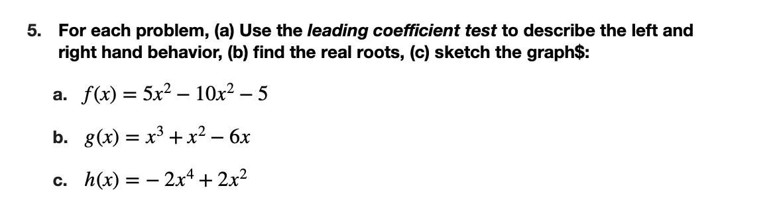
Notes:
+see answer key

Slide 9
Notes:
The graph has a negative leading coefficient and an odd highest exponent, so it should decreases as x gets larger. This means that after a certain point

Slide 10
d
exit ticket
be sure to: Answer on a sheet of loose leaf paper. Show all work or write a complete sentence for each answer:
For $f(x)=x^{5}-2x^{4}+x^{3}-2x^{2}$, describe
the left- and right-hand behavior, using the leading coefficient test
how many real roots can this function have?
How many relative extrema can this function have?

