Slide 1
Fall 2021 AP CS A
Lesson 13.5
Dr. O’Brien
Herbert H. Lehman High School
17 December 2021
Notes:
VOCAB:
nested loop

Slide 2
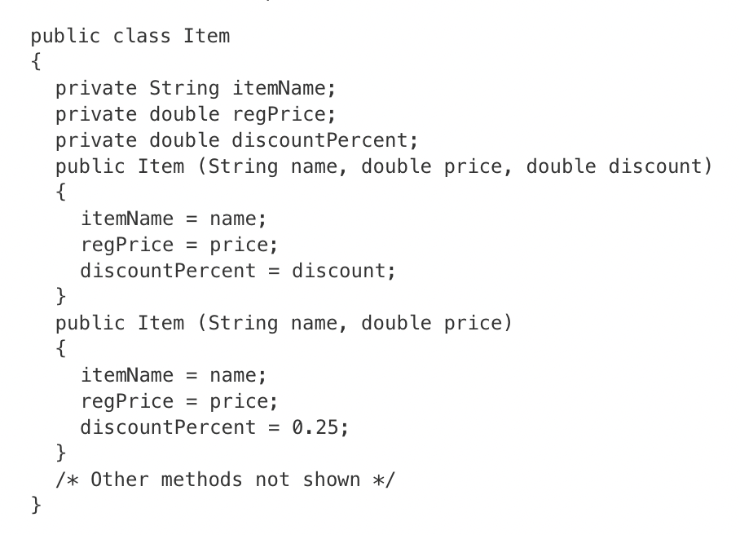
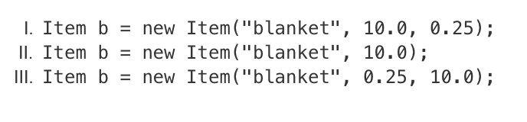
Do now
be sure to: Get out your binder. Copy goal and answer do now questions below. Answer the question below and write a sentence justifying your answer.
Each object of the class Item will store the item’s name as itemName, the item’s regular price, in dollars, as regPrice, and the discount that is applied to the regular price when the item is on sale as discountPercent. For example, a discount of 15% is stored in discountPercent as 0.15.
Which of the following code segments, found in a class other than Item, can be used to create an item with a regular price of $10 and a discount of 25% ?
Notes:
I and II. The third argument represents the discount, so III doesn’t make sense (10 would represent a 1000% increase.). II works because the default value for discount is 0.25.

Slide 3
Activity: Practice with AP questions
Log in to AP Classroom. Begin working on Friday AP Practice. For each question:
In your notebook: use a code tracing table or other appropriate means to make your thinking visible.
Answer the questions!
Write down any questions you have. Be prepared to share them out!

Slide 4
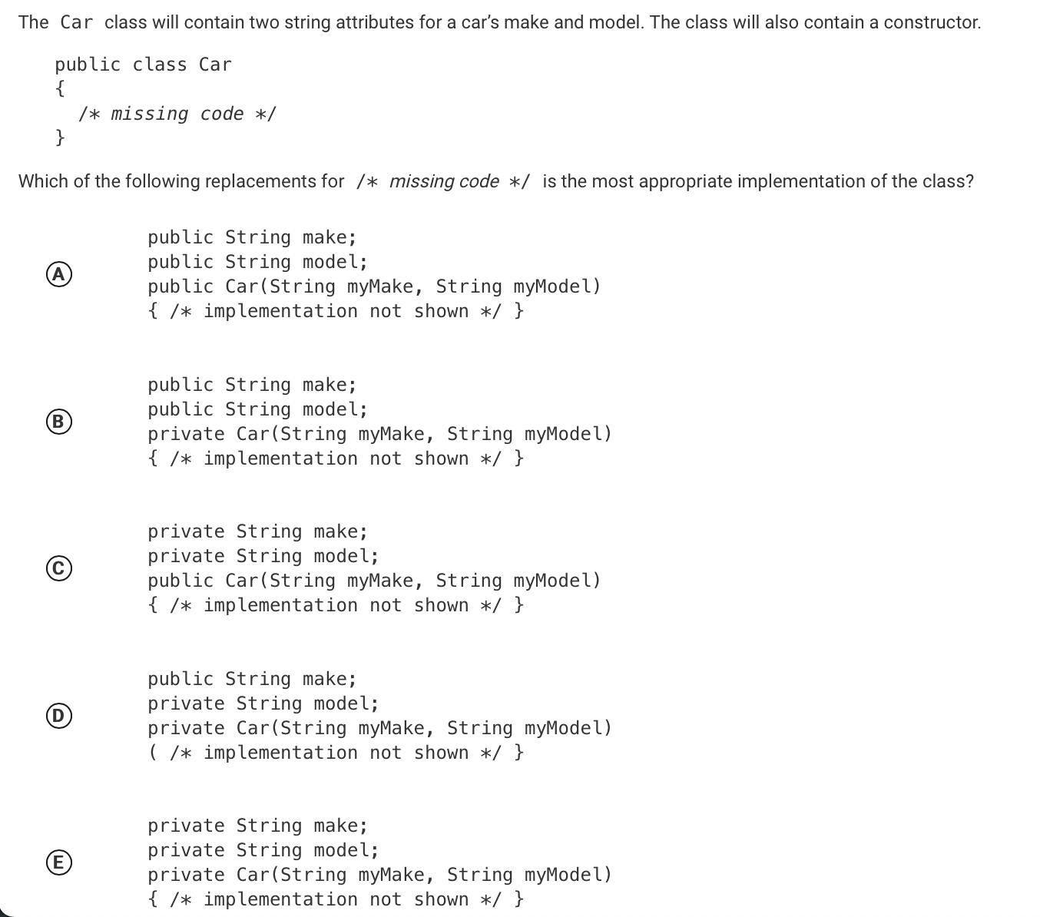
Practice problem #1
be sure to: Review your work. Be prepared to share out!
Notes:
C. you can determine this because the instance variables should be private and the constructor public.

Slide 5
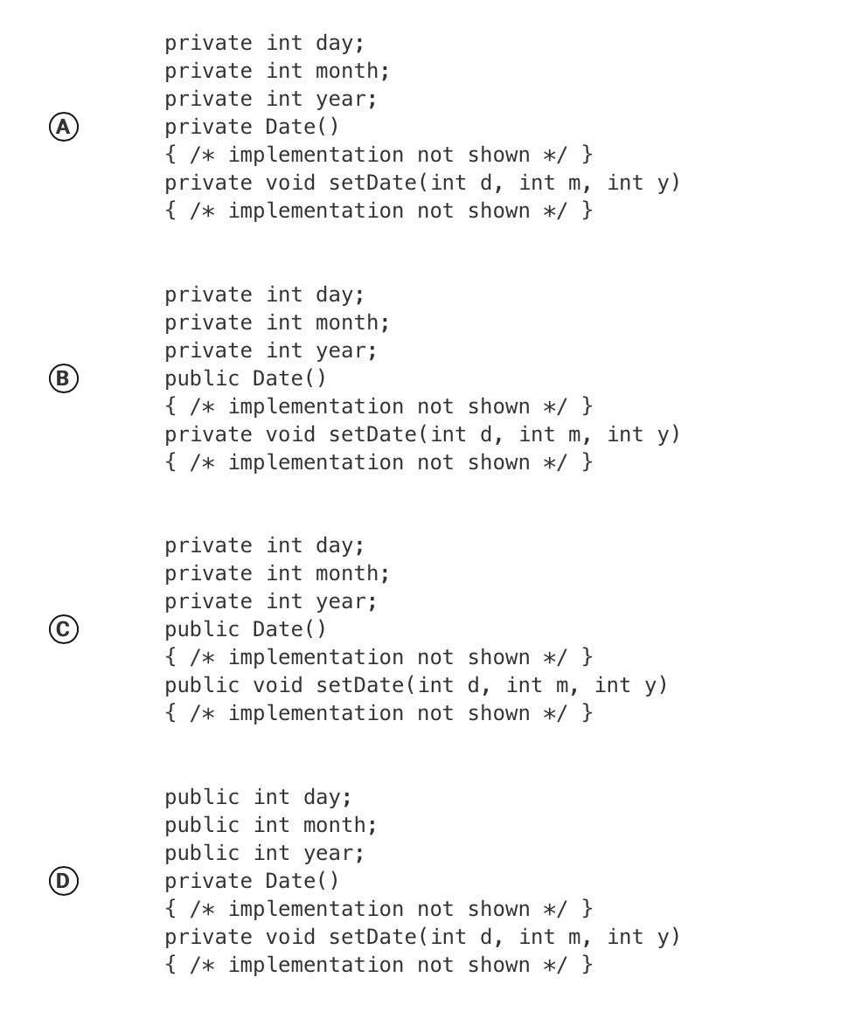
Practice problem #2
be sure to: Review your work. Be prepared to share out!
The Date class will contain three int attributes for day, month, and year, a constructor, and a setDate method. The setDate method is intended to be accessed outside the class.
public class Date
{
/* missing code */
}
Which of the following replacements for /* missing code */ is the most appropriate implementation of the class?
Notes:
C is best. setDate() should be public.

Slide 6
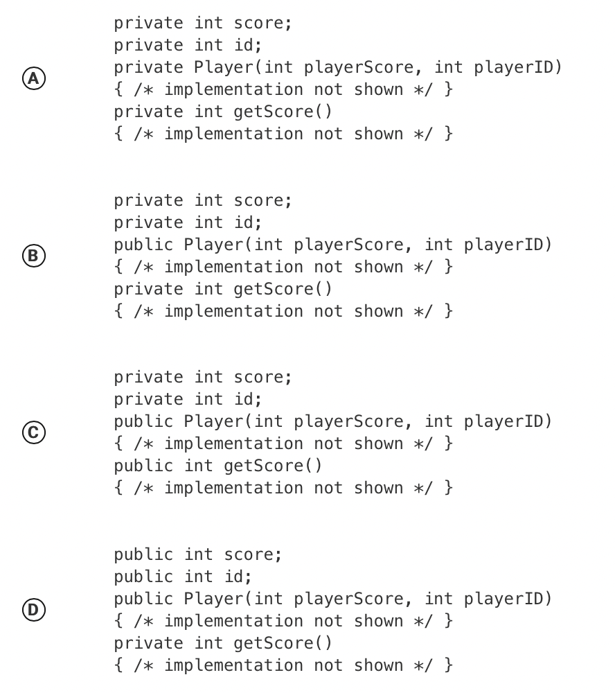
Practice problem #3
be sure to: Review your work. Be prepared to share out!
The Player class below will contain two int attributes and a constructor. The class will also contain a method getScore that can be accessed from outside the class.
public class Player
{
/* missing code */
}
Which of the following replacements for /* missing code */ is the most appropriate implementation of the class?
Notes:
C. Same reasoning as previous question.

Slide 7
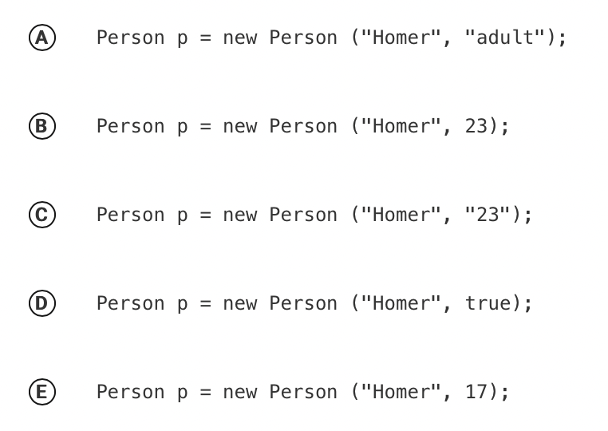
Practice problem #4
be sure to: Review your work. Be prepared to share out!
Consider the definition of the Person class below. The class uses the instance variable adult to indicate whether a person is an adult or not.
public class Person
{
private String name;
private int age;
private boolean adult;
public Person (String n, int a)
{
name = n;
age = a;
if (age >= 18)
{
adult = true;
}
else
{
adult = false;
}
}
}
Which of the following statements will create a Person object that represents an adult person?
Notes:
C. Same reasoning as previous question.

Slide 8
Homer at 23
Practice problem #4
be sure to: Review your work. Be prepared to share out!
Notes:
C. Same reasoning as previous question.

Slide 9
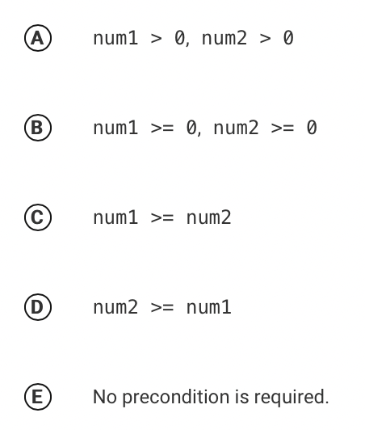
Practice problem #5
be sure to: Review your work. Be prepared to share out!
Consider the following method, which is intended to return the product of 3 and the nonnegative difference between its two int parameters.
public int threeTimesDiff (int num1, int num2)
{
return 3 * (num1 - num2);
}
Which, if any, precondition is required so that the method works as intended for all values of the parameters that satisfy the precondition?
Notes:
C. The assumption is that the difference will be nonnegative.

Slide 10
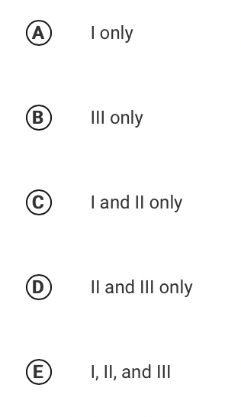
Practice problem #6
be sure to: Review your work. Be prepared to share out!
Consider the following while loop. Assume that the int variable k has been properly declared and initialized.
while (k < 0)
{
System.out.print("*");
k++;
}
Which of the following ranges of initial values for k will guarantee that at least one "*" character is printed?
k < 0
k = 0
k > 0
Notes:
A. if k is greater than or equal to 0, the condition will not be satisfied and the loop will be exited

Slide 11
Reflection: Thinking about thinking
be sure to: Answer each question below with a complete sentence.
How do you feel like you did on these AP questions?
What’s one thing that you understand better after going through the questions?

