Slide 1
Fall 2021 Pre-calculus
Lesson 6.2
Dr. O’Brien
Lehman High School
October 26, 2021
Notes:
students need calculator
Parabola
Vertex

Slide 2
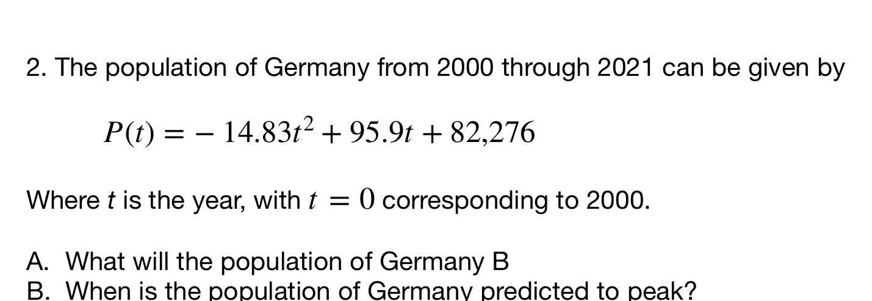
do now
be sure to: Get out your binder. Copy goal and answer do now questions below. Show all work or write a complete sentence for each answer:
Understand the problem:
What information are we given?
What would a sensible answer look like?
Notes:
Given equation we want to know the max height of football. We can also draw a graph.
We expect the height to be positive, probably not more than 50.
+why is it a good idea to estimate the answer? When we’re done we’ll know if the result of our calculations makes sense

Slide 3

how to solve it
Understand the problem:
Read the problem carefully.
What would a sensible final answer look like (number, equation, sentence, etc.)?
Make a plan:
Come up with a strategy to solve a problem
What formulas/math skills will you need?
Execute the plan:
Work through your strategy step by step
Review your work:
Does your answer make sense?
If not go back to (2). Do it again!!
Notes:
Make sure you have your HTSI handout!

Slide 4
framing
what: use vertex form to solve complex word problems .
why: Quadratic equations can be used to model things in science, engineering, and more!
where to: graphing higher degree polynomials

Slide 5
Partner work
Today we will be doing work with a partner . Be sure to:
Work on each problem. Show all work and answer any questions in a complete sentence.
Stay together! Do not move on to the next problem until everyone in your group agrees on an answer.
After you finish a section, ask for the section answer key.
Be prepared to turn in one of your assignments (with both names on it).

Slide 6
Vocabulary
Vertex: Minimum or maximum point of a quadratic function
Parabola: The curve formed by the graph for a quadratic function.

Slide 7
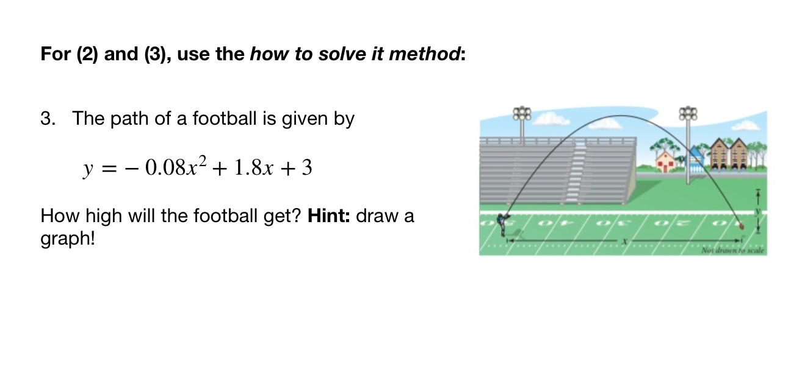
Notes:
See answer key
+hdw rewrite in standard form? Factor out-0.08, then it’s the same strategy as normal
+hdw know this graph will be a frowns face? It’s what the path of a football should look like. Also when we rewrite in standard form the coefficient is -.
+how do you tell from a sketch the highest point? It’s the vertex

Slide 8
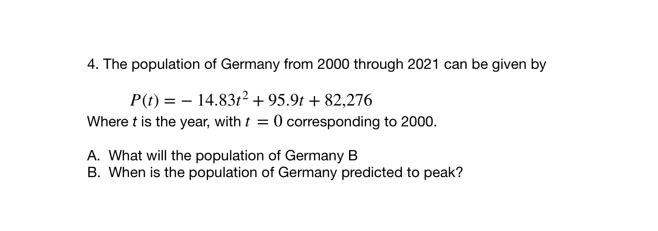
Notes:
Same qs as previous question

Slide 9
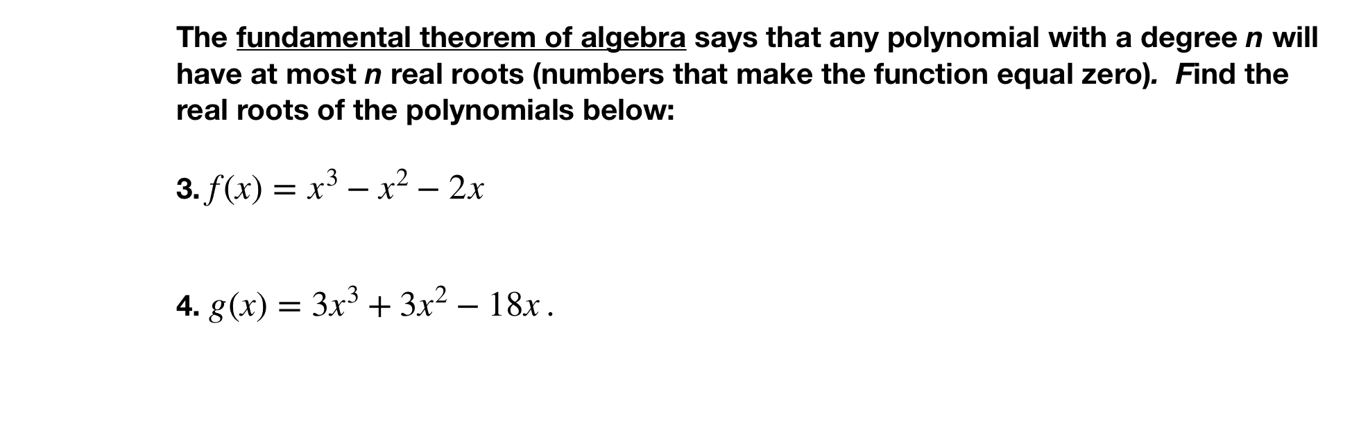
Notes:
3. = x(x^2 -x -2) = x(x+1)(x-2)
4g(x) = 3x^3 + 3x^2 − 18x. = 3x(x^2+ x - 6) = 3x(x+3)(x-2)

Slide 10
d
exit ticket
be sure to: Answer on a sheet of loose leaf paper. Show all work or write a complete sentence for each answer:
Rewrite $h(x)=x^{2}-2x-12$ in standard form.
Find the x-intercepts then sketch a graph for the equation.
Notes:
(x^2 - 2x - 1) + 1 + 1
(x - 1)^2 + 2
vertex = (1,2)
2. sketch an upward facing quadratic with vertex at (1,2).

