Slide 1
Fall 2021 Pre-calculus
Lesson 11.5
Dr. O’Brien
Lehman High School
3 December 2021
Notes:
NOTES:

Slide 2
do now
be sure to: find seat. Get out your binder and answer the do now questions below. Show all work or answer each question with a complete sentence.
Use the contracts to the right to describe the domain and range for the scale() and rotate() functions in Pyret.
Use mathematically precise language to explain why the line of code below will lead to an error message.
scale:: Number, Image —> Image
rotate:: Number, Image —> Image
scale(star(100, "solid", "green"), 90)
Notes:
Both functions have a domain that is a sequence of a number and a image. The range is the set of images.
The domain for scale specifies that the first parameter is a number, but here the argument is an image. This will lead to a type clash.

Slide 3
framing
what: HDW use function composition to build complex images in Pyret
why: In this unit we’ll be applying our mathematical knowledge to make a video game using the programming language Pyret. Composing functions is a big part of this.
where to: Next we explore using function composition to draw complex images in Pyret

Slide 4

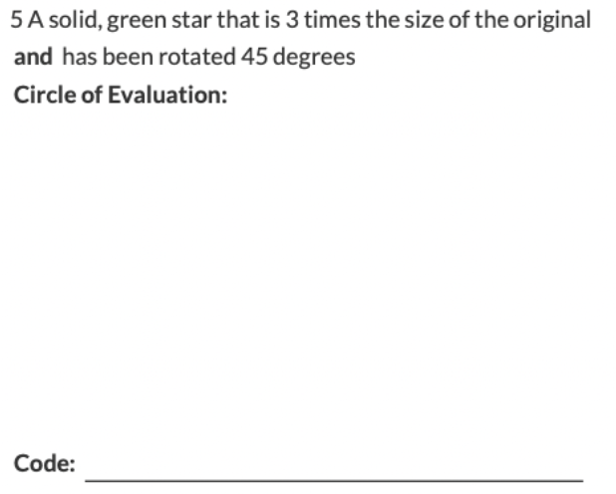
Review
Notes:
Student comes to the board and illustrates.

Slide 5
Preview
What do you notice about the contracts above?
What questions do you have about these contracts?
If you’re not sure how a function works, how could you figure out?
Notes:
1.the names describe what the function does, along with the domain and range. Eg flip-horizontal takes an image and flips it along a horizontal axis. Above takes two image and puts one above the other
2. Will var. may wonder what. Text does. Encourage students to explore in PyRet.
3. Error messages read them!

Slide 6
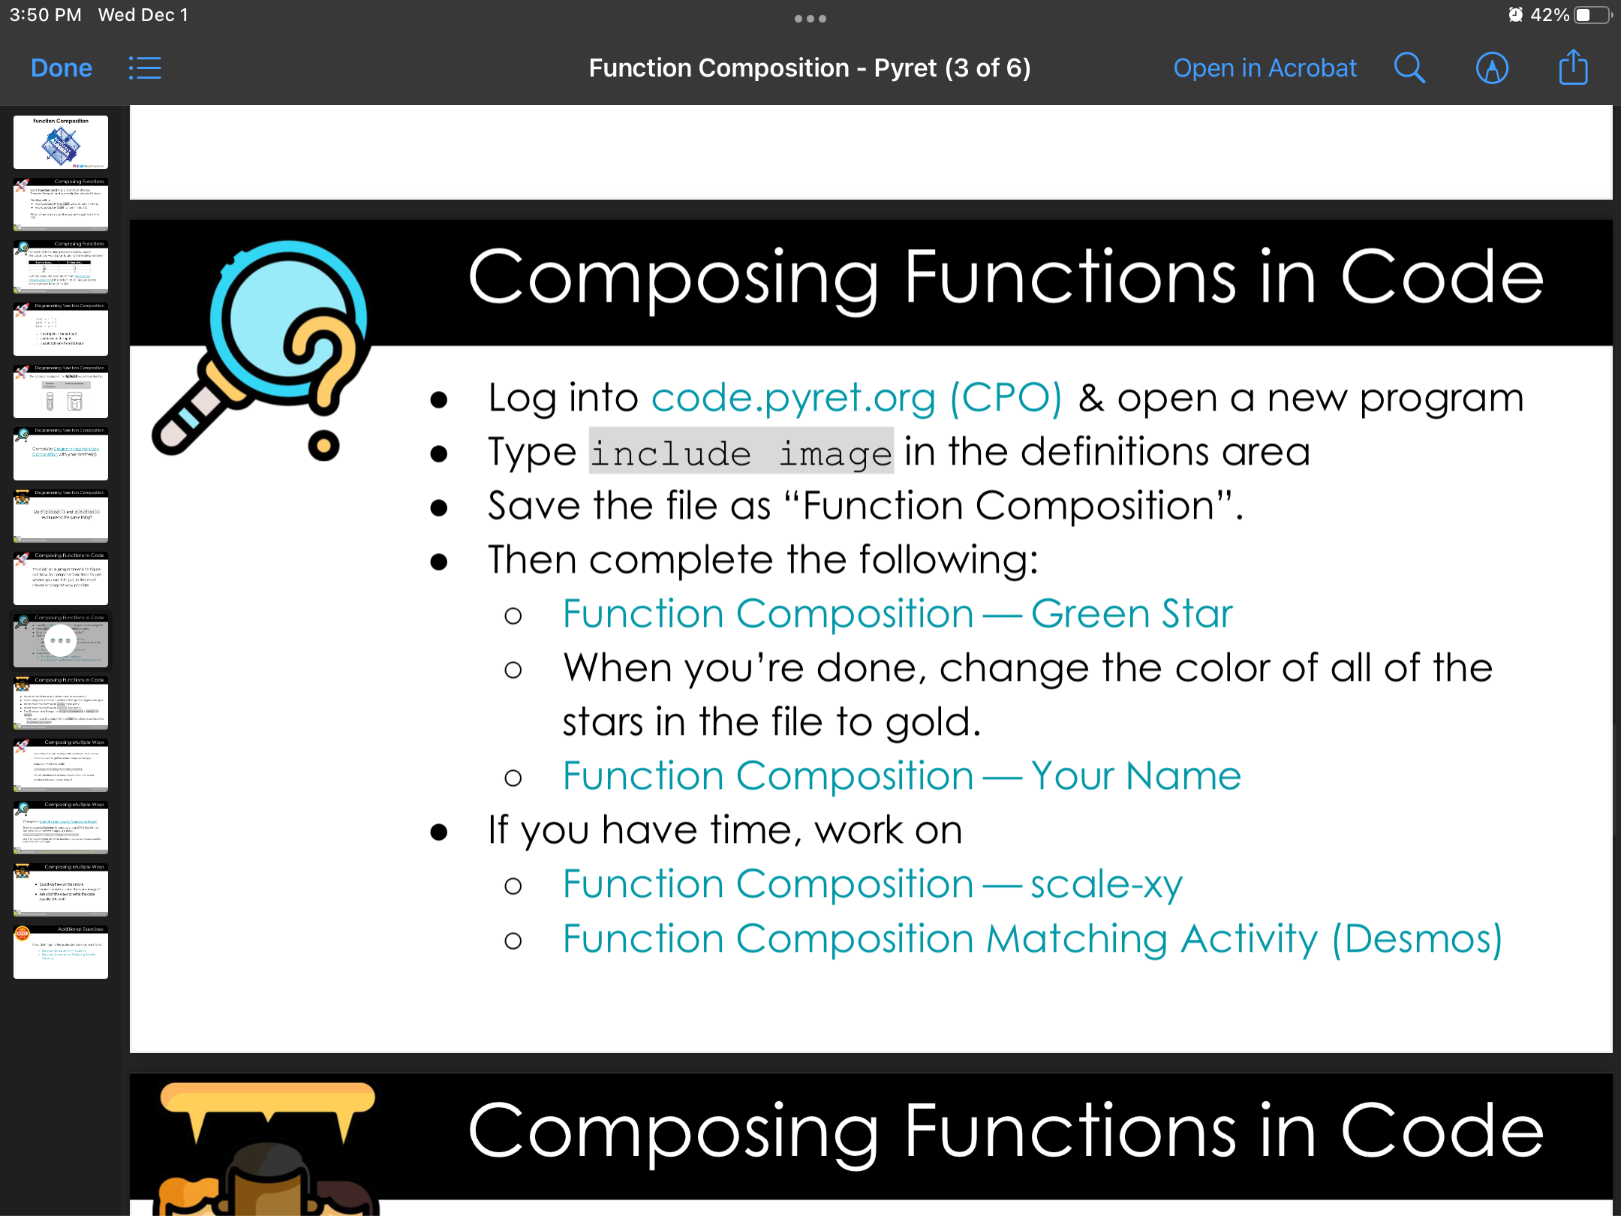
Coding to learn
Be sure to…
Notes:
HANDOUT WORKSHEET WHILE STUDENTS ARE LOGGING IN

Slide 7

Preview
How could we use the text() function to write our name in big letters? First try writing the code in the Pyret editor, then draw the circle of evaluation:
Notes:
How do we write the contract for star()? star:: Number String String —> Image
Draw circle of evaluation and code

Slide 8
Coding to learn
Be sure to…
Notes:
See teacher resources at bootstrap::algebra for answer keys
How do we use the scale function? Use the same method as Tuesday to discover its parameter structure. Scale takes a number and an image as arguments.
How do we rotate functions? Investigate how the rotate function works
How is this even math? When you embed one function in another, that’s function composition. All complex programs in Pyret , along with other functional programming languages like Lisp or Haskell, involve function composition.

Slide 9

Coding to learn: Bonus problem
Use function composition in Pyret to make the image to the right. Each square should have a size of 100 px.
Notes:
fun square_color(color):
square(100, "solid", color)
end
sq_blue = square_color("blue")
sq_black = square_color("black")
sq_red = square_color("red")
sq_orange = square_color("orange")
sq_green = square_color("dark green")
fun cross():
above(
above(
sq_blue, beside(sq_green,beside(sq_black, sq_red))
),
sq_orange
)
end
How can you represent your plan with a circle of evaluation?

Slide 10
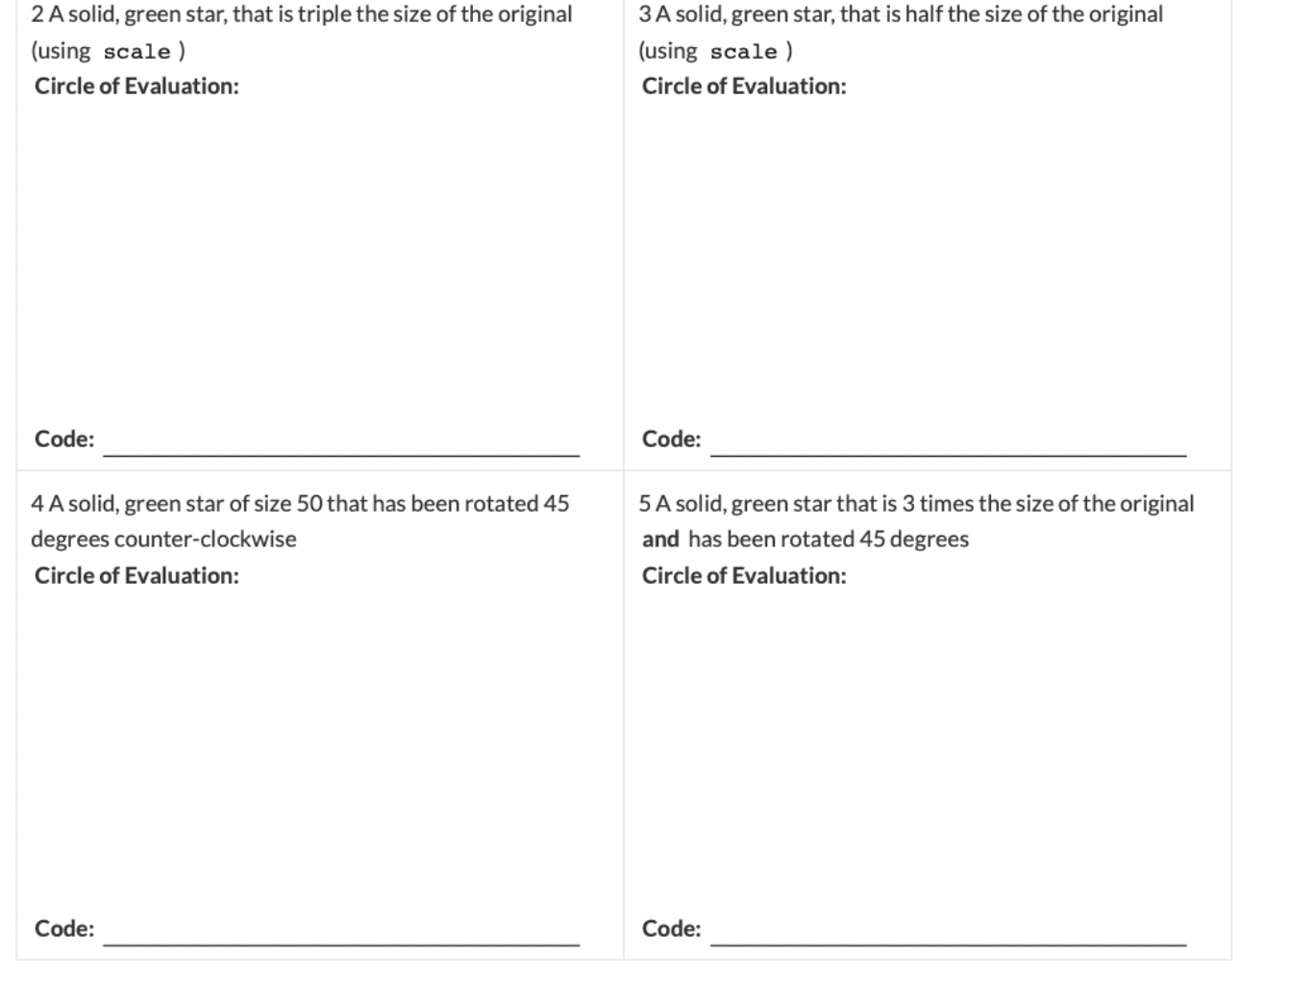
Coding to learn

Slide 11
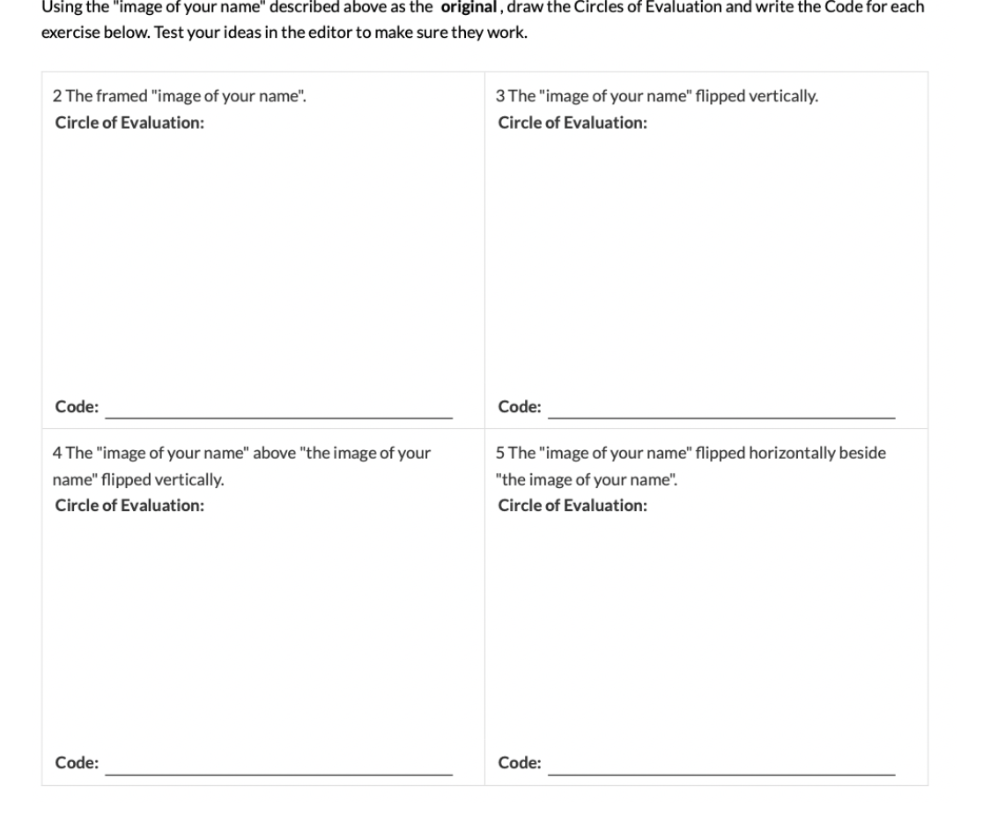
Coding to learn

Slide 12
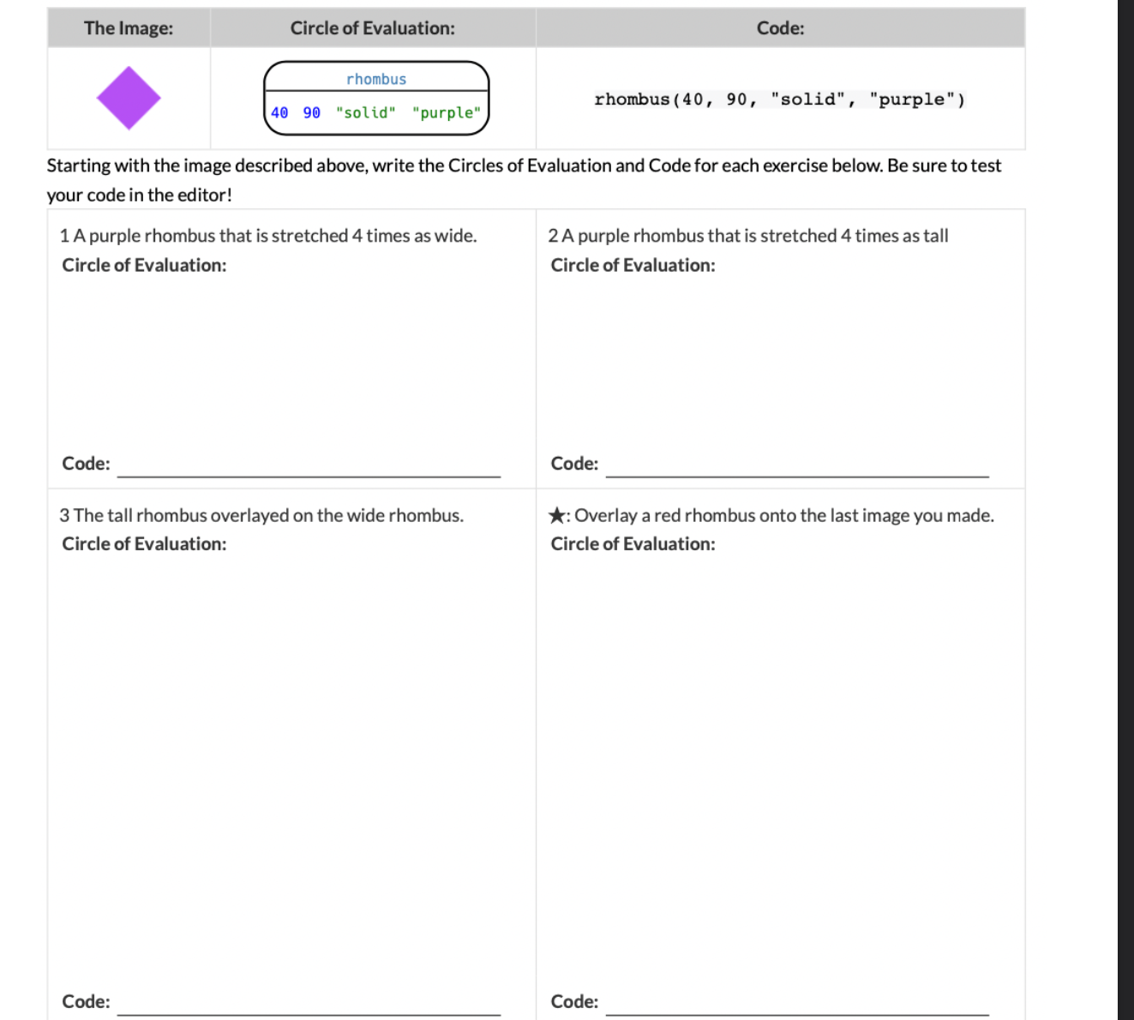
Coding to learn

Slide 13
Reflection: Thinking about thinking
be sure to: Answer each question below with a complete sentence.
How is function composition in Pyret similar to function composition in regular math? How is it different?
Why is it useful to pay attention to the contracts when trying to compose two functions?

Slide 14
wrapping up!
read the directions below!
be sure to:
Separate your desks!
Make sure you are logged out of your google on your computer!
Return your computer to the correct location in the cart. Plug your computer in!
Return to your seat. Remain there until the bell rings.

