Slide 1
Fall 2021 Precalc
Lesson 12.1
Dr. O’Brien
Herbert H. Lehman High School
6 December 2021
Notes:
VOCAB:
nested loop

Slide 2
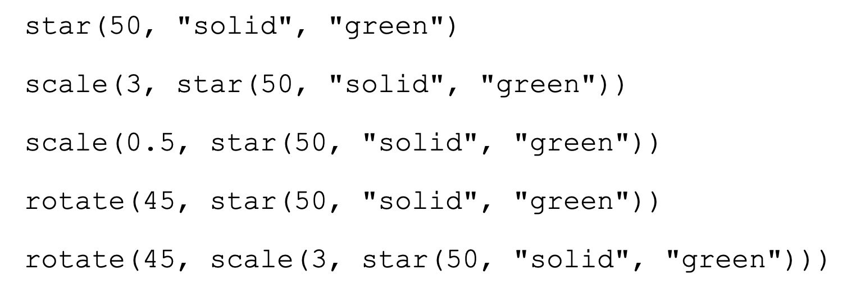
Do now
be sure to: Get out your binder. Copy goal and answer do now questions below. Show all work or write a complete sentence for each answer:
What do these five lines of code have in common? List at least two things.
Make a Prediction: What will happen if we execute this code in Pyret?
Notes:
They all share the function star(50, “solid”, “green”). They are all Pyret functions that take three arguments. They all have have Image in their range.
You will produce a sequence of five stars, differing in size and orientation.

Slide 3
framing
what: define variables to represent numbers and other data types
why: In this unit we’ll be applying our mathematical knowledge to make a video game using the programming language Pyret. Variables let us represent mathematical expressions and make our code more readable.
where to: Tomorrow a flag making project. Then defining functions.

Slide 4
Vocab
be sure to: Keep your notebook open. These definitions should be in your Glossary. If not Copy each definition, in your Pyret Glossary.
In math, if we define a value, like x = 4,
we can evaluate expressions using that value, like x + 2.
Pyret is no different!
Variable
A symbol that stores a value. In math the value is typically a number. In Pyret it can have other data types.

Slide 5
Mini-lesson
be sure to: Take notes and answer questions in your notebook.
Duplicate Code is almost always bad!
Readability: The more code there is, the harder it can be to read.
Performance: Why re-evaluate the same code a dozen times, when we can evaluate it once and use the result as many times as we need?
Maintainability: If we need to change the size of the stars, we would have to make sure every line is changed! That’s lot of room for error!
We can use variables to make our code more readable and maintanable.

Slide 6
Mini-lesson
Be sure to…
Open the Defining Values Starter File on Google Classroom.
Make a table in your notebook like the one below:
I notice… | Question…
Run the code. With your partner, identify three things you notice. Also write down at least two questions.
Notes:
Notice variables are used for numbers but also other data types.
Do variables work for all data types?

Slide 7
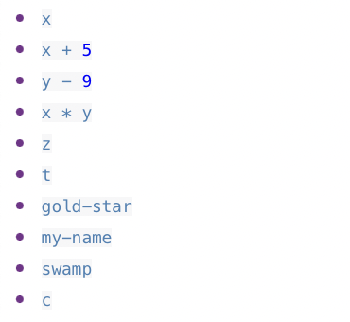
Mini-lesson
Be sure to…
Keep open the Defining Values Starter File on Google Classroom.
Examine the expressions listed to the right.
Write down what you expect each of them to produce.
Then, test them out one at a time in the Interactions Area. Write down what they do.
Write down two new variables of your own in the definitions area. Test and see if they work. Then write down your code in your notebook.
Notes:
Go through first one as a group. We expect x to return the value of x, and it does!

Slide 8

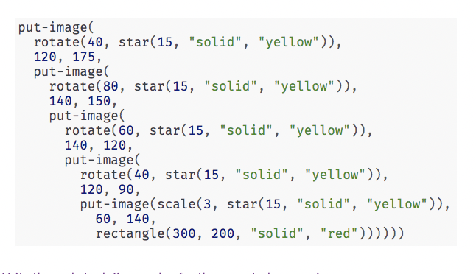
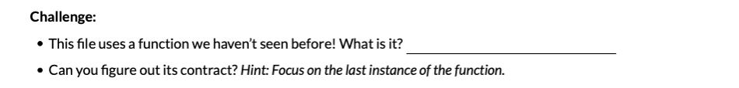
Coding to Learn: Chinese flag activity
What do you see repeated in this flag?
1. Work on Defining values - Chinese Flag worksheet.
What do you see repeated in this code?

Slide 9
Reflection: Thinking about thinking
be sure to: Answer each question below with a complete sentence.
What are some reasons why defining values is useful, both in Pyret and regular math?
Notes:
In pyret it helps make our code more readable and efficient. We Can also make mathematical expressions and code that apply in a variety of different contexts.

