Slide 1
Fall 2021 Precalc
Lesson 2.1
Dr. O’Brien
Herbert H. Lehman High School
7 February 2022

Slide 2
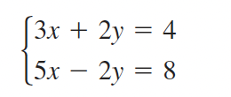
Do Now
Be sure to…Get out your notebook/binder. Read the paragraph below carefully, then answer the questions below. Show all work and check your results!
Examine the system of equations to the right. Do you think substitution is the easiest way to solve it? Explain why or why not.
What other strategies can you think of to solve it?
Notes:
No, the ys are identical, with only the signs reveresd. elimination would be easier.

Slide 3
B24 rules
Welcome to our new room, B24! Please read the information below:
When you come in, please find a seat at a desk (if one’s available) or one of the six closest desks to the screen. Do not sit in the back of the classroom. We’ll conduct the do now and mini lesson from here.
When I dismiss you for independent work, find a sit at one of the computer workstations.
No food or drink by the computers.
At the end of the period, you’ll be directed to assemble for the exit ticket/debrief. Log out of your computer, and quietly return to a seat near the front.

Slide 4
framing
what: use the elimination to solve systems of equations
why: Systems of equations are useful in situations where variables must satisfy two or more conditions. E.g. cost and revenue per units sold.
where to: Vectors and matrices

Slide 5
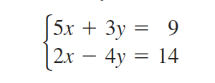
Warm up
Use elimination to solve the systems of equations below:
a.
b.
Notes:
8x = 12. x = 3/2. 3(3/2) + 2y = 4.
20x + 12y = 36. 6x - 12y = 42 26x = 78 x = 3 5(3) + 3y = 9 3y. = -6 y = -2

Slide 6
vocabulary
Copy the definitions below in your notebook:
A system of equations is consistent if it has at least one solution. It is inconsistent otherwise.

Slide 7
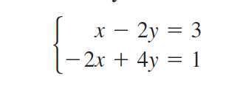
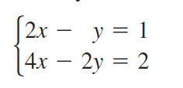
2 more examples
a.
b.
Notes:
2x - 4y = 6 -2x + 4y = 1 0 = 1 no solution!!!
+Why is this an inconsistent system? it has no solution.
b. 4x - 2y = 2 4x - 2y = 2 0 = 0 This is always true, so these equations are equivalent.

Slide 8
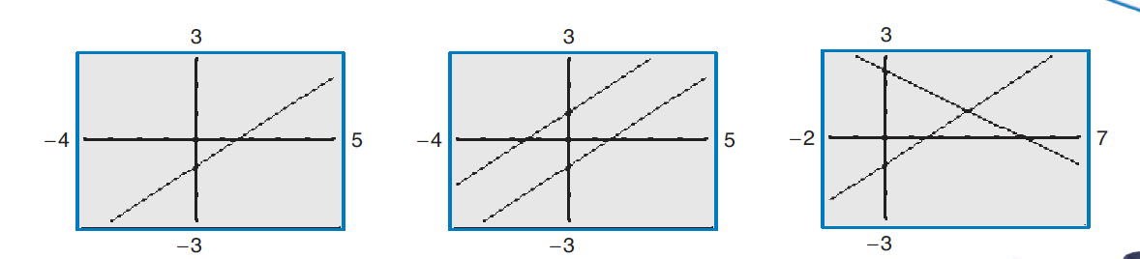
Recognizing graphs of linear systems
Notes:
see page 482 for solution.

Slide 9
Practice problem #1
\
The grocery store sells oranges for $0.95 and grapefruits for $1.05. Harvinder bought a mix of 16 oranges and grapefruits for $15.90. How many grapefruits did he buy?
Notes:
o: oranges
g: grapefruits
o + g = 16
0.95o + 1.05g = 15.90
0.95( o + g) = 0.95*16
0.95o +. 0.95g = 15.2
- 0.95o + 1.05g = 15.90
=. 2g = 31.1
g =

Slide 10
Practice problem #2
You are deciding how to invest a total of $20,000 in two funds paying 5.5% and 7.5% simple interest. You want to earn a total of $1300 in interest annually.
Write a system of equations to represent this problem. Let $x$ and $y$ represent the amounts invested at 5.5% and 7.5% respectively.
How much of the $20,000 should you invest at 5.5% to earn $1300 in interest per year? Explain you reasoning.
Notes:
x = amount invested in fund 1
y = amount invested in fund 2
x + y = 12000 (eq. 1)
0.09*x + 0.11*y = 1180
+HDW apply substitution to solve this system?
could go in either direction
y = 12000 - x
0.09x + 0.11(12000 - x) = 1180
0.09x + 1320 - 0.11x = 1180
-0.02x = -140
x = 7000
y = 12000 - 7000 = 5000
solution: (7000, 5000)

Slide 11
wrapping up!
be sure to: read the directions below!
Make sure there isn’t any litter near your workstation.
If you borrowed headphones, sign them back in.
Make sure you are logged out of your computer!
Remain in your seat until the bell rings.

