Slide 1
Fall 2021 AP CS A
Lesson 11.5
Dr. O’Brien
Herbert H. Lehman High School
3 December 2021
Notes:
VOCAB:
nested loop

Slide 2

Do now
Be sure to… find a seat at a desk. Get out your notebook. Copy the date and goal.
Answer the questions below in your notebook with a complete sentence. Be prepared to share out.
how to solve it
Understand the task:
Read the problem carefully.
What should be the outcome (an answer, program, algorithm).
Make a plan:
Come up with a strategy to solve a problem
How does this problem resemble problems you’ve seen before.
Execute the plan:
Work through your strategy step by step
Review your work:
Does your solution make sense?
If not go back to (2). Do it again!!
What did you find most challenging about the practice problems yesterday?
How are code tracing tables helpful for making sense of problems?
Describe the four steps of Polya’s “how to solve it” method.
How could Polya’s method be helpful for tackling AP problems?
Notes:
ANSWERS WLL vary. STUDENTS likely to have had trouble understanding the problems, knowing where to start. Polya’s method is helpful for breaking a problem down and understanding it.

Slide 3
framing
what: HDW use informal run-time comparison to analyze algorithmic efficiency?
why: Efficient algorithms save time and money ($).
where to: Test next week. Then writing classes.
Announcements:
Test on Monday.
See Google Classroom for study guide.

Slide 4
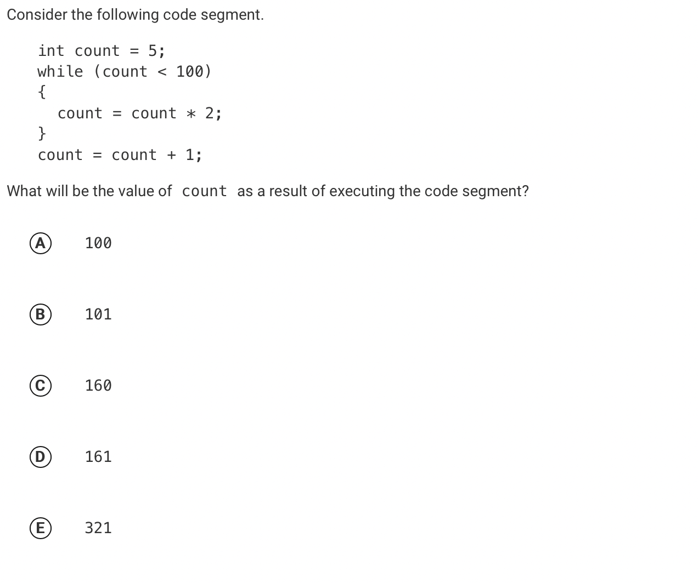
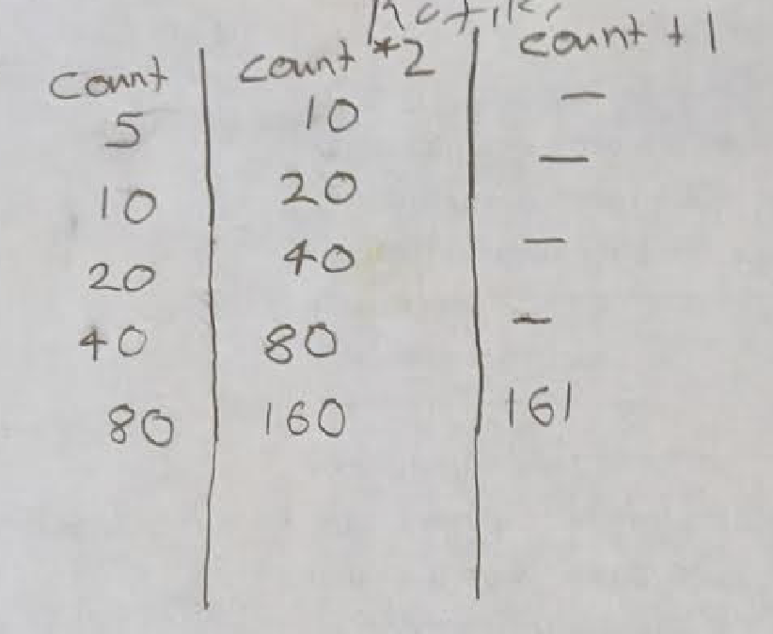
Review: Pre-test problem #1
be sure to: Examine Rafiki’s code tracing table. In your notebook, answer the following questions: 1. What answer does it predict? 2. How is it useful for answering solving the problem?
Notes:
It predicts the final count will be 161.
It’s useful because it keeps track of the value for ‘count’ at each iteration in the loop.
+why does the loop stop when count=160? because the test is count <100.
+How does Rafiki’s table compare to the one you made? What do you like about it? ANSWERS WILL VARY. Rafiki’s is very explicit, does a good job if picking the appropriate variables to keep track of.

Slide 5
Review: Pre-test problem #1
be sure to: Check if your answer was correct. Explain how to get the right answer in your notebook. Be prepared to share out.
Notes:
D: 161.

Slide 6
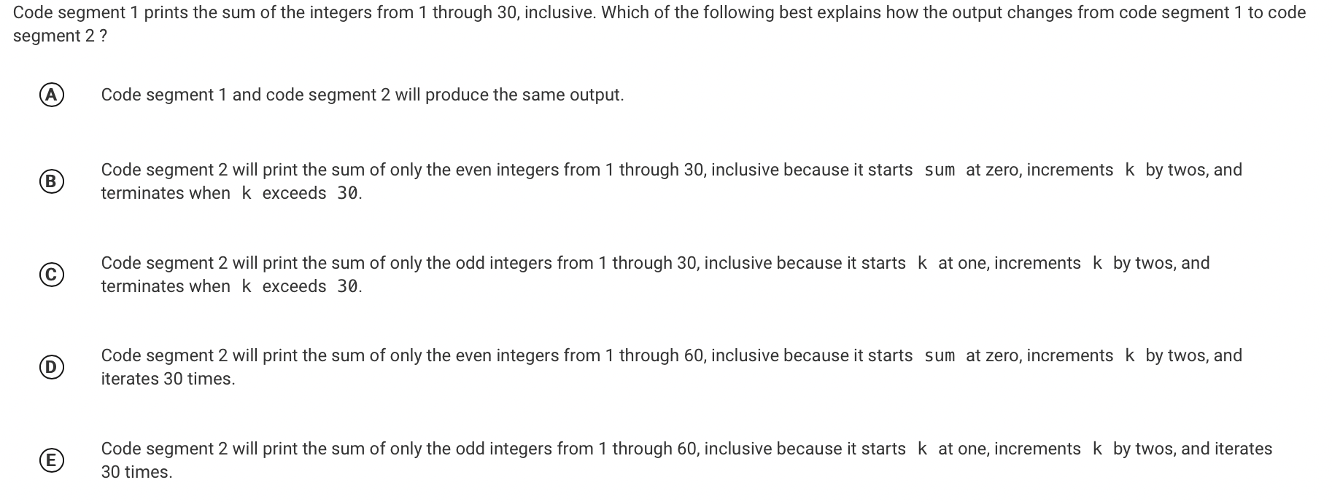
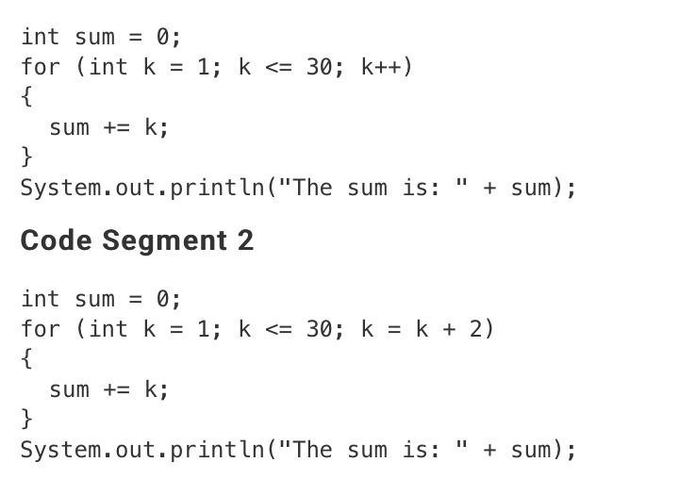
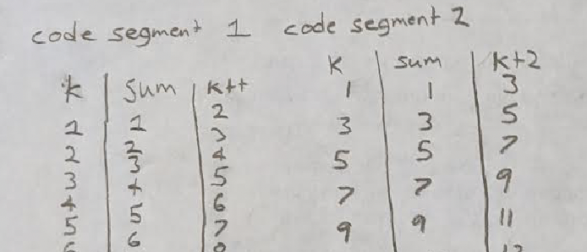
Review: Pre-test problem #2
be sure to: Answer the questions below in your notebook. Be prepared to share out:
1. How does Rafiki’s code tracing table help us solve this problem?
2. What will be the correct answer?
Notes:
+how does Rafiki’s help? it shows us that code segment two is only summing teh odd numbers.
See handwritten notes for details, including a code tracing table.
+Why don’t we need to complete a full code tracing table to solve this? We should write out the code tracing table long enough to establish a pattern. Once the pattern is clear, we can stop.

Slide 7
Review: Pre-test problem #2
be sure to: Check if your answer was correct. Explain how to get the right answer in your notebook. Be prepared to share out.
Notes:
C
See handwritten notes for details, including a code tracing table.
+Why don’t we need to complete a full code tracing table to solve this

Slide 8
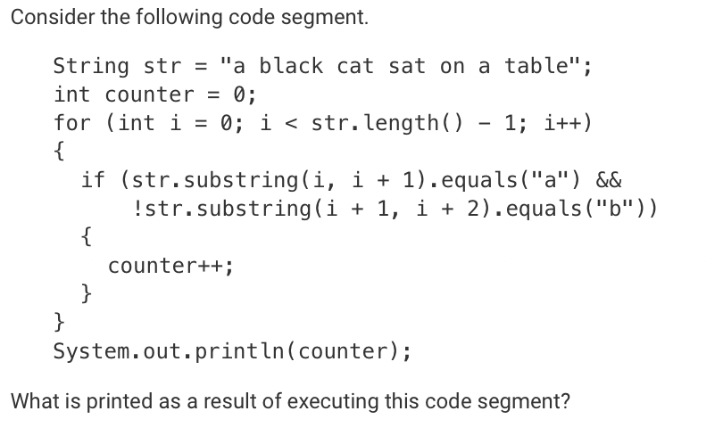
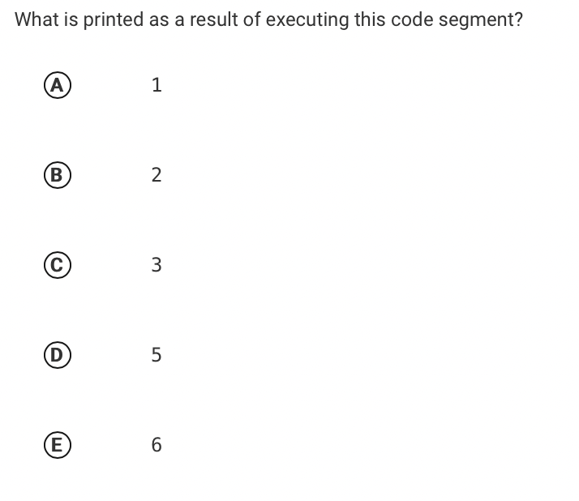
Review: Pre-test problem #3
be sure to: how to get the right answer in your notebook. Be prepared to share out.
Notes:
5. All instanes of “a” except the last one. Note that a blank space. counts as a character

Slide 9
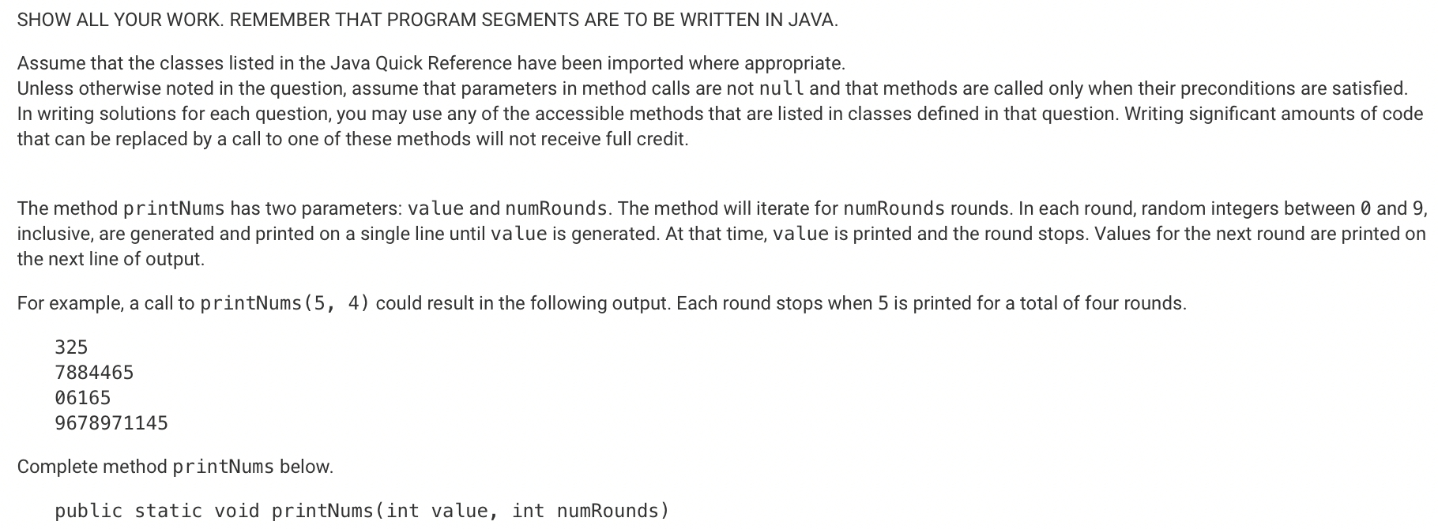
Review: Pre-test problem #4
be sure to: Use the how to solve it method to tackle this problem as a group. In your notebook, answer the questions Dr. O’Brien asks.
Notes:
for (int i = 0; i <. numRounds; i++){
String str = “”;
int rand_int = Random.randInt();
while (value != rand_int){
str += rand_int;
rand_int = Random.randInt();
}
System.out.print(str);
}
What are we trying to do here? What’s the task? For each round, concatenate a string of randomly generated numbers. Once the value is generated, add it to string and then print the string
What vocab don’t we understand? answers will vary.
THE FIRST TWO PARAGRAPHS ARE BOILERPLATE. EMPHASIZE THAT TO STUDENTS
How can we make a plan? Write solution out in pseudo code
DONT WORRY ABOUT IMPLEMENTATIONAL DETAILS OF JAVA YET. eg you may not know how to generate random numbers. That’s ok you’ll still get most of the points if your algorithm works.
DONT FREAK OUT.
Pseudo code example is above,

Slide 10
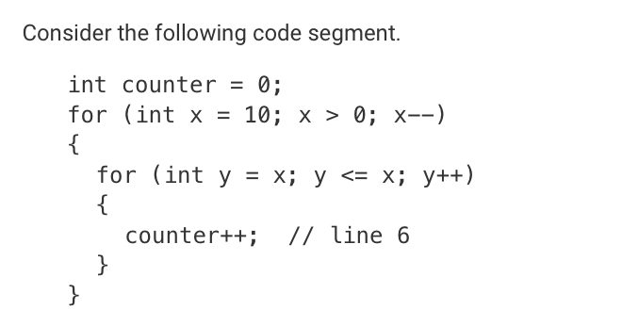
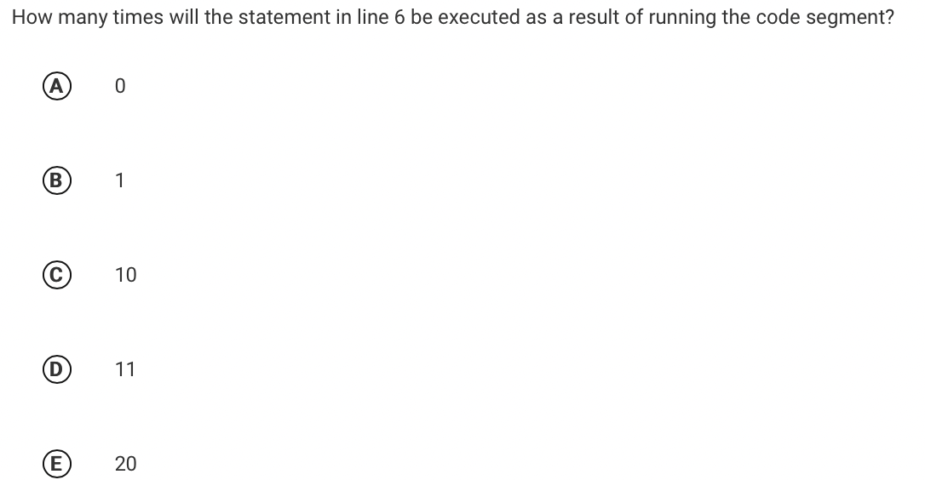
Review: Pre-test problem #5
be sure to: Check if your answer was correct. Explain how to get the right answer in your notebook. Be prepared to share out.
Notes:
10. If y is initialized as x in the inner loop, it will only be less than or equal to x on the first iteration, so it only runs once for each iteration in the outer loop, of which there are ten iterations in total.

