Slide 1
Fall 2021 AP CS A
Lesson 10.2
Dr. O’Brien
Herbert H. Lehman High School
November 23, 2021
Notes:
VOCAB:
nested loop

Slide 2
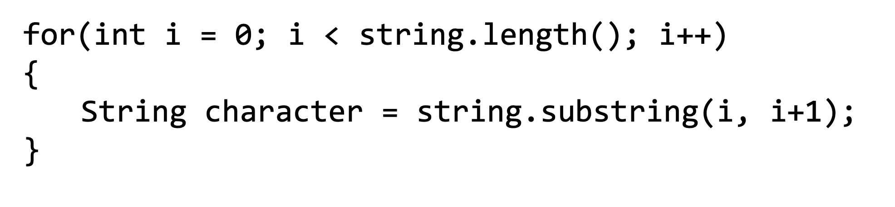
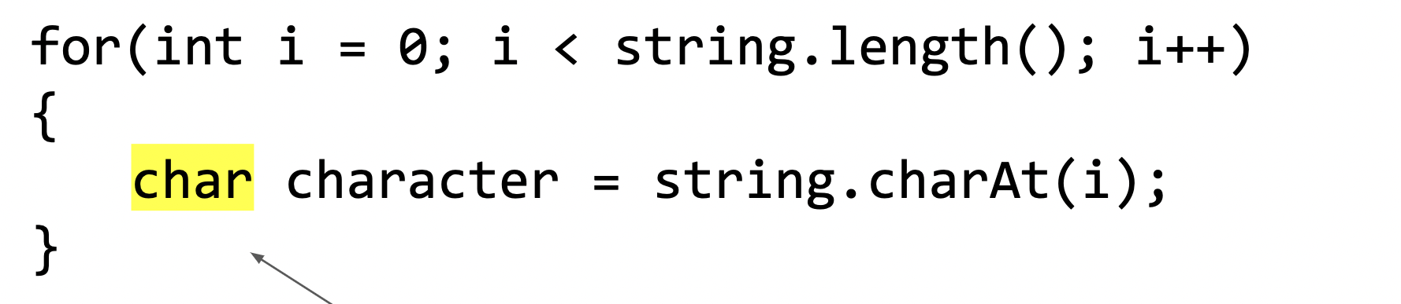
Coding to learn
be sure to: Log in to Workstation. Work on CodeHS exercises below. Make sure to write out a plan before you start coding!
General formula for traversing a String string
4.1.6: making Taffy
4.2.6: Print the odds
4.2.10: multiplication table
4.3.7: Password Checker
4.3.9: Fixing grammar
4.4.6: Upright number triangle
4.4.8: Multiplication table
Notes:
BE SURE TO WRITE OUT A PLAN
+How could you use .indexOf() to solve the password checker assignment? You could make a string containing all lower case letters. and all digits 0-9. then you could check if a given character is in them because if not you’ll return -1.
+
+How is fixing grammar similar to the ‘remove’ method we discussed in the mini-lesson? It’s similar in that we want to make a new string with the corrected form of the input string.
SEE CODEHS PROBLEM GUIDES FOR DETAILED SOLUTIONS.

Slide 3
Reflection: Thinking about thinking
be sure to: Answer each question below with a complete sentence.
Why is it useful to apply loops to strings?
Do you think the algorithms we’ve learned about today can only work in Java? Or are the applicable for other programming languages? Explain why or why not
Notes:
Strings are sequences of characters. This sequence can be traversed with a for loop. We can traverse a string and perform various operations on individual characters.
Loops strings and characters appear in most other languages, including python. so these algorithms are not Java specific.

