Slide 1
Fall 2021 Pre-calculus
Lesson 10.2
Dr. O’Brien
Lehman High School
November 23, 2021
Notes:
Circles of evaluation
Yret

Slide 2
Retake/Pyret
be sure to: Read the directions below
If you’re doing the retake
Grab a calculator. Then take a seat close to the windows.
Put away all notes, begin working on the test.
You may use loose leaf paper for calculations.
If you’re not doing the retake
Grab a computer. Finish the pset from yesterday
When you’re finished, Dr. O’Brien will hand you a challenge pset.

Slide 3
Mini-lesson
be sure to: Take notes and answer questions in your notebook.
We’ll use something called the Circles of Evaluation. The rules are simple:
Every Circle must have one - and only one! - function, written at the top
The inputs to the function are written left-to-right, in the middle of the Circle.
Circles can contain other circles.
Draw the circle of evaluation for:
$5×6$
$(10-5)×6$
Notes:
Copy rules in your notes.
(+ | 5 6 )
(X | (- | 10 5) 6 )

Slide 4
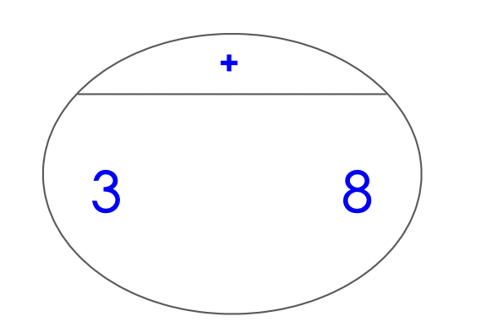
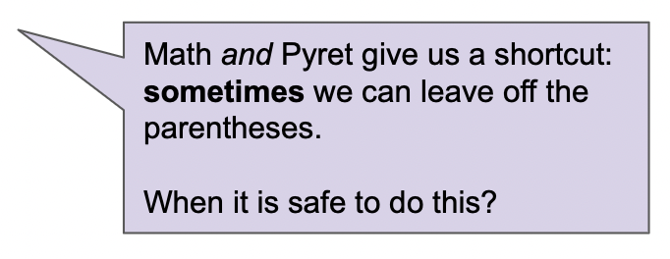
Mini-lesson
be sure to: Take notes and answer questions in your notebook.
From circles of evaluation to code:
Expression: $3+8$
Circle of evaluation:
Code: (3 + 8)

Slide 5
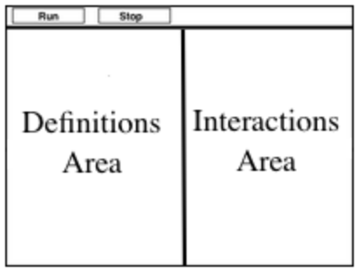
Coding to learn
be sure to: Open your computer. Navigate to code.pyret.org
Introducing Pyret:
Click “open editor”.
What do you see?
Toolbar at the top
Definitions area on the left
Interactions area on the right
Notes:
After students see this info, Move to live coding:
Type in : (​8 ​* 2​) + (​6 / 3​)
+what happens if you don’t use parens? you get an error message: “The * and + operations are at the same grouping level. Add parentheses to group the operations, and make the order of operations clear.”

Slide 6
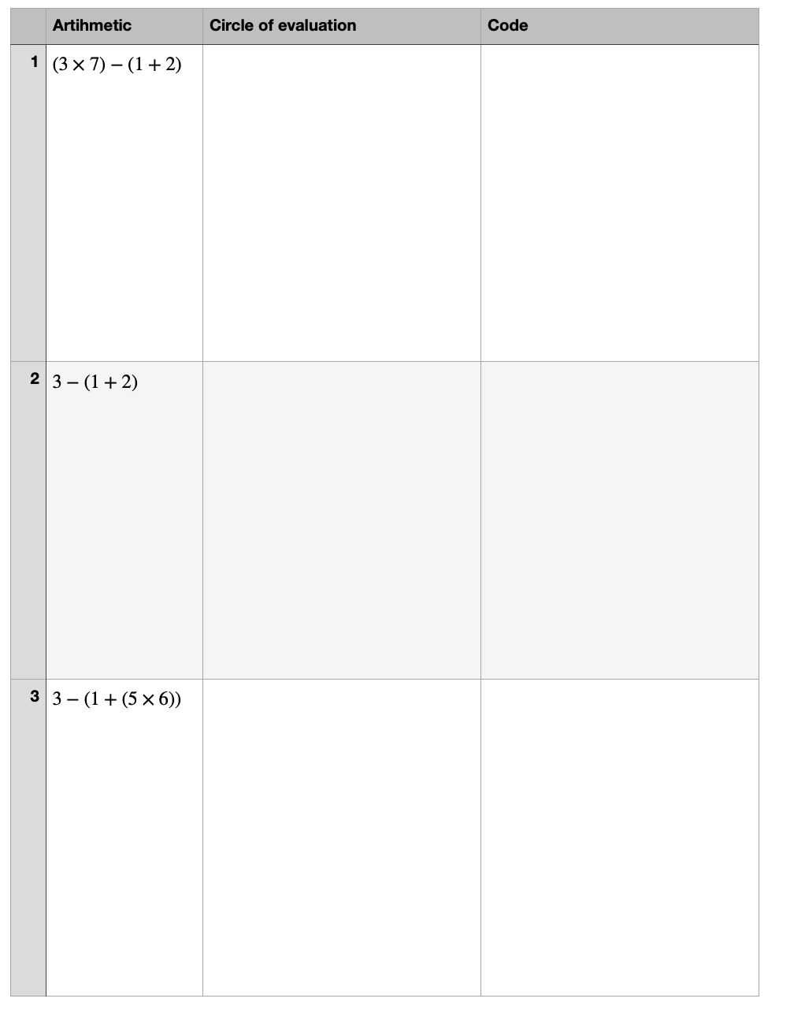
Coding to learn
be sure to: Work through these problems with your partner.

Slide 7
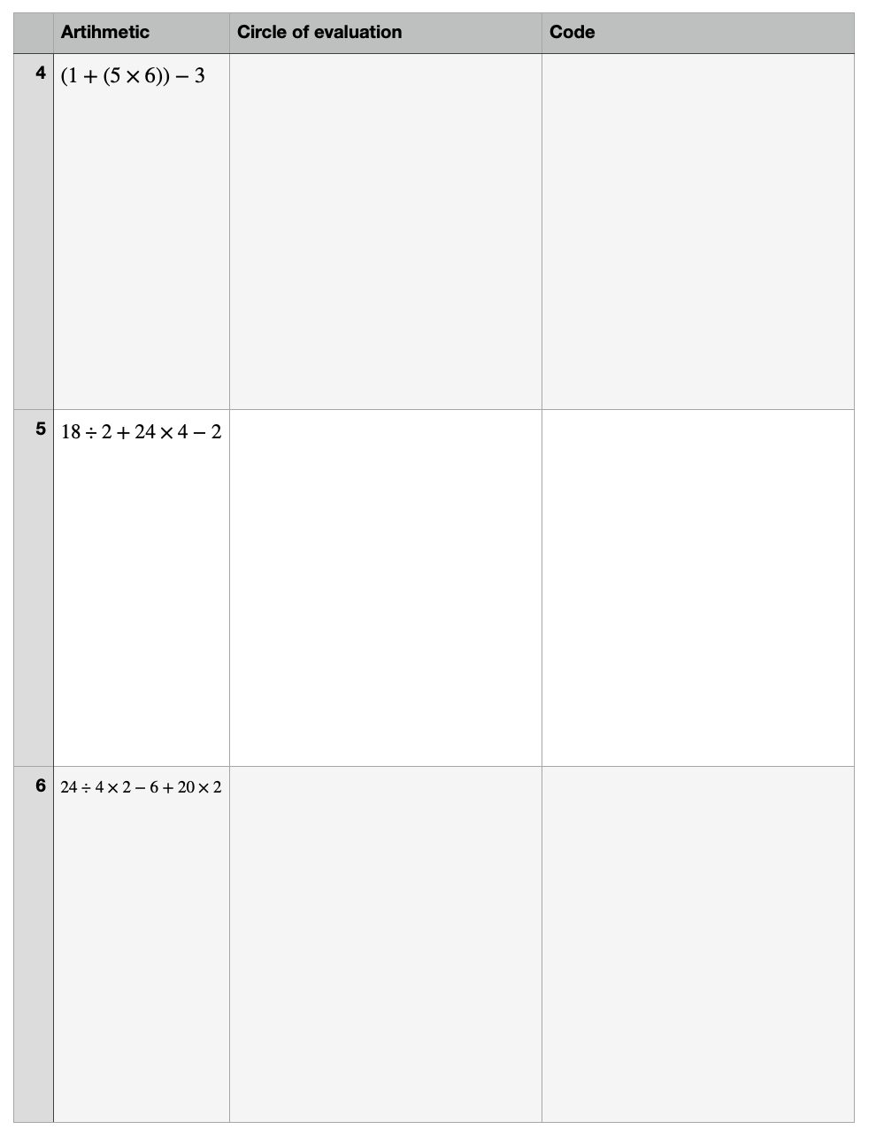
Coding to learn
be sure to: Open your computer. Navigate to code.pyret.org
Coding to learn
be sure to: Work through these problems with your partner.

Slide 8
