Slide 1
Fall 2021 Java
Lesson 7.4
Dr. O’Brien
Herbert H. Lehman High School
November 4, 2021

Slide 2
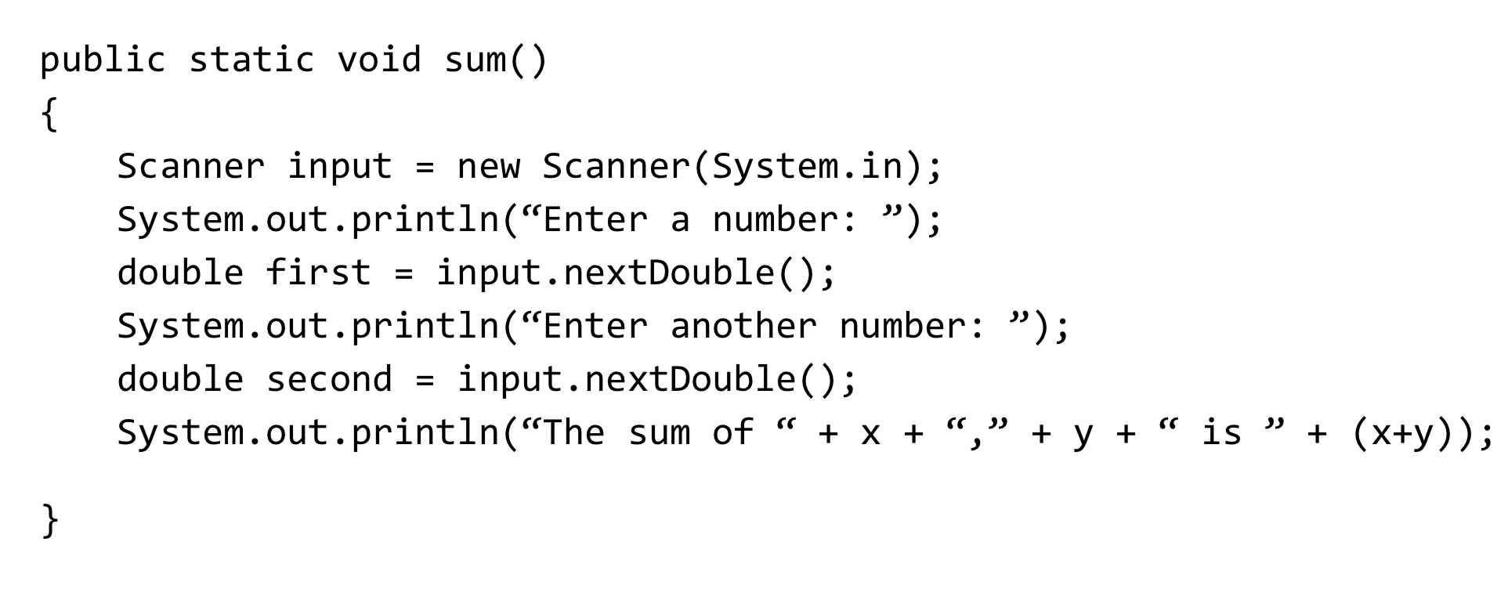
do now
be sure to: Get out your binder. Copy goal and answer do now questions below. Show all work or write a complete sentence for each answer:
The sum() method on the right asks the user for two numbers and outputs their sum.
What questions do you have about how the method works?
How could you alter this method so that it instead asks the user for ten numbers and outputs their sum? Try to think of at least two ways and describe each.
Notes:
+answers will vary. Make a plan can be hard, if you don’t know where to start. (4) can also be hard, since people want to do as little work as possible.
+Why is it a good idea to understand the problem and then make a plan? because otherwise we don’t know what we’re doing!
+How do you start making a plan? Think about what you already know, and about how this problem resembles problems you’ve seen before.

Slide 3
framing
what: use for loops and while loops to iterate code in Java
why: These are basic control structures that are crucial to any programming language. Today we’ll explore them in Java.
where to: Basic algorithms that use loops.

Slide 4
Writing to learn
be sure to: Keep your notebook open. Answer each question in at least a complete sentence. Write silently, the share out with your partner. We’ll discuss afterward.
How could you write a program that outputs the text?
How could you alter your program so the the user inputs how long the countdown is?
10…
9…
8…
7…
6…
5…
4…
3…
2…
1…
Lift off!
Notes:
Use could write it manually, you could also use a loop to iterate through a series of numbers, printing each one.
You have to use a loop, then you could use the Scanner class.

Slide 5
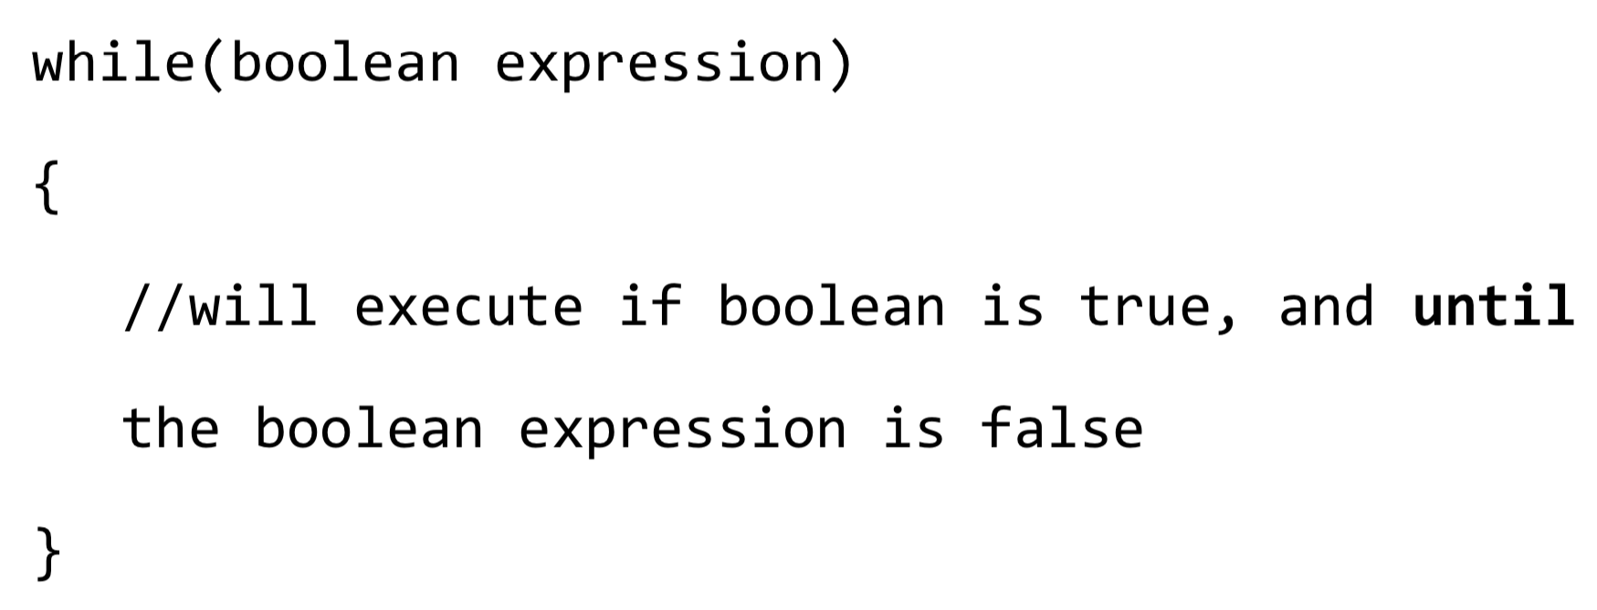
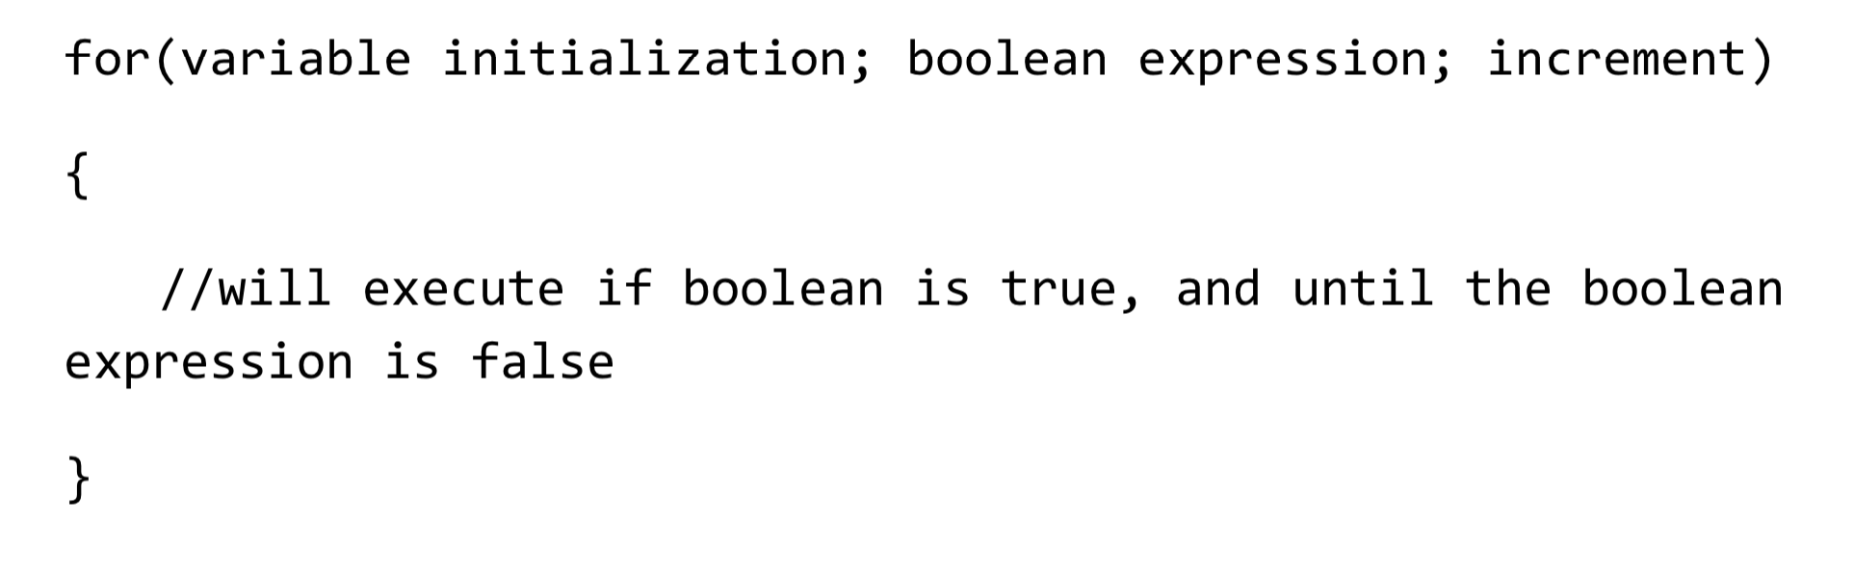
Vocab
be sure to: Keep your notebook open. Copy each definition, including the code sample, in your Java Glossary.
While loop
Repeats a set of statements until a condition is met.
For loop
Repeats a set of statements a specific number of times.

Slide 6
Coding to learn: live coding
be sure to: Move to your workstations. Log Into CodeHS and visit Countdown in In Class Examples.
Let’s see how we could code this up in Java
Using a while loop.
Make sure you follow along at your workstation!
Enter a number: 6
6…
5…
4…
3…
2…
1…
Lift off!
Notes:
make countdown().
{
Scanner input = new Scanner(system.in);
System.out.println(“Enter a number: “)
int countdown = input.nextInt();
while (countdown > 0){
print(countdown + “…”)
countdown- -
}
+make sure to call countdown in the in the main();
+What’s the problem if we don’t include countdown - -? The program enters an infinite loop! Why? because it’s value down’t
decrease, so it’s always greater than 0.
+Why does lift off need to be outside of the loop? b.c. otherwise it’ll print n times
Now let’s try it with a for loop
Countdown2()
for (int i = 0; i < countdown; i++){
print(countdown + “…”)
countdown- -
}
+what goes wrong if you include countdown- - in the for loop? it messes with the value of the boolean expression i < countdown
+how could we fix this? two ways, either decrement i and start it’s value as countdown, or we could make a second variable n = countdown above the loop., and then use n in the for loop

Slide 7
Thinking about thinking
be sure to: Answer each question below with a complete sentence.
How are the two loops used differently in this problem?
Which one do you like better? Why?
Why do you think the same control structures are used in different programming language, including Python and Java?
Notes:
They have different syntax, we can use for loop with decrement to make our lives a little simpler.
answers will vary, for loop is simpler but while loop may seem more transparent for students.
Because we can use these structures to do basically anything a computer can do. Computers are machines, machines are good at doing the same thing over and over again, and that’s what loops do.

Slide 8
do now
be sure to: Complete at home tonight.
Exercise 4.1.6: Making Taffy
Exercise 4.2.6: Print the Odds
Exercise 4.2.10: Multiplication table

