Slide 1
Fall 2021 Java
Lesson 9.4
Dr. O’Brien
Herbert H. Lehman High School
November 18, 2021
Notes:
VOCAB:
str.indeOf(str String)

Slide 2
do now
be sure to: Get out your binder. Copy goal and answer do now questions below. Show all work or write a complete sentence for each answer:
You want to write a program with a method called passwordCheck to return if the string is a valid password. The method should have the signature shown in the starter code.
The password must be at least 8 characters long and may only consist of letters and digits.
How could you use string traversal to solve this problem?
Write out an algorithm, in a paragraph or in pseudocode, for how this task could be accomplished.
Notes:
You could go through a string and check if each character is a number or a letter.
for char in string: if char is not letter and char is not number: return false return true

Slide 3
do now
be sure to: Get out your binder. Copy goal and answer do now questions below. Show all work or write a complete sentence for each answer:
As we develop more sophisticated algorithms, and tackle more complex problems, you’ll find it very convenient to make a plan before you start coding!!!
Notes:
You could go through a string and check if each character is a number or a letter.
for char in string: if char is not letter and char is not number: return false return true

Slide 4
framing
what: implement string algorithms in Java
why: We’ve studied algorithms for string manipulation, now let’s practice implementing them!
where to: Nested iteration of for loops

Slide 5
Vocab
be sure to: Keep your notebook open. Copy each definition, including the code sample, in your Java Glossary.
string.indexOf(String str)
Returns the index of the first occurrence of str; returns -1 if not found.
Make a prediction. What will the program below output? How do you know?
String str = “lehman lions”;
System.out.println(str.indexOf(“L”);
System.out.println(str.indexOf(“x”);
Notes:
MAKE A PREDICTION: It will return 0, because the first occurrence of “l” is at index 0. The second line will return -1, because “x” does not occur in the string.
+why does it make sense to use -1 as the return value if there is no index with the associated the input string? because index values all have to be 0 or positive. there’s no negative values.
+What do you predict str.indexOf(“man”) will return? it will return 3, because the substring “man” begins at index 3.

Slide 6
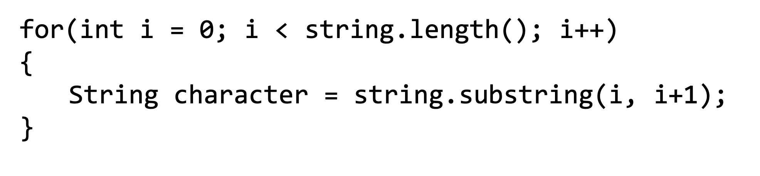
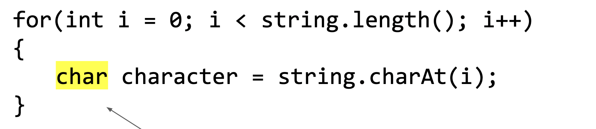
Coding to learn
be sure to: Log in to Workstation. Work on CodeHS exercises below. Make sure to write out a plan before you start coding!
General formula for traversing a String string
Exercise 4.3.7: Password checker
Exercise4.3.9: Fixing grammar
string.indexOf(String str)
Returns the index of the first occurrence of str; returns -1 if not found.
Notes:
BE SURE TO WRITE OUT A PLAN
+How could you use .indexOf() to solve the password checker assignment? You could make a string containing all lower case letters. and all digits 0-9. then you could check if a given character is in them because if not you’ll return -1.
+
+How is fixing grammar similar to the ‘remove’ method we discussed in the mini-lesson? It’s similar in that we want to make a new string with the corrected form of the input string.

Slide 7
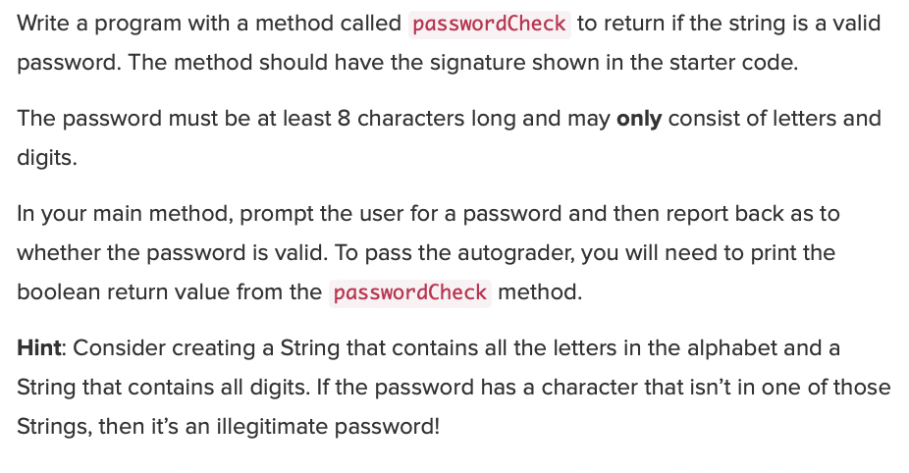
Coding to learn
be sure to: Log in to Workstation. Work on CodeHS exercises below. Make sure to write out a plan before you start coding!
Notes:
See CodeHS program guide for detailed solution. Pre-planned questions on previous page.

Slide 8
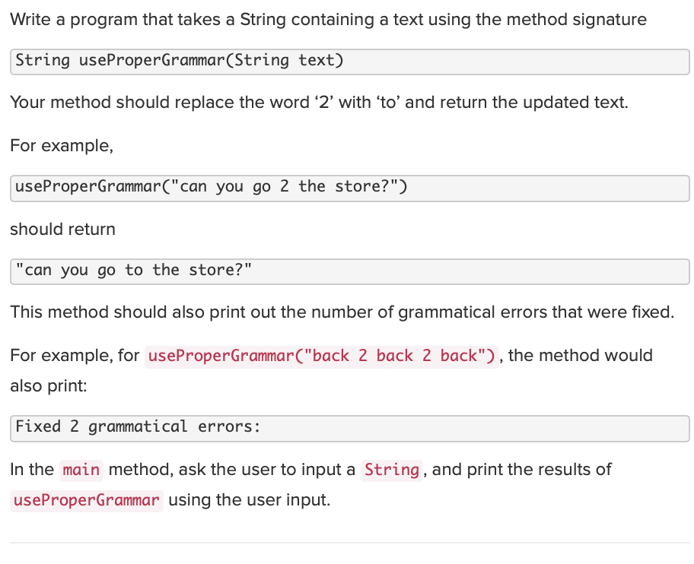
Coding to learn
be sure to: Log in to Workstation. Work on CodeHS exercises below. Make sure to write out a plan before you start coding!
Notes:
See CodeHS program guide for detailed solution. Pre-planned questions on previous page.
+How could you pre-plan this before you could? Write out an algorithm in pseudocode. e.g.
newstring = “”;
for each char in String:
if char == “2”:
replace with “to”
add to newString
else:
add char to newString

Slide 9
Reflection: Thinking about thinking
be sure to: Answer each question below with a complete sentence.
Why is it useful to apply loops to strings?
Do you think the algorithms we’ve learned about today can only work in Java? Or are the applicable for other programming languages? Explain why or why not
Notes:
Strings are sequences of characters. This sequence can be traversed with a for loop. We can traverse a string and perform various operations on individual characters.
Loops strings and characters appear in most other languages, including python. so these algorithms are not Java specific.

