Slide 1
Fall 2021 Precalc
Lesson 9.4
Dr. O’Brien
Herbert Lehman High School
Nov. 18, 2021

Slide 2
Coaching stations
be sure to: grab a calculator,ask Dr. O’Brien where to sit. Get out notebook. Read directions below!
Today we’ll be working in stations. Each station will have a coach. At the stations, you’ll work to review topics from the test that you need to work on.
Work on the problem set at your own pace. Do the work in your notebook. If you have a question, ask your coach!
If you need extra space, use the back pages!
Tutoring:
I’ll be available for tutoring the following times in room B24:
8th period, daily
3:30-4, Tuesday and Thursday
Notes:
See answer key for detailed answers.
The test is out of 60 pts. I made question (5) extra credit.

Slide 3
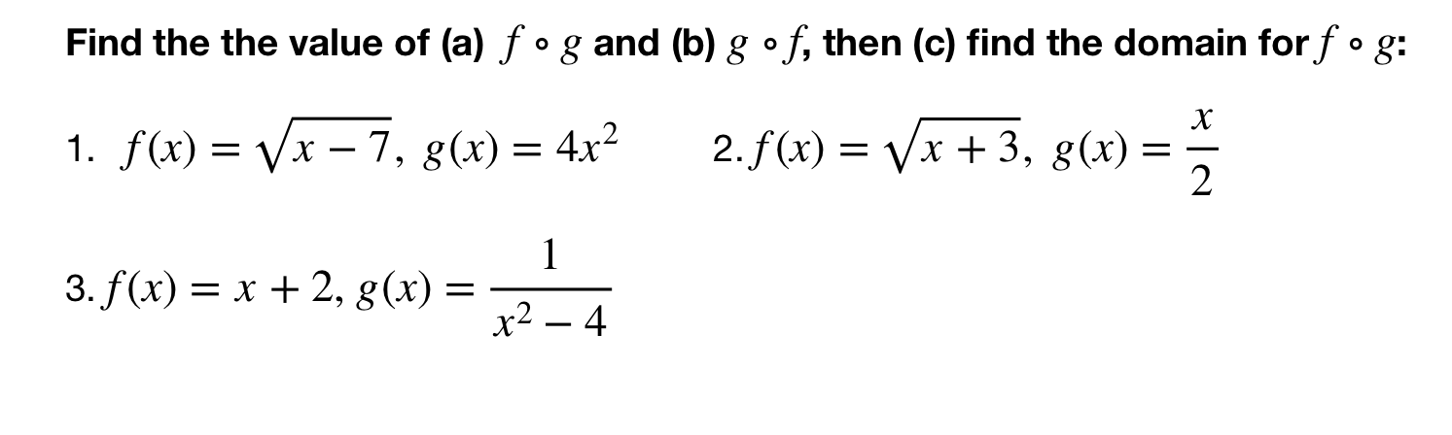
Coaching stations
be sure to: grab a calculator,ask Dr. O’Brien where to sit. Get out notebook. Read directions below!
Notes:
See answer key for detailed answers.
The test is out of 60 pts. I made question (5) extra credit.

Slide 4
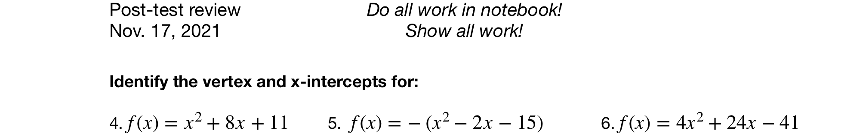
Coaching stations
be sure to: grab a calculator,ask Dr. O’Brien where to sit. Get out notebook. Read directions below!
Notes:
See answer key for detailed answers.
The test is out of 60 pts. I made question (5) extra credit.

Slide 5
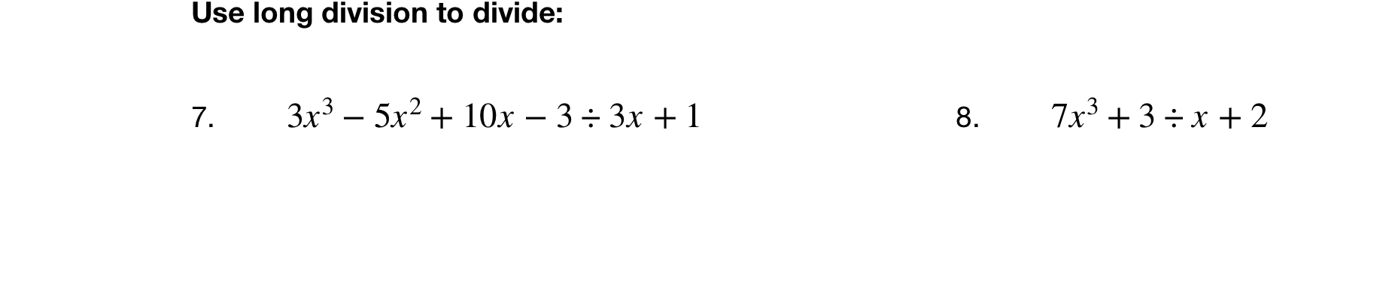
Coaching stations
be sure to: grab a calculator,ask Dr. O’Brien where to sit. Get out notebook. Read directions below!
Notes:
See answer key for detailed answers.
The test is out of 60 pts. I made question (5) extra credit.

Slide 6
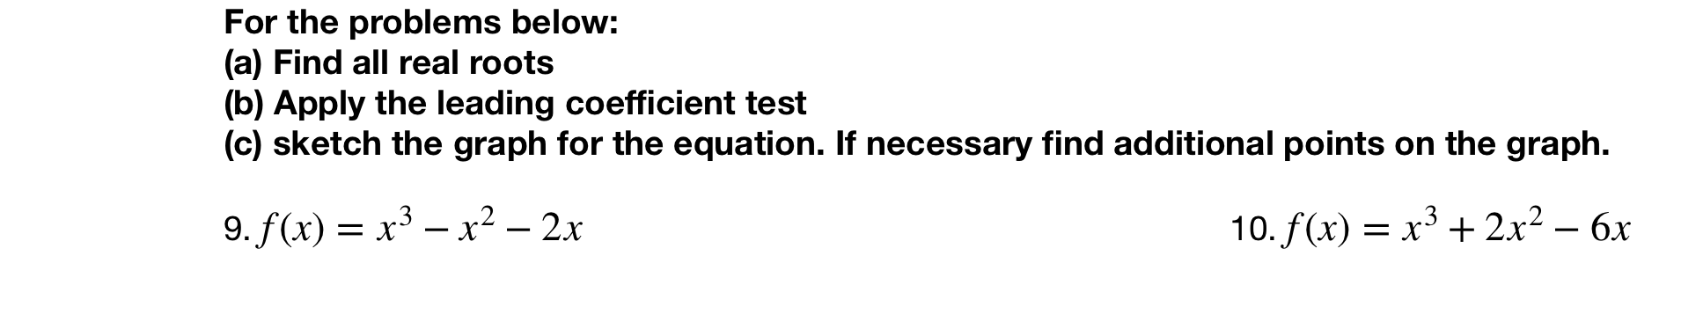
Coaching stations
be sure to: grab a calculator,ask Dr. O’Brien where to sit. Get out notebook. Read directions below!
Notes:
See answer key for detailed answers.
The test is out of 60 pts. I made question (5) extra credit.

Slide 7
Reflection
How much time did you spend studying for this examine?
For your next test, what would you do differently in terms of studying?
Announcements:
Retake next TUESDAY.
Be sure to work on post-test self assessment on Google Classroom,

