Slide 1
Fall 2021 Pre-calculus
Lesson 9.5
Dr. O’Brien
Lehman High School
November 19, 2021
Notes:
Quadratic formula

Slide 2
Do now
be sure to: find seat. Get out your binder and answer the do now questions below. Show all work or answer each question with a complete sentence.
What is your favorite video game?
How long do you think it took to create that game?
How many people do you think it takes to create a game like that?
How much money do you think it takes to create a game like that?
Notes:
ANSWERS WILL VARY.
Dr. O’Brien’s favorite game is breath of the wild. It cost 120 million to make. About 300 software developers worked on it, plus lots of other people. And it took five years.
+

Slide 3
Do now
be sure to: find seat. Get out your binder and answer the do now questions below. Show all work or answer each question with a complete sentence.
How do you think math is used in making video games?
Notes:
Lots of answers. But representing where objects are in the world and how they move is a big part of it. Also there’s lots of geometry in how shapes are represented.

Slide 4
framing
what: Use mathematical language to describe what’s happening in a video game.
why: This is the start of a unit where we’ll be using our knowledge of functions to build a video game!
where to: Evaluating mathematical expressions in the programming language PyRet.

Slide 5
Warm up: Ninja cat demo
Make a table like the one below in your notes:
Be sure too…
One partner should log in to Google Classroom. Click on Ninja Cat Game.
Take turns playing the game. Use the arrow keys to move back and forth, up and down.
First write down everything you notice. Then write down any questions that you have.
What do you notice? | What questions do you have?

Slide 6
Warm up: Ninja cat demo
What do you notice? | What questions do you have?
Notes:
Various answers. Students will notice that the cat, dog, and rubies move around. They might wonder how this works.

Slide 7
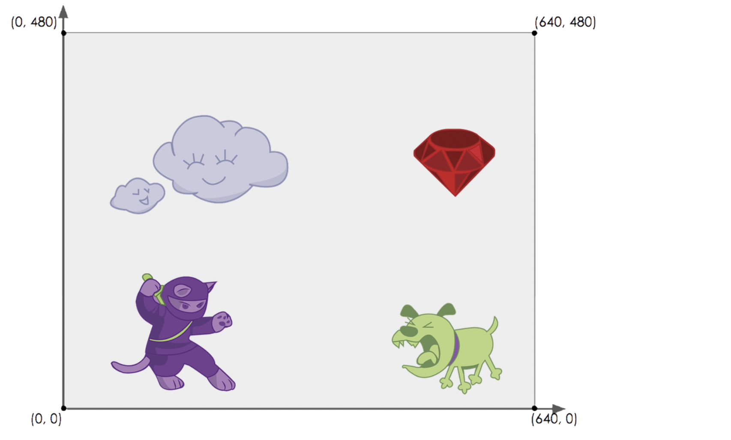
Writing to learn: Ninja cat demo
List each “thing” you see in the game. Then describe how that “thing” changes throughout the game. Be as specific as possible!
Notes:
One thing to notice is that we can assign coordinates to each ‘thing’ in the world.
+Why would it be useful for video game designers to give objects coordinates?
+How would we have to change our coordinate system in a 3D game?
Possible Misconceptions
Students are likely to describe what the character is doing, as opposed to what changes. For example: "The dog is moving to the left" is not actualy describing the property being changed (position, place, location, etc).
Students may write down what they hope is changeable, as opposed to what actually changes. It’s common for students to say they cat’s costume is changing, because they assume the cat will somehow "level up" if they get enough points.

Slide 8
Activity: Game Brainstorming
Be sure to…
Take a Game Brainstorming worksheet.
With your partner, come up with at least one idea for a game!
Every game has a BACKGROUND (where the game is set)
Every game has a PLAYER (moves up and down)
Every game has a DANGER (moves left/right - lose points if you hit!)
Every game has a TARGET (moves left/right - gain points if you hit!)
When you’re finished, ask Dr. O’Brien what to do next.
Notes:
Start 9:30 at latest.
One thing to notice is that we can assign coordinates to each ‘thing’ in the world.
+Why would it be useful for video game designers to give objects coordinates?
+How would we have to change our coordinate system in a 3D game?
When students finish direct them to template on google classrom.
END OF PERIOD: have students share out their ideas for a game.

Slide 9
Reflection
be sure to: Write an answer to question in your notebook. Then share with classmates in discussion.
How do you think math is used in making video games? How has your perception changed today?
Notes:
Lots of answers. But representing where objects are in the world and how they move is a big part of it. Also there’s lots of geometry in how shapes are represented.

Slide 10
d
Announcements
Post-test self-assessment (Google Classroom)
Due: Monday, Nov. 22
For each problem that you got wrong on assessment #2:
a. Compare your answer to the answer key (attached). Explain how to get the correct answer and what you did wrong.
b. What do you understand better now about the problem.
c. What are some questions that you still have.
Remember, do this for each problem on assessment #2, clearly labelling the question. Submit on Google Classroom.
Retake on Tuesday!
Notes:
x=-1,-4

