Slide 1
Fall 2021 AP CS A
Lesson 4.2
Dr. O’Brien
Herbert H. Lehman High School
1 March 2022

Slide 2
Do now
Let’s say you want to add a new item 7 to the array below:
int[] scores = {17, 45, 63, 22};
How would you do this? Write an algorithm in pseudocode.
Notes:
You need to make a new intermediate array scores with five items, fill the first four slots with the items from scores and then point the scores variable to scores2. Pseudocode:
scores2 = new int[5]
for i in 0:length.scores:
scores2[i] = scores[i]
scores2[4] = 7
scores = scores2

Slide 3
framing
what: represent collections of related data using ArrayLists
why: ArrayLists are much more convenient and flexible than arrays.
where to: Algorithms with ArrayLists.

Slide 4
Vocabulary
ArrayList
An adjustable array. We can add new items to ArrayLists, remove, and replace items.

Slide 5
Coding to learn: Live coding
be sure to: Log in to Workstation. Follow along, but try to stay one step ahead!
Notes:
final code for arrays:
int[] scores = {23,46,89,123};
// scores = {23,46,89,123, 75};
//How do we add a new item to an array?
int[] scores2 = new int[5];
for (int i=0; i <scores.length; i++){
scores2[i] = scores[i];
}
scores2[4] = 75;
scores = scores2;
for(int score: scores){
System.out.print(score+", “);
final code for arraylists
// input scores = {23,46,89,123}; as an ArrayList
ArrayList<Integer> scores = new ArrayList<Integer>();
scores.add(23);
scores.add(46);
scores.add(89);
scores.add(123);
System.out.println(scores);
//How do we add a new item 67 to an array?
scores.add(67);
System.out.println(scores);
//access the 3rd item in the ArrayList
System.out.println(scores.get(2));
//get size of ArrayList
System.out.println(scores.size());
//replace 3rd item with 17
scores.set(2,17);
System.out.println(scores);
//remove 3rd item
scores.remove(2);
System.out.println(scores);
Comment: Notice you need Java.util.* for arraylists.

Slide 6
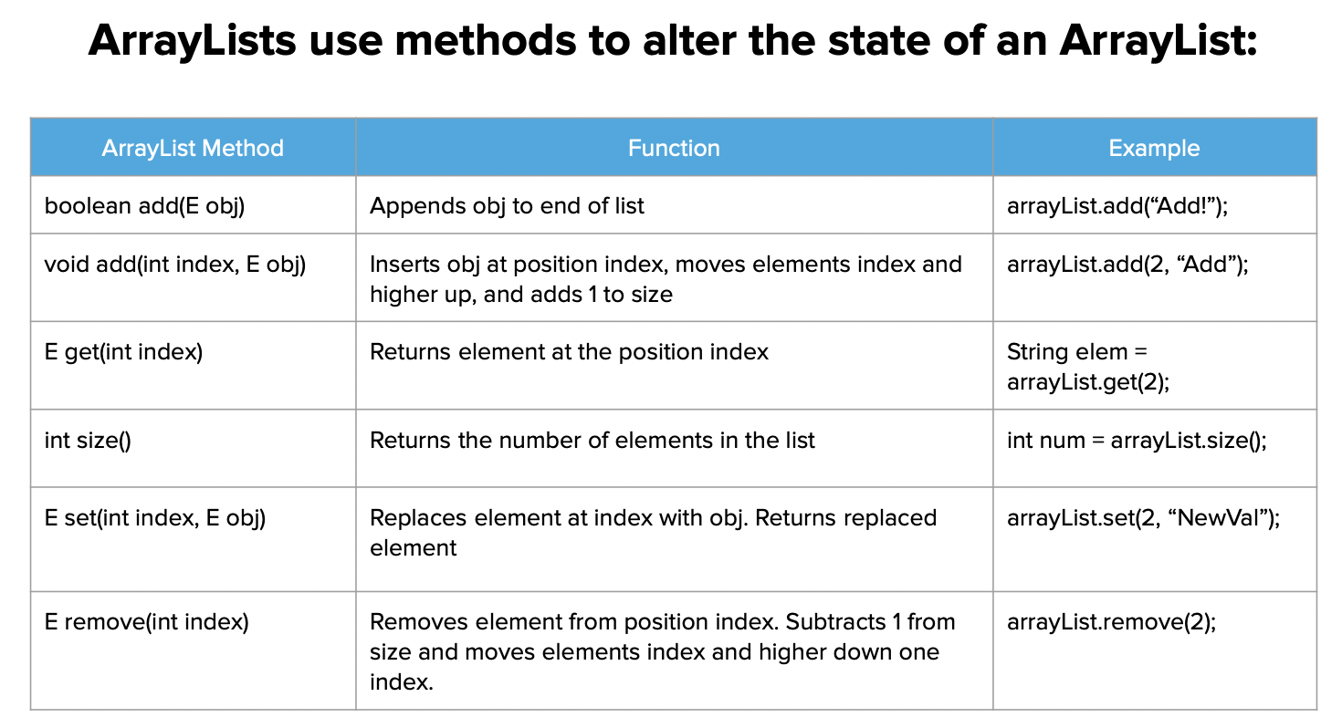
Independent work
be sure to: Complete exercises in lessons 6.1 and 6.1(ArrayLists) on CodeHS!
Notes:
In order to make use of the ArrayLists we create, we need to learn some of the methods that make them useful. ArrayLists offer a series of methods that allow us to alter the state of an ArrayList. In this lesson, we are going to explore some of the more useful methods that may be tested on the AP exam. These methods will be included on your Java Quick Reference.
See problem guides on CodeHS for detailed solutions.

Slide 7
Reflection: Thinking about thinking
be sure to: Answer each question below with a complete sentence. Be prepared to share out!
How would you add the double 75.6 to the end of an ArrayList of Doubles named myDoubles?
How do you create an ArrayList of integers?
What must be done before using ArrayLists?
Notes:
How would you add the double 75.6 to the end of an ArrayList of Doubles named myDoubles?
myDoubles.add(75.6);
How would you print out the value in the fourth index of an ArrayList of Doubles named myDoubles?
System.out.println(list.get(4));
Consider the following code segment.

