Slide 1
Fall 2021 Precalc
Lesson 6.1
Dr. O’Brien
Herbert H. Lehman High School
14 March 2022
Notes:
VOCAB
identity matrix

Slide 2
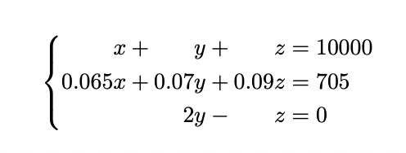
Do now…Get out your notebook/binder. Write down the date and goal. Be Sure to carefully answer the questions below.
You decide to invest in AAA-rated bonds, A-rated bonds, and B-rated bonds. The average yields are: 6.5% for AAA-rated, 7% for A-rated, and 9% for B-rated bonds. Your financial advisor tells you to buy twice as many B-rated bonds as A-rated bonds.
How How is the system of linear equations to your right related to this problem?
How could you transform this system into a matrix equation?

Slide 3
framing
what: use Gauss-Jordan elimination to find the inverse of a matrix
why: this lets us quickly solve lots of systems of linear equations
where to: solving linear systems in Python

Slide 4
B24 rules
Welcome to our new room, B24! Please read the information below:
When you come in, please find a seat at a desk (if one’s available) or one of the six closest desks to the screen. Do not sit in the back of the classroom. We’ll conduct the do now and mini lesson from here.
When I dismiss you for independent work, find a sit at one of the computer workstations.
No food or drink by the computers.
At the end of the period, you’ll be directed to assemble for the exit ticket/debrief. Log out of your computer, and quietly return to a seat near the front.

Slide 5
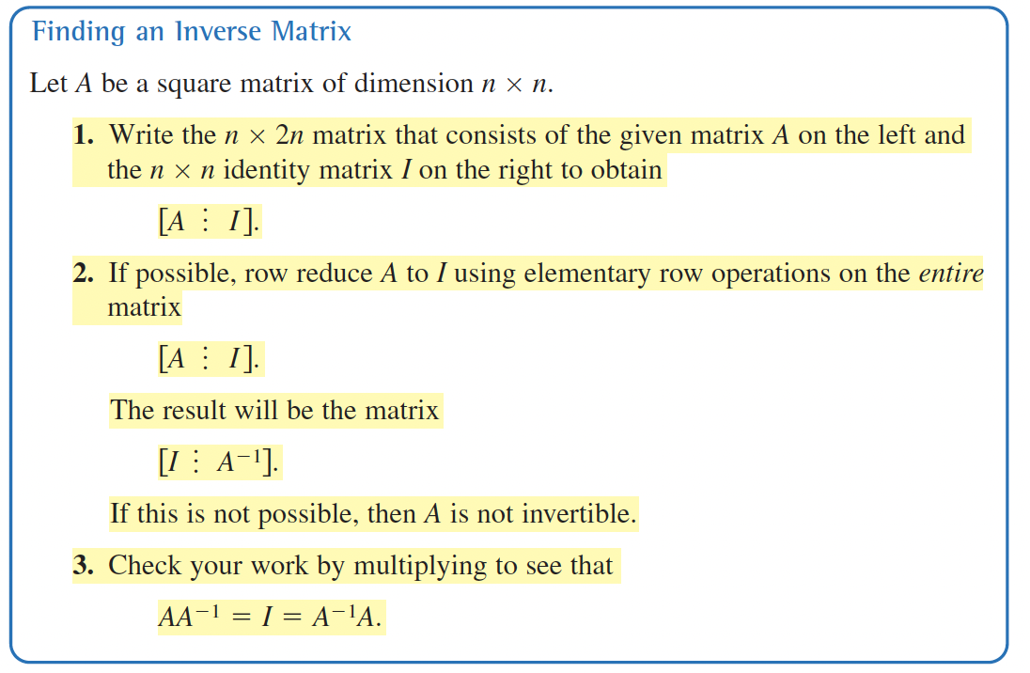
Mini-lesson
Be sure to… Follow along on the board! Info below should be in your notes (copy if it’s not there already)
Matrix inverse
$A$ is an $n×n$ square matrix.
$I_{n}$ is an $n×n$ identity matrix.
If there is a matrix $A^{-1}$ such that
$A×A^{-1}=A^{-1}×A=I_{n}$
Then $A^{-1}$ is called the inverse of $A$.
If we know the inverse $A^{-1}$ for an invertible matrix $A$, then we can solve for $X$, the variable matrix.
A matrix is invertible if it has an inverse.
Notes:
SEE HAND WRITTEN LP.

Slide 6
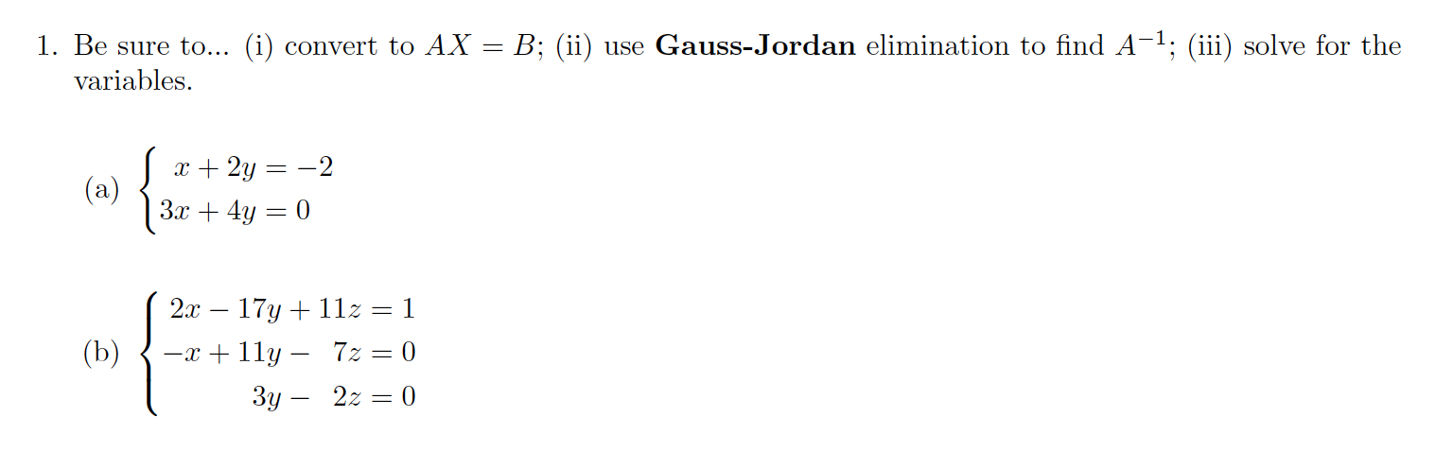
Independent work
Be sure to… Take worksheet. Do your work in the notes. Show all your work! Be prepared to hand in on Google Classroom!.

Slide 7
Independent work
Be sure to… Take worksheet. Do your work in the notes. Show all your work! Be prepared to hand in on Google Classroom!.
You decide to invest in AAA-rated bonds, A-rated bonds, and B-rated bonds. The average yields are: 6.5% for AAA-rated, 7% for A-rated, and 9% for B-rated bonds. Your financial advisor tells you to buy twice as many B-rated bonds as A-rated bonds.
How could you transform this system into a matrix equation? (same as do now)
Use the matrix inverse to determine how much you invested in each class of bonds.
Use Gauss-Jordan elimination and matrix inverses to determine how much you should purchase of each class of bonds. Write a sentence explaining why your answer makes sense
.

Slide 8
wrapping up!
be sure to: read the directions below!
Make sure there isn’t any litter near your workstation.
If you borrowed headphones, sign them back in.
Make sure you are logged out of your computer!
Remain in your seat until the bell rings.

