Slide 1
Fall 2021 Precalc
Lesson 9.1
Dr. O’Brien
Herbert H. Lehman High School
29 March 2022
Notes:
VOCAB
adjugate
determinate

Slide 2
Do now…Get out your notebook/binder. Write down the date and goal. Copy the vocab below:
Transpose
If $A^{T}$ is the transpose of $A$ than the first row of $A$ becomes the first column of $A^{T}$, and so on.
Cofactor matrix
The cofactor matrix $C$ for a matrix $A$ replaces every element $a_{i,j}$ in $A$ with its cofactor $c_{i,j}$ in $C$
Adjugate
The adjugate of a matrix A $\text{adj}(A)$ is the transpose of the cofactor matrix $C^{T}$

Slide 3
framing
what: find the adjugate of a matrix
why: This let’s us find the inverse of any square matrix (if there is one)
where to: Use inverse of matrix to solve problems

Slide 4
Warm up: Stop ’n’ Jot
Be sure to… Answer the question below in at least two complete sentences, in your notes. Use the four formulas below in your answerBe prepared to share out!
Explain why it’s useful to find the determinant of a matrix. Use the four formulas below in your answer:
1. $AX=B$ 3.
2. $X=A^{-1}B$ 4.
$$A^{-1}=\frac{\text{adj}(A)}{\text{det}(A)}$$
$$X=\frac{\text{adj}(A)}{\text{det}(A)}B$$
Notes:
A system of linear equations can be represented as the matrix eq. AX = B, meaning X = A^-1 * B. Because we know that the inverse A^-1 = adj(A)/det(A), if we find the adjugate and determinant then we can find the matrix X, meaning we can solve the system.

Slide 5
Mini-lesson Be sure to copy the notes below and on the board in your notebook & ask questions!
Transpose
If $A^{T}$ is the transpose of $A$ than the first row of $A$ becomes the first column of $A^{T}$, and so on.
Find the transpose for this matrix:
$$\left[\begin{matrix}-8 & -2 & -2 \\ 2 & -2 & -2 \\ 9 & 1 & 6\end{matrix}\right]$$
Notes:
PP#1: M_11 = det ( [ -1 2, 0 1]) = -3
M_23 = det ( [ 0 2, 4 0]) = -8
PP2
C_11 = (-1)^{2) M_11 = -3
C_23 = -M_23 = 8

Slide 6
Mini-lesson Be sure to copy the notes below and on the board in your notebook & ask questions!
Cofactor matrix
The cofactor matrix $C$ for a matrix $A$ replaces every element $a_{i,j}$ in $A$ with its cofactor $c_{i,j}$ in $C$
Adjugate
The adjugate of a matrix A $\text{adj}(A)$ is the transpose of the cofactor matrix $C^{T}$
$$A=\left[\begin{matrix}1 & 3 & -2 \\ -1 & 3 & 1 \\ 0 & 2 & -2\end{matrix}\right]$$
If $C$ is the cofactor matrix of $A$, find the determinant and adjugate of $A$,
then find $A^{-1}$.
$$C=\left[\begin{matrix}-8 & -2 & -2 \\ 2 & -2 & -2 \\ 9 & 1 & 6\end{matrix}\right]$$
Notes:
C^T =
-8. 2. 9
-2 -2 1
-2. -2. 6
det(A) = 1(-8) + 3(-2) + (-2)-2 = -8 - 6 + 4 = -10
A^-1 =

Slide 7
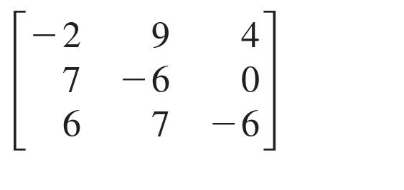
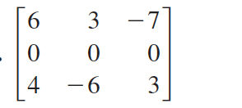
Independent work Be sure to:
Copy notes below (if you came in late).
Do problems to your left in your notebook..
Work silently for the first 4 minutes. After that you can check in with your neighbor.
Use the adjugate and determinant calculator on Google Classroom to find the inverse for the matrices below, if there is one:
Explain in a sentence how the cofactors of a matrix are used to find its inverse.
a.
Transpose
If $A^{T}$ is the transpose of $A$ than the first row of $A$ becomes the first column of $A^{T}$, and so on.
b.
Cofactor matrix
The cofactor matrix $C$ for a matrix $A$ replaces every element $a_{i,j}$ in $A$ with its cofactor $c_{i,j}$ in $C$
Adjugate
The adjugate of a matrix A $\text{adj}(A)$ is the transpose of the cofactor matrix $C^{T}$
Notes:
see answer key for solutions
pre-planned questions:
+How do you find the adjugate/determinant? use the formulas on the board!!!
+How can I use the adjugate/determinant to find the inverese? adj(A)/det(A)
+How do I convert to AX=B? A is the coefficient matrix, X reprsents the variables and B the solutions
+Why can’t I just use substitution? Because we’re practicing using adjugates and determinates. It might seem silly here, but with bigger matrices it will be a LOT easier.

Slide 8
Reflection: Thinking about thinking
be sure to: Answer each question below with a complete sentence. Be prepared to share out!
Why do you think it’s important to find the cofactor and minor of a matrix (think back to framing)?
What’s one thing you’d like to understand better after today’s lesson?
Notes:
last five minutes of class. share out.

Slide 9
wrapping up!
be sure to: read the directions below!
Make sure there isn’t any litter near your workstation.
If you borrowed headphones, sign them back in.
Make sure you are logged out of your computer!
Remain in your seat until the bell rings.

