Slide 1
Fall 2021 Python
Lesson 9.1
Dr. O’Brien
Herbert Lehman High School
4 April 2022

Slide 2
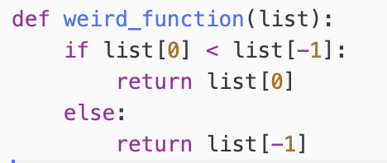
Do now
Get out your notebook/binder. Write down the date and goal. Be sure to:answer the questions below:
What does the function below do? Explain in a complete sentence
What do you think a return statement does?
Notes:
IT will get an error message, because strings are immutable
your OSIS, your birthday. things that are mutable include your age, since it changes, along with your grade.
Strings are immutable. It cannot be changed (that’s why you get an error in (1)

Slide 3
framing
what: use a return statement in Python
why: Return statements are crucial to writing sophisticated functions
where to: Using lists and tuples to solve computational problems.

Slide 4
Work day
be sure to:
be sure to:
Find your seat
Read through the Weekly goals to the right and the framing below.
Copy the vocab in your notes (if it’s not there already
Begin work! Raise your hand quietly if you have any questions
tuple
A data structure that holds a collection of objects in a particular order. Unlike lists, tuples are immutable.
List
A data structure that holds a collection of objects in a particular order. Lists are mutable.
Weekly Goal:
Complete up through unit 9
After, that complete Python word game: Part 1
mutable
Able to be changed. Something which is immutable cannot be changed.
Notes:
Make sure students are working quietly. See CodeHS problem guides for specific Python activities.
Frequently asked questions:
+I don’t know what to do!?! Make sure to carefully read the instructions. Take notes when watching the video.
+What are you trying to do with your program? answers will vary, direct student to assignment instructions.
+how can I figure out why my code doesn’t work? Try getting out a piece of paper, and following your commands yourself. What do you draw. Where do things go wrong?
+What do I do if I forget a command? See the docs section of CodeHS.

Slide 5
wrapping up!
be sure to: read the directions below!
Make sure there isn’t any litter near your workstation.
If you borrowed headphones, sign them back in.
Make sure you are logged out of your computer!
Remain in your seat until the bell rings.

Slide 6
Cell phone distro
be sure to: Carefully read the directions below
a. Students will receive their phones at the end of 9th period and 10th period.
b. Students without a phone may leave class immediately. All other students should remain seated. Once a student collects their phone, they should exit the classroom.
c. Students must show their ID, program, or a notebook with their name on it to receive their phone.

