Slide 1
Fall 2021 Java
Lesson 9.2
Dr. O’Brien
Herbert H. Lehman High School
November 16, 2021
Notes:
VOCAB:

Slide 2
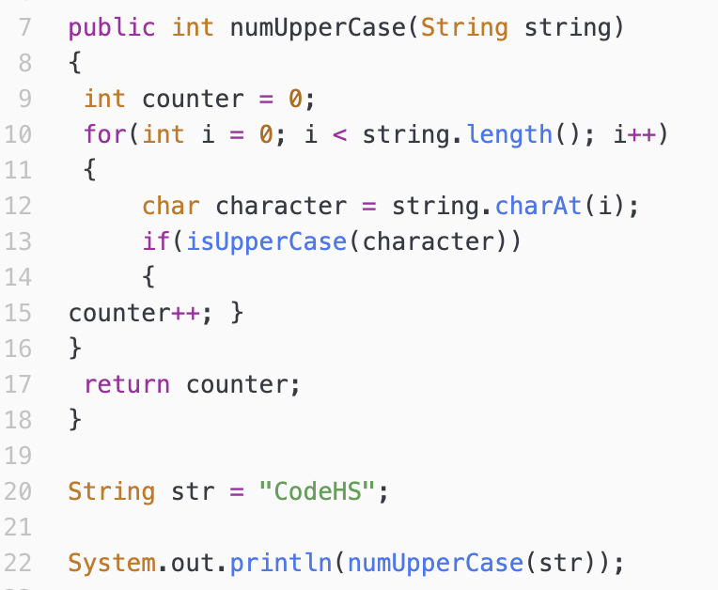
do now
be sure to: Get out your binder. Copy goal and answer do now questions below. Show all work or write a complete sentence for each answer:
Review your exit ticket from yesterday.
What is the predicted output for this program?
How was code tracing useful to making your prediction?
Notes:
it should output 3, since there are 3 uppercase letters.
it helps us see what’s happening each step of the computations, especially for each iteration of a loop.

Slide 3
framing
what: use for loops to traverse a string?
why: This will provide us with a powerful set of tools to manipulate strings.
where to: Practice building algorithms that manipulate strings.

Slide 4
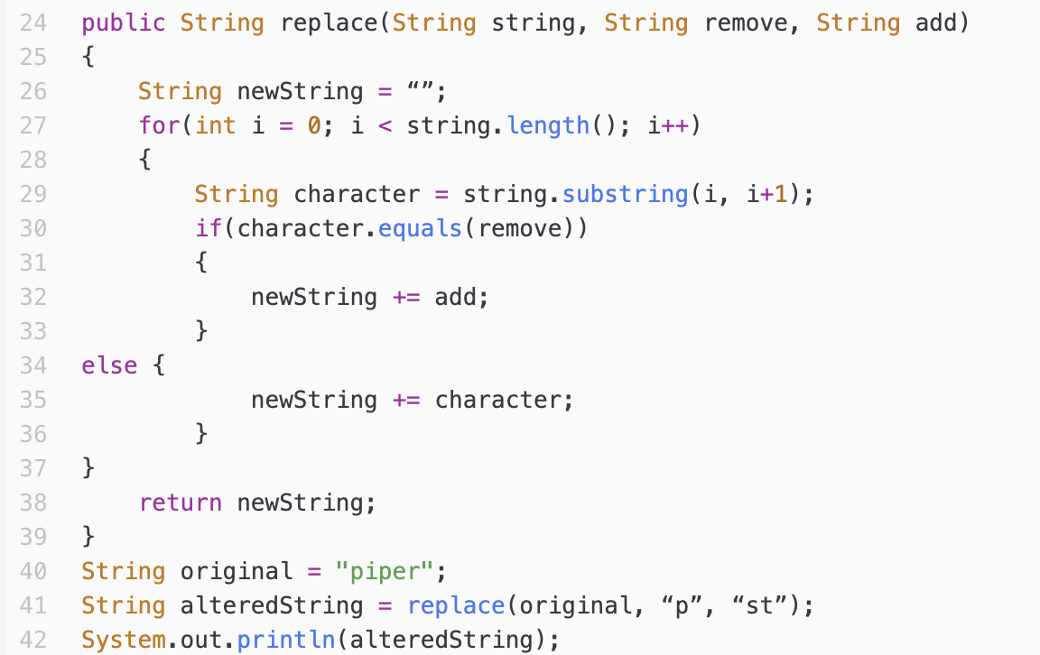
Warm up: Code Tracing
be sure to: Keep your notebook open. Make a column for code tracing. Use code tracing table to determine output of this program.
Notes:
string. length = 5
+Why do you think substring is used here instead of charAt()? Because the .equals() method will compare it with a string. You. can’t compare a string and a character.
+What columns will you want to have in your table? i, character, and newString. You don’t need one for remove, add, and length() because these remain the same throughout the life of the program.
original = piper
remove = “p”
add = “st”
| i | character | newString
| - | - | “”
| 0 | “p” | “st”
| 1 | “i” | “sti”
| 2 | “p” | “stist”
| 3 | “e” | “stiste”
| 4 | “r” | “stister”

Slide 5
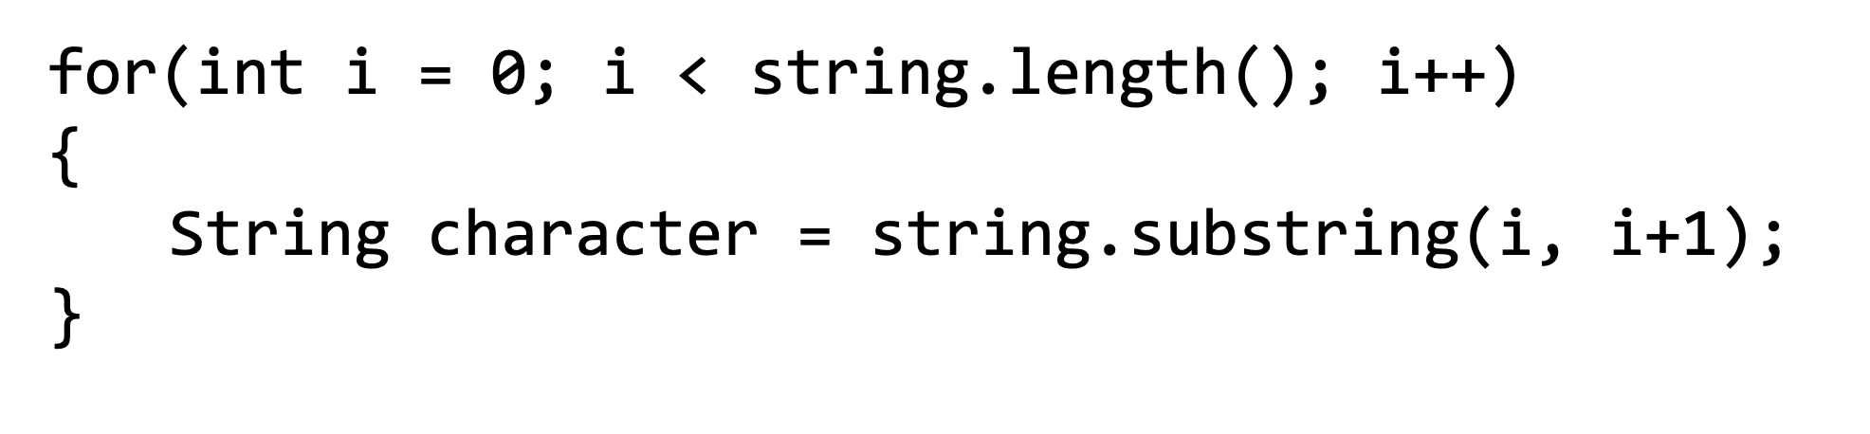
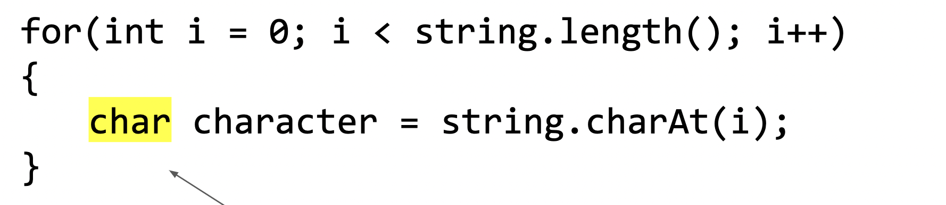
Vocab
be sure to: Keep your notebook open. Copy each definition, including the code sample, in your Java Glossary.
General formula for traversing a String string
Traversal
The process of going through a string one character at a time, often using loops.
string.charAt(int index)
Another way to accessing individual characters in a string
Notes:
review from yeterday.

Slide 6
Writing to learn: planning
be sure to: Keep your notebook open. Write out a description of your algorithm in pseudocode. Don’t worry about Java specifics!
Create an algorithm to reverse the order of the string.
If the string is “Rafiki Holder” it should output “redloH ikifaR”
Notes:
+HDW start? think of a specific example. write down what you do, being very explicit about each step, to reverse this.
+It’s useful to plan a program before you actually go and write it.
Start with first character. Put that at front of a new empty string. Then move to second letter, also place that at the front of the newstring. continue until you run out of letters.
newString = “”
for character in string:
newString = character + newString;
return newString

Slide 7
Coding to learn
be sure to: Log in to Workstation and navigate to CodeHS. Go to Nov. 16 Reversal under In Class Examples. Implement your algorithm in Java!
Now implement your algorithm for string reversal.
Remember; If the string is “Rafiki Holder” it should output “redloH ikifaR”
Notes:
+HDW use our planning work to implement our algorithm? Just transform your pseudocode into Java.
+How do you know whether to use charAt or substring? Try both! in this case you’ll have to use substring
// implement reverse method here
String newString = "";
for (int i = 0 ; i<str.length(); i++){
String character = str.substring(i,i+1);
newString = character + newString;
}
return newString;

Slide 8
Coding to learn
be sure to: Log in to Workstation. Work on CodeHS exercises below. Make sure to plan before you start coding.
General formula for traversing a String string
Exercise 4.3.7: Password checker
Exercise4.3.9: Fixing grammar
Notes:
ASSIGN AS HOMEWORK
+How could you use .indexOf() to solve the password checker assignment?
+How is fixing grammar similar to the ‘remove’ method we discussed in the mini-lesson?

Slide 9
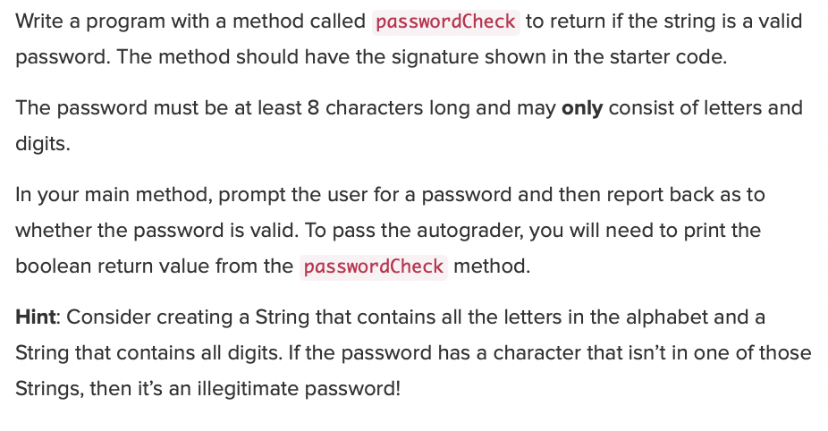
Coding to learn
be sure to: Log in to Workstation. Work on CodeHS exercises below. Make sure to plan before you start coding.
Notes:
+How could you use .indexOf() to solve the password checker assignment?
+How is fixing grammar similar to the ‘remove’ method we discussed in the mini-lesson?

Slide 10
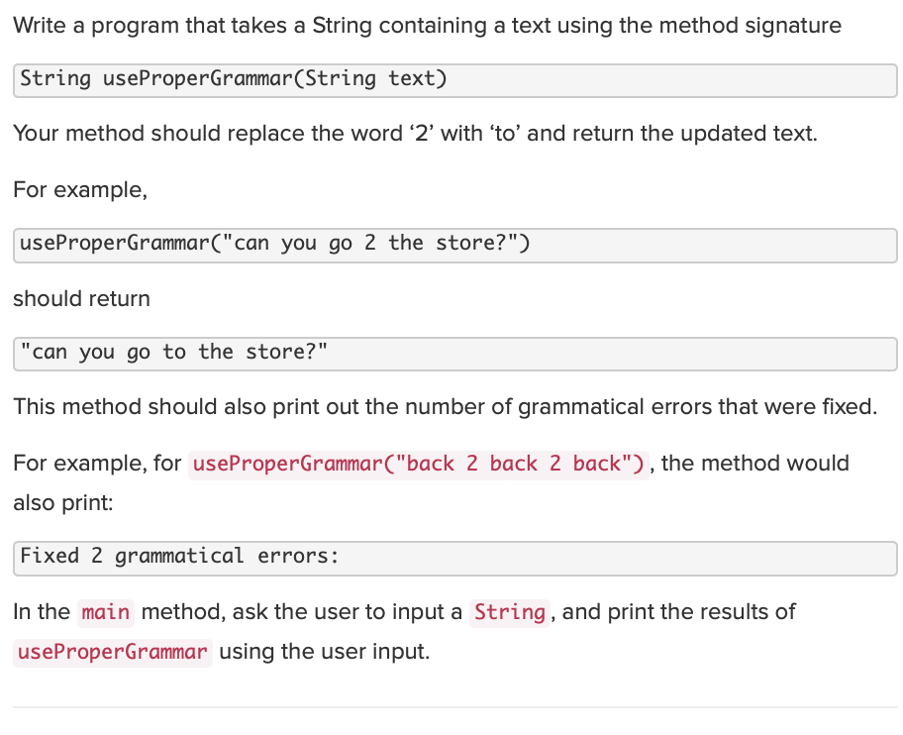
Coding to learn
be sure to: Log in to Workstation. Work on CodeHS exercises below. Make sure to plan before you start coding.
Notes:
+How could you use .indexOf() to solve the password checker assignment?
+How is fixing grammar similar to the ‘remove’ method we discussed in the mini-lesson?

Slide 11
Reflection: Thinking about thinking
be sure to: Answer each question below with a complete sentence.
Why is it useful to apply loops to strings?
Do you think the algorithms we’ve learned about today can only work in Java? Or are the applicable for other programming languages? Explain why or why not
Notes:
Strings are sequences of characters. This sequence can be traversed with a for loop. We can traverse a string and perform various operations on individual characters.
Loops strings and characters appear in most other languages, including python. so these algorithms are not Java specific.

