Slide 1
Fall 2021 Precalc
Lesson 2.5
Dr. O’Brien
Herbert H. Lehman High School
11 February 2022

Slide 2
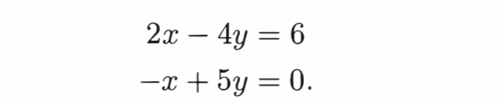
Do Now
Be sure to…Get out your notebook/binder. Read the paragraph below carefully, then answer the questions below. Show all work and check your results!
Solve for $x$ and $y$, using any method you choose.
What does row-echelon form mean?
Describe the steps for solving this system using Gaussian elimination.
Notes:
We want the pivot to become x. Multiply row 1 by 0.5. Add to row 2:
x - 2y = 3
-x + 5y = 0
—————-
3y = 3
y = 1
x=5
+why are we multiplying the first row by 1/2, instead of multiplying row two by 2? Both strategies work. But we want to develop an algorithm that we can use over and over again, so we don’t have to think about it. The algorithm says multiply row 1 by -(a/b), where a is the coefficient we want to zero out and b is the pivot. Then add two rows
Color pivot and target coefficient differently from rest of eq. On board.
Algorithm (write on small board)
Identify pivot (2) and coefficient to be zeroed out (-1). Divide coefficient by pivot to get multiplier: -1 / 2
Multiply pivot row by -1/2. Add to second row. Replace second row with the sum.

Slide 3
B24 rules
Welcome to our new room, B24! Please read the information below:
When you come in, please find a seat at a desk (if one’s available) or one of the six closest desks to the screen. Do not sit in the back of the classroom. We’ll conduct the do now and mini lesson from here.
When I dismiss you for independent work, find a sit at one of the computer workstations.
No food or drink by the computers.
At the end of the period, you’ll be directed to assemble for the exit ticket/debrief. Log out of your computer, and quietly return to a seat near the front.

Slide 4
framing
what: use Gaussian elimination to solve multivariate systems of equations
why: Gaussian elimination is a powerful method for solving systems of equations. It’s what computers use.
where to: representing systems of equations as matrices

Slide 5
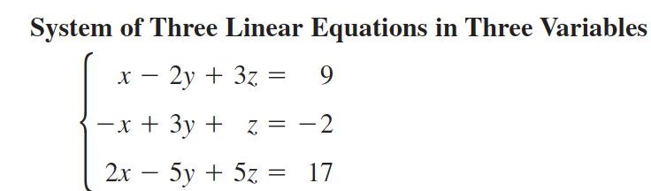
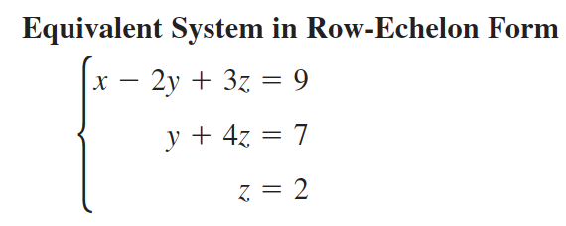
Row-echelon form (review)
To solve systems with more than two variables, we want to transform the system into row-echelon form:
A system is in row-echelon form if it has a stair-step pattern and each equation has a leading coefficient of 1.

Slide 6
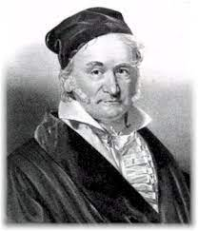
Row operations (review)
Gaussian elimination involves three row operations:
Exchange equations
Multiply one of the equations but some number (but not zero)
Add one equation to a multiple of another equation
Johann Gauss, the guy who came up with this algorithm

Slide 7
Independent work
Today we’ll be working on Pset #2.
If you choose to work in a group with Dr. O’Brien
Be sure to:
Sit at a desk.
Ask questions!
If you feel confident enough to do the pset on your own…
Be sure to:
Move to a seat near a computer.
Follow directions carefully.
Use answer key on Google Classroom.
Feel free to work with a partner!
Notes:
See pset 2 for work.
See answer key for detailed solutions

Slide 8
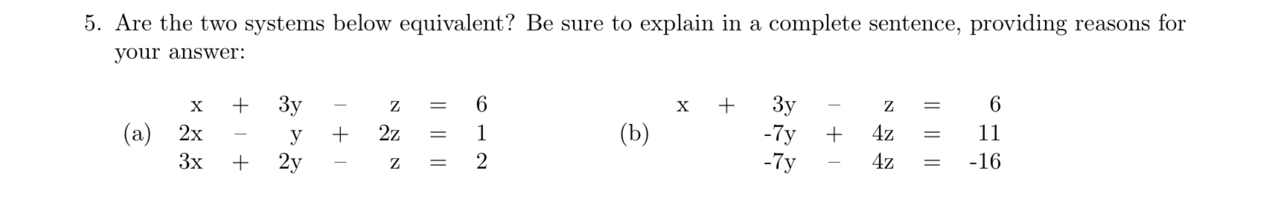
Reflection
Notes:
possible exit ticket.
See answer key for detailed solution

Slide 9
wrapping up!
be sure to: read the directions below!
Make sure there isn’t any litter near your workstation.
If you borrowed headphones, sign them back in.
Make sure you are logged out of your computer!
Remain in your seat until the bell rings.

