Slide 1
Fall 2021 Precalc
Lesson 6.4
Dr. O’Brien
Herbert H. Lehman High School
17 March 2022
Notes:
VOCAB
identity matrix

Slide 2
Do now…Get out your notebook/binder. Write down the date and goal. Be Sure to read the announcements below. Write down any questions you have.
Quiz on Monday. Review today. This quiz will count towards MP2.
Test corrections will be available for the free response questions on the last assessment. Come to 8th period tutoring for this (if you can’t make it let me know and we’ll work something out. You have until next Wednesday to do this.
Notes:
answers will vary. students might notice that A almost looks like an identity matrix, except that the top left pivot is 2 instead of 1
This will be identical to B except taht the elements of the first row will be X2

Slide 3
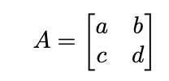
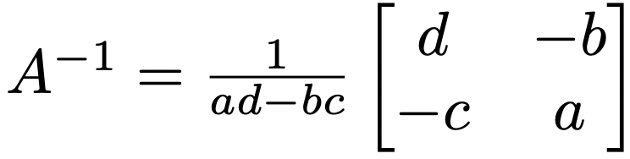
One easy trick to find the inverse of a $2×2$ matrix!!
You might have noticed that the inverse of a 2X2 matrix often has the same numbers, just switched around. This isn’t an accident.
Assume:
Then we can easily find the inverse using the formula below:
If $ad-bc=0$ then the matrix has no inverse!
Notes:
HDW use the rule to find the inverse of
[ 4 5
3 4 ]
??

Slide 4
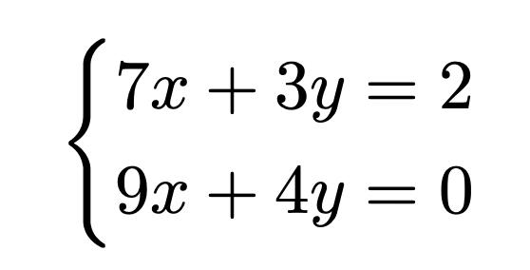
Today’s activity: prequiz review
Be sure to…
For matrices A and B (see left board), showing all work, calculate:
$$2B$$
$$A+B$$
$$2(A×B)-B$$
Answer the questions below in a complete sentence each:
What has to be true about two matrices X and Y in order for you to be able to add or subtract them?
What has to be true about two matrices X and Y in order for you to be able to multiply $X×Y$?
Be sure to... (i) convert to $AX=B$; (ii) find $A^{-1}$; (iii) solve for the variables with $X=A^{-1}B$.

Slide 5
wrapping up!
be sure to: read the directions below!
Make sure there isn’t any litter near your workstation.
If you borrowed headphones, sign them back in.
Make sure you are logged out of your computer!
Remain in your seat until the bell rings.

