Slide 1
Fall 2021 Pre-calculus
Lesson 11.3
Dr. O’Brien
Lehman High School
1 December 2021

Slide 2
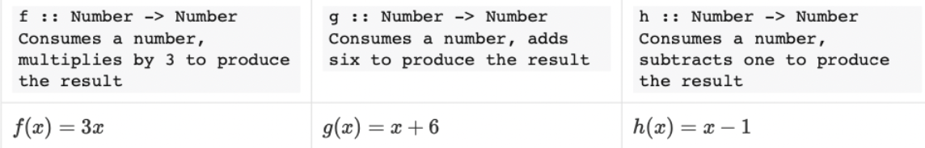
do now
be sure to: find seat. Get out your binder and answer the do now questions below. Show all work or answer each question with a complete sentence.
If $x=3$, then what will $g(h(x))$ equal?
How else could we write $g(h(x))$?
Notes:
8
g o h (x)

Slide 3
framing
what: diagram function composition using circles of evaluation
why: In this unit we’ll be applying our mathematical knowledge to make a video game using the programming language Pyret. Composing functions is a big part of this.
where to: Next we explore using function composition to draw complex images in Pyret

Slide 4
Circles of evaluation review
We’ll use something called the Circles of Evaluation. The rules are simple:
Every Circle must have one - and only one! - function, written at the top
The inputs to the function are written left-to-right, in the middle of the Circle.
Circles can contain other circles.

Slide 5
Assume $x=5$.
How could you compose these functions to turn 5 into 10? How about 20? Be sure to answer in notebook.
Try to draw a circle of evaluation for each composed function in (1).
Notes:
Answers will vary g(h(f(x)) is one way. also h(g(x))
Draw circle of evaluations for each solution. Elicit from students

Slide 6
activity
be sure to: complete worksheet with partner, using circles of evaluation and standard mathematical notation.
We’ll use something called the Circles of Evaluation. The rules are simple:
Every Circle must have one - and only one! - function, written at the top
The inputs to the function are written left-to-right, in the middle of the Circle.
Circles can contain other circles.
Notes:
Answers will vary g(h(f(x)) is one way. also h(g(x))

Slide 7
activity
be sure to: complete worksheet with partner, using circles of evaluation and standard mathematical notation.
Bonus questions
How could you rewrite these composed expressions using the $∘$ notation?
Why is there a difference between $f(g(h(x))$ and $g(f(h(x))$? What does this tell us about function composition?
Assume $f(x)=\sqrt{x-2}$ and $g(x)=2+3x^{2}$.
Write contracts for each function. Be sure to use the examples on your worksheet as a guide.
Find the domain and range for $(f∘g)(x)$.
How could you use the contracts for the functions to identify the domain for the composed function?
Notes:
E.g. (f o( g o h))(x).;important to remember that each side of o is a function

Slide 8
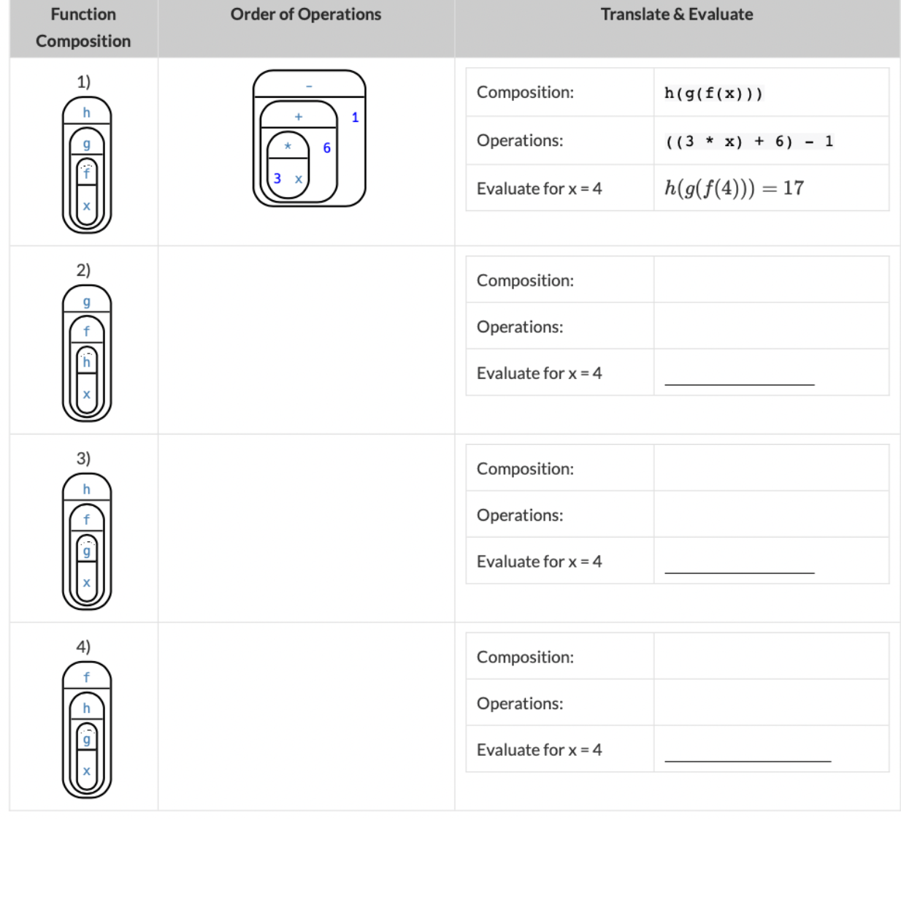
activity
be sure to: complete worksheet with partner, using circles of evaluation and standard mathematical notation.
Notes:
See teacher resources for full answers.

Slide 9
d
Reflection: Thinking about thinking
be sure to: Answer each question below with a complete sentence in your notebook. Be prepared to share out with your partner and the group.
How could you describe the relationship between the contracts we learned about yesterday and domain/range?
How are domain and range import for for understanding function composition?
Notes:
Answers will vary. Some contracts have more arguments than others, error messages help by telling you exactly what sort of arguments you need. Students may also notice annotations specifying the type of an argument in their error messages.

