Slide 1
Fall 2021 AP CS A
Lesson 15.2
Dr. O’Brien
Herbert H. Lehman High School
4 January 2022

Slide 2
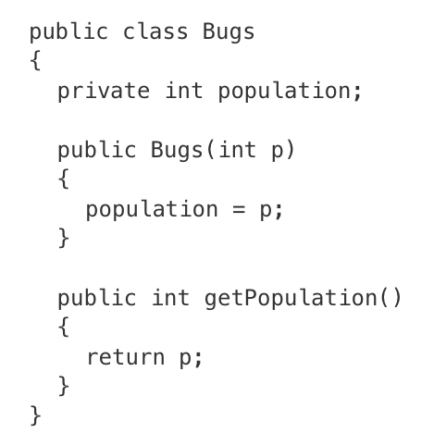
Do now
be sure to: Get out your binder. Copy goal and answer do now questions below. Answer the questions below and write a sentence justifying your answer.
Consider the following Bugs class, which is intended to simulate variations in a population of bugs. The population is stored in the method’s int attribute. The getPopulation method is intended to allow methods in other classes to access a Bugs object’s population value; however, it does not work as intended.
The getPopulation method should be declared as private .
The return type of the getPopulation method should be void.
The getPopulation method should have at least one parameter.
The variable population is not declared inside the getPopulation method.
The instance variable population should be returned instead of p, which is local to the constructor.
Notes:
answer: E.

Slide 3
framing
what: define the behavior of an object using mutator methods
why: We want to develop facility with writing mutator methods, so we can efficiently write more complex classes.
where to: How to change formal parameters in methods

Slide 4
Vocab (review)
be sure to: Keep your notebook open. Copy the definitions in your notebook, if they are not there already.
getter method
Allows us to access specific instance variables in an object. Aka accessor methods.
setter method
Allows us to change specific instance variables in an object. Aka mutator methods

Slide 5
Coding to learn: Independent work
be sure to:
Go to your workstation.
Watch the video 5.5.1: Mutator Methods
Work on following problems in CodeHS:
5.5.5: Student Setters
5.5.6: Full Fraction Class
5.5.7: Weekly routine
5.4.8 A Chef’s best Meal
We’ll go over the exercises at tehe end of class!
Notes:
see for full solutions: https://codehs.com/library/solution_references/assignment/55325729?section_id=256470tructor.
Pre-planned questions:
5.5.5
+Why aren’t the setter methods properly setting the instance variables?
You might have reversed the order of assignment when setting the new value of the instance variables. The instance variable should be on the left, and the new value should be assigned to the instance variable.
+How do I implement getArea and getPerimeter?
These methods rely on the width and height instance variables. The area of a rectangle is width*height, and the perimeter is 2*(width+height).
5.5.6
+How can I add or subtract Fractions?
Fractions can be added or subtracted when a common denominator is found. The easiest way to do this is to multiply the value of one denominator to the other, and make the correct conversions to the numerator.
+I’m confused about implementing these methods!
add, subtract and multiply all take another Fraction object as a parameter. In each method, the only Fraction that is changing is the Fraction that called the method. Only the denominator and numerator instance variables should change, not the ones related to the other Fraction. Those should be used, however, by calling the getNumerator and getDenominator methods.
5.5.7
+How do I calculate the weekly hours and the grand total?
In the printTotal method, there should be some calculations that help determine how many hours are being used per week. The instance variables should be multiplied by 7 to get the total number of hours per week that a Student is doing the different activities. Each calculation should be added together to compute the grand total.

Slide 6
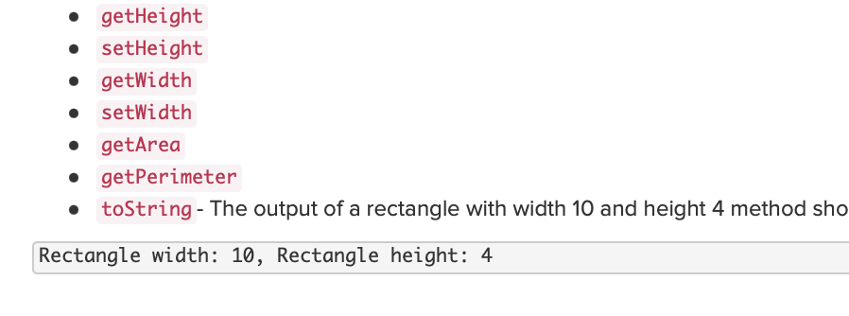
Practice problem 5.5.5
be sure to: Review your work. Be prepared to share out!
Notes:
+students share out

Slide 7
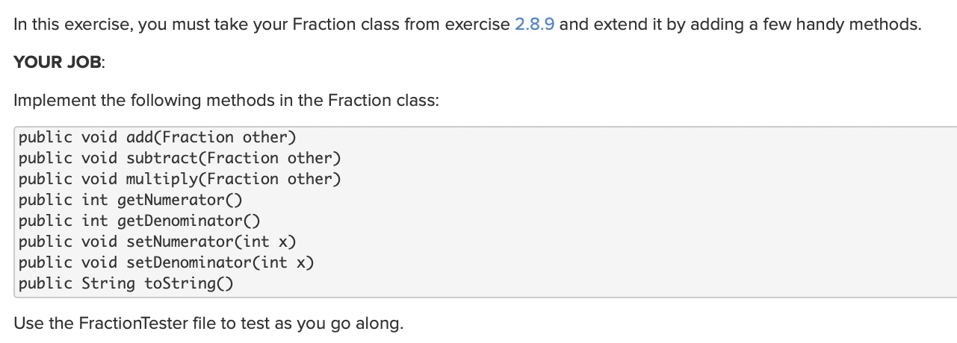
Practice problem 5.5.6
be sure to: Review your work. Be prepared to share out!
Notes:
+students share out

Slide 8
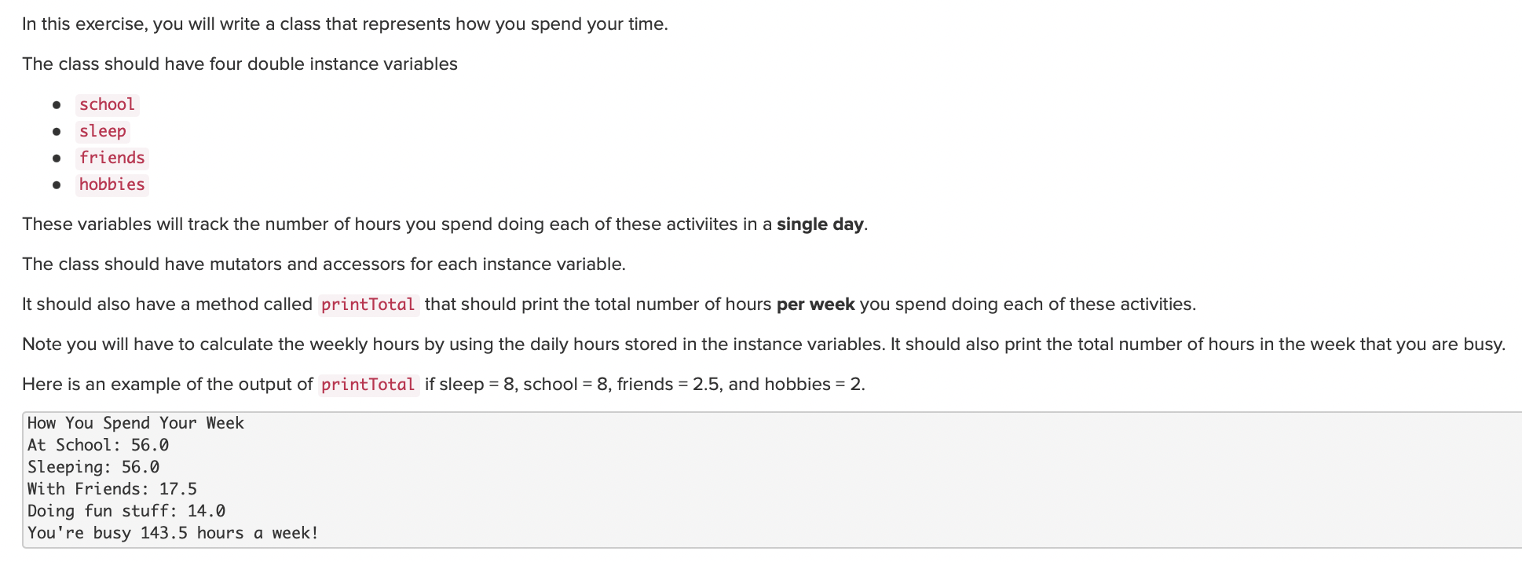
Practice problem 5.5.7
be sure to: Review your work. Be prepared to share out!
Notes:
+students share out

Slide 9
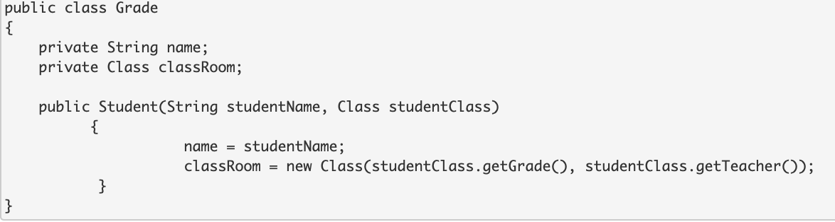
Exit ticket
be sure to: Get out a sheet of loose leaf paper. Write your name and the date on the top. Answer each question below with a complete sentence. Be prepared to turn in!
Consider the code below:
write a setter method for name.
write a possible setter method for classRoom.
Notes:
+Write a mutator method for the variable String name.
public void setName(String studentName)
{
name = studentName;
}
+Write a possible mutator method for the object Class classRoom.
public void setClass(int grade, String teacher)
{
classRoom.setGrade(grade);
classRoom.setTeacher(teacher);
}

