Slide 1
Fall 2021 Precalc
Lesson 2.4
Dr. O’Brien
Herbert H. Lehman High School
10 February 2022

Slide 2
Do Now
Be sure to…Get out your notebook/binder. Read the paragraph below carefully, then answer the questions below. Show all work and check your results!
$$x+2y=4$$
$$2x+3y=-2$$
Solve for $x$ and $y$, using any method you choose.
What does row-echelon form mean?
Describe the steps for solving this system using Gaussian elimination.
Notes:
This is a system of linear eqs written in row echelon form.
y =

Slide 3
B24 rules
Welcome to our new room, B24! Please read the information below:
When you come in, please find a seat at a desk (if one’s available) or one of the six closest desks to the screen. Do not sit in the back of the classroom. We’ll conduct the do now and mini lesson from here.
When I dismiss you for independent work, find a sit at one of the computer workstations.
No food or drink by the computers.
At the end of the period, you’ll be directed to assemble for the exit ticket/debrief. Log out of your computer, and quietly return to a seat near the front.

Slide 4
framing
what: use Gaussian elimination to solve multivariate systems of equations
why: Gaussian elimination is a powerful method for solving systems of equations. It’s what computers use.
where to: representing systems of equations as matrices

Slide 5
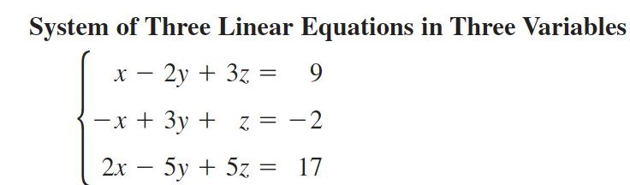
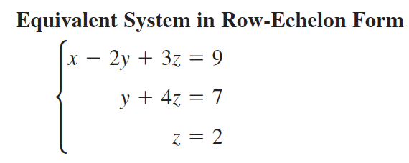
Row-echelon form (review)
To solve systems with more than two variables, we want to transform the system into row-echelon form:
A system is in row-echelon form if it has a stair-step pattern and each equation has a leading coefficient of 1.

Slide 6
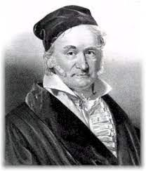
Row operations (review)
Gaussian elimination involves three row operations:
Exchange equations
Multiply one of the equations but some number (but not zero)
Add one equation to a multiple of another equation
Johann Gauss, the guy who came up with this algorithm

Slide 7
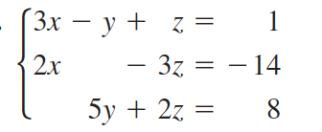
Warm up
Let’s solve this system using Gaussian elimination
Be sure to follow along in your notes. Try to stay one step ahead!
Notes:
Row exchange for 1 and 2.
Ask if student wants to lead the class.
see handwritten notes for solution.

Slide 8
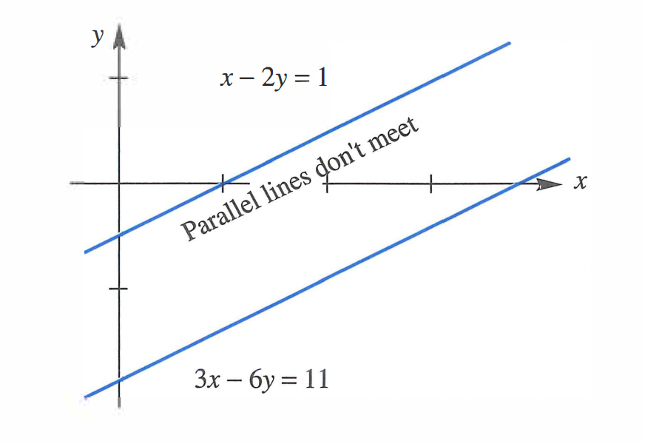
mini-lesson
Use Gaussian elimination to solve the two systems below. Be sure to work on your own
showing all work. Be prepared to share out.
a.
$$x-2y=1$$
$$3x-6y=11$$
b.
$$x-2y=1$$
$$3x-6y=3$$
Notes:
see pg. 490 of textbook for solution.

Slide 9
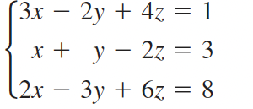
mini-lesson
With a partner, try to solve this systems using Gaussian elimination:
Row operations
Exchange equations
Multiply one of the equations but some number (but not zero)
Add one equation to a multiple of another equation

Slide 10
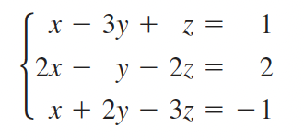
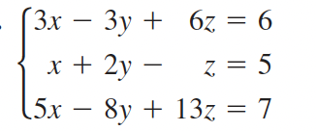
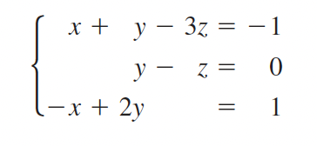
Independent work
1. Use elimination and back substitution to solve the systems below. Be sure to show all work:
a.
b.
c.

Slide 11
Reflection
How is elimination different from substitution?
Why is it useful to reduce systems of equations to row-echelon form?
Notes:
possible exit tickets

Slide 12
wrapping up!
be sure to: read the directions below!
Make sure there isn’t any litter near your workstation.
If you borrowed headphones, sign them back in.
Make sure you are logged out of your computer!
Remain in your seat until the bell rings.

