Slide 1
Fall 2021 precal
Lesson 12.3
Dr. O’Brien
Herbert H. Lehman High School
8 December 2021
Notes:
VOCAB:
nested loop

Slide 2

Do now
The definitions for dot and background are: dot = circle(50, "solid", "red") background = rectangle(300, 200, "outline","black")
be sure to:
Describe two ways you can combine dot and overlay to make the Japanese flag in Pyret.
How are variables and function composition use for making flags in Pyret?
Notes:
Annotate bard w coordinate grid. Fill in top left flag with o,o
Draw 200 on y axis and 300 on x axis.

Slide 3
framing
what: combine and manipulate image functions to create more complex images
why: We’ve learned to use functions and variables in Pyret. today we’ll apply that to making flags
where to: Defining our functions in Pyret

Slide 4
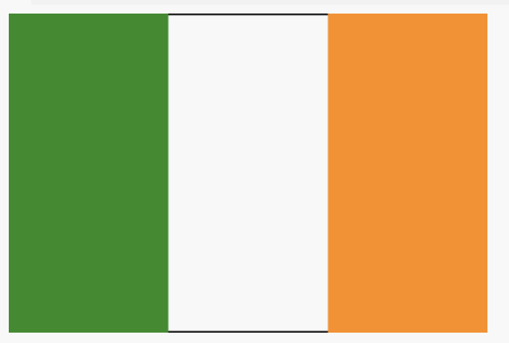

Coding to learn: Activity
Log in to computer. Read the BSTs below.
be sure to:
Reopen your save flags file from yesterday. Otherwise Open the Flags of Netherlands, Ireland & Mauritius. Save a copy.
Design the flags for Ireland and Mauritius. If necessary use the Netherlands flag for each.
Use your knowledge of Pyret to make the flag for each

Slide 5
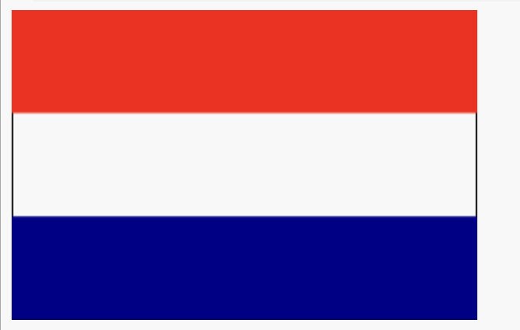
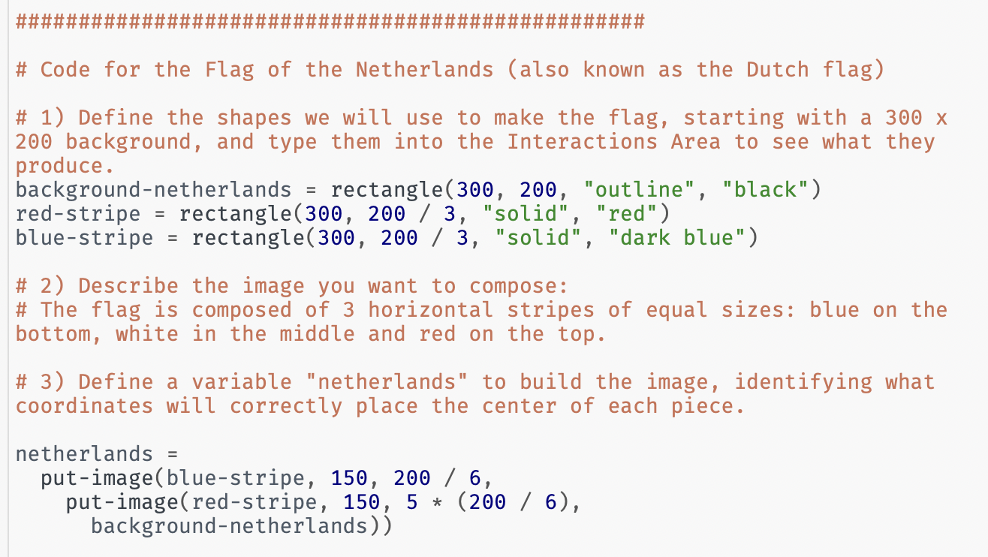
Coding to learn: Activity:
Log in to computer. Read the BSTs below.
be sure to:
Open the Flags of Netherlands, Ireland & Mauritius. Save a copy.
Notes:
For students who were absent yesterday or just want a review. Go through code for Netherlands flag:
+What are the dimensions of the Netherlands’ flag?
+What was the programmer thinking when she coded the height of the red stripe as 200 / 3?
+The center of the blue stripe is placed at (150, 200 / 6). How did the programmer know to use 150 as the x-coordinate?
+Explain the thinking behind coding the red stripe’s y-coordinate as 5 ​* (​200 / 6​).

Slide 6
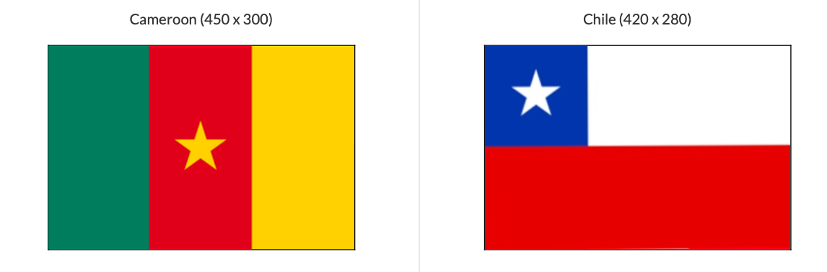
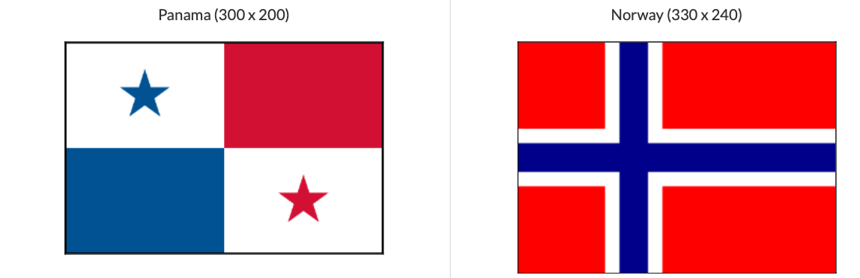
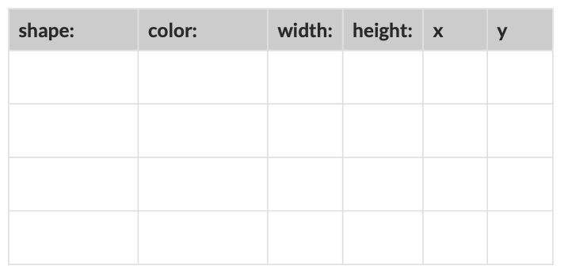
Coding to learn: bonus Activity
Log in to computer. Read the BSTs below.
be sure to:
Pick one of the flags in the work sheet. Use the table below the flag to identify the dimensions and positions of the shapes that make up the flag.
Use your knowledge of Pyret to make the flag.

Slide 7
Reflection: Thinking about thinking
be sure to: Answer each question below with a complete sentence.
What is easy about making flags? What’s hard?
How can it be helpful to use variables and flags if you want to make a flag, or any other image, in Pyret?

