Slide 1
Spring 2022 precal
Lesson 13.1
Dr. O’Brien
Herbert Lehman High School
3 May 2022

Slide 2
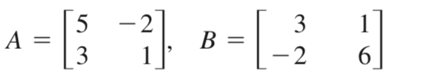
Do now
Be sure to…
Find seat. Take out notebook/binder. Copy date and goal.
Find (i) $A-2B$ and (ii) $A×B$. Show all work!

Slide 3
Today’s activity
Take your graded quiz #2. Decide what you want to do today:
Test corrections
For each question you got wrong
Find the correct answer, showing all work.
Check answer key (ask Dr. O’Brien)
Write a sentence explaining what you got wrong.
Psets
Work on any psets you have yet completed.
Pset #8 has been posted!
Announcements
Quiz #2 retake on Thursday
MP linear optimization final project Friday-Monday
Notes:
Make sure students are working quietly. See CodeHS problem guides for specific Python activities.
Frequently asked questions:
+I don’t know what to do!?! Make sure to carefully read the instructions. Take notes when watching the video.
+What are you trying to do with your program? answers will vary, direct student to assignment instructions.
+how can I figure out why my code doesn’t work? Try getting out a piece of paper, and following your commands yourself. What do you draw. Where do things go wrong?
+What do I do if I forget a command? See the docs section of CodeHS.

Slide 4
wrapping up!
be sure to: read the directions below!
Make sure there isn’t any litter near your workstation.
If you borrowed headphones, sign them back in.
Make sure you are logged out of your computer!
Remain in your seat until the bell rings.

