Slide 1
Spring 2022 AP CS A
Lesson 13.1
Dr. O’Brien
Herbert H. Lehman High School
May 3, 2022

Slide 2
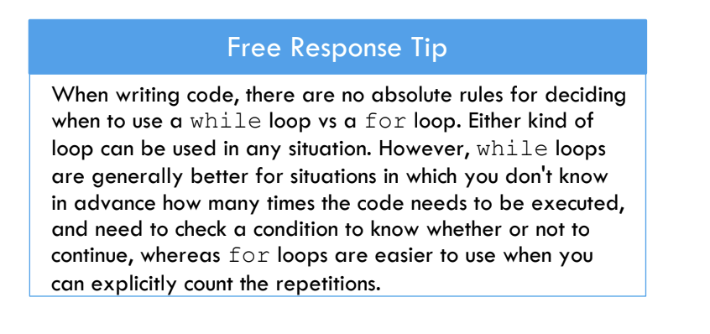
Today’s
Be sure to…
Log in to AP classroom.
Complete Unit 4 Progress check. We’ll go over it the second half of class
If you finish early, complete the MC practice quiz.
Notes:
5! = 5*4*3*2*1 = 120
num combinations:
4! / 3!(4-3)! = 4! / 3!*1! = 4! / 3! = 4*3*2*1 / 3*2*1 = 4

Slide 3
FR question 1
The method longestStreak is intended to determine the longest substring of consecutive identical characters in the parameter str and print the result.
For example, the call longestStreak("CCAAAAATTT!") should print the result "A 5" because the longest substring of consecutive identical characters is "AAAAA".
Complete the method below. Your implementation should conform to the example above.
public static void longestStreak(String str){
}
Notes:
+How could you diagram this problem? think through what you need to do to solve this problem. you need to traverse the string, checking each letter with the one right adjacent to it, if they are the same you increment some variable (call it counter). If they aren’t you check if the current value of counter is greater than a variable (longest_streak) storing the current longest streak, then reset counter to 1.

Slide 4
FR question 2a
You will write method getPlayer2Move, which returns the number of coins that player 2 will spend in a given round of the game. In the first round of the game, the parameter round has the value 1, in the second round of the game, it has the value 2, and so on. The method returns 1, 2, or 3 based on the following rules.
If round is divisible by 3, then return 3.
If round is not divisible by 3 but is divisible by 2, then return 2.
If round is not divisible by 3 and is not divisible by 2, then return 1.
Complete method getPlayer2Move below by assigning the correct value to result to be returned.

Slide 5
FR question 2b
(b) Assume that getPlayer2Move works as specified, regardless of what you wrote in part (a) . You must use getPlayer1Move and getPlayer2Move appropriately to receive full credit.
Complete method playGame below.

Slide 6
Reflection: Thinking about thinking
be sure to: Answer each question below with a complete sentence.
What do you understand better after today’s review session?
What do you still need to work on?

