Slide 1
Fall 2021 AP CS A
Lesson 9.1
Dr. O’Brien
Herbert H. Lehman High School
4 April 2022

Slide 2
Do now
What are some examples of searching for information when you’re using a computer?
What are some challenges you can foresee when it comes to writing a program for search?
Notes:
-Google. searchnig for something in your finder (or the windows equivalent). searching for text on a webpage or in a document.
-If we have a lot of information, it can take a long time!

Slide 3
framing
what: use recursion to search through data
why: Recursion is a very powerful tool for making algorithms. We’ll see how it makes search easier.
where to: Using recursion in sorting algorithms

Slide 4
warm up: linear vs. binary search
Watch Dr. O’Brien carefully.
Stop ’n’ Jot: (1)How are the two search algorithms different. Which one do you like better?
(2) What has to be true about data for binary search to work?

Slide 5
Vocabulary
The linear search algorithm starts at the middle of an array or ArrayList and search through each element until the desired value is found or all elements have been eliminated.
The binary search algorithm starts at the middle of a sorted array or ArrayList and eliminates half of the array or ArrayList in each iteration until the desired value is found or all elements have been eliminated.

Slide 6
Coding to learn: Live coding
be sure to: Log in to Workstation. Follow along, but try to stay one step ahead!
Notes:
def binsearch(data, target, begin, end):
if begin <= end:
mid = (begin+end)/2
if target == data[mid]:
return data[mid]
elif target < data[mid]:
return binsearch(data, target, begin, mid)
else:
return binsearch(data, target, mid, end)
return None
+why is this program recursive?
+ what would go wrong if you made mid the end of your search

Slide 7
Independent work
Complete exercises in lessons 10.1 and 10.2 on CodeHS!
Remain your workstation.
Work on following problems in CodeHS:
10.1.6: Factorial
10.1.7: Countdown
10.1.8: recursive minimum
10.2.6: Exploring binary search
10.2.7: Comparing binary and linear search
10.2.8: maximum iterations
Notes:
In order to make use of the ArrayLists we create, we need to learn some of the methods that make them useful. ArrayLists offer a series of methods that allow us to alter the state of an ArrayList. In this lesson, we are going to explore some of the more useful methods that may be tested on the AP exam. These methods will be included on your Java Quick Reference.
See problem guides on CodeHS for detailed solutions.

Slide 8
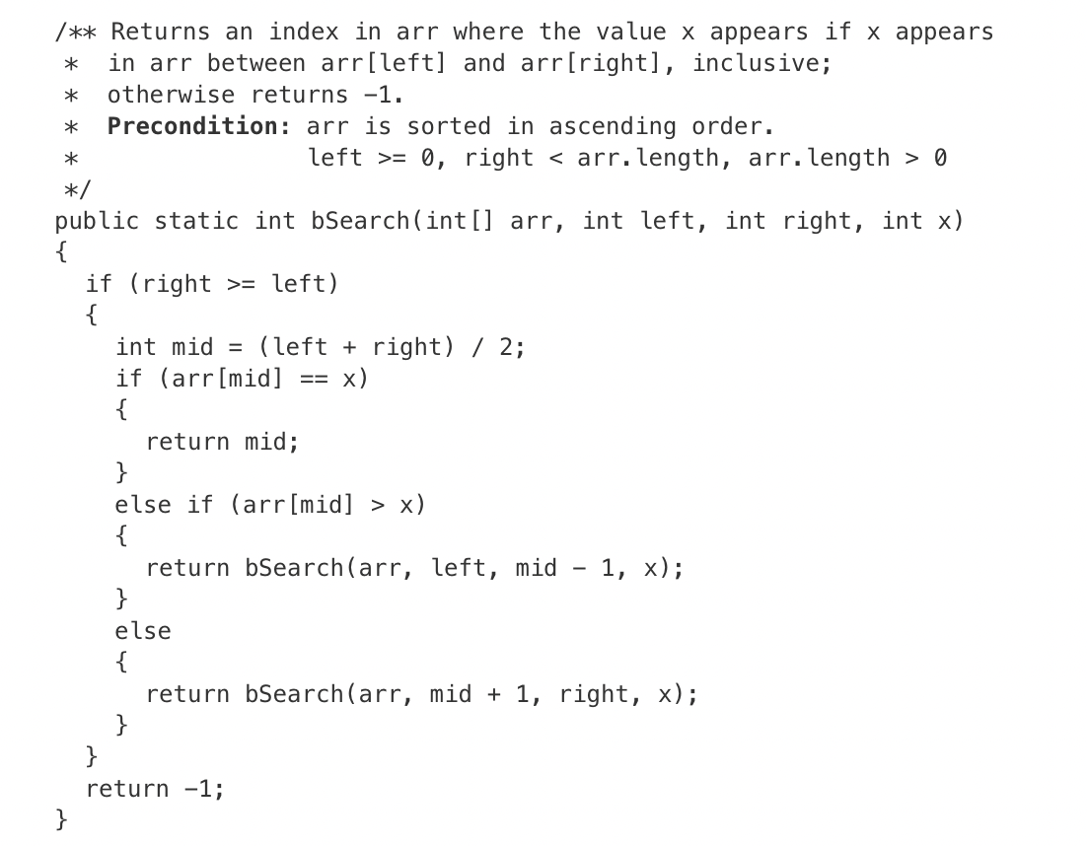
Exit ticket
be sure to: Answer the question below with a complete sentence. Be prepared to share out!
The following statement appears in a method in the same class as bSearch. Assume that nums is a sorted array of length 7, containing only positive integers.
int result = bSearch(nums, 0, nums.length - 1, -100);
How many times will the bSearch method be called as a result of executing the statement, including the initial call?
1
3
4
5
7
Notes:
the list has to be sorted
the algo works by dividing the list into two, then it’s executed on one of the sub lists, until the desired element is found

