Slide 1
Fall 2021 Pre-calculus
Lesson 12.1
Dr. O’Brien
Lehman High School
April 25, 2021
Notes:
students need calculators
no new vocab

Slide 2
do now
be sure to: Get out your binder. Copy goal and answer do now questions below. Show all work or write a complete sentence for each answer:
How do you find two points that satisfy the equations to the right?
How do you plot these equations
$$5x+4y=80$$
$$10x+20y=200$$
Notes:
see handwritten notes for solution

Slide 3
framing
what: use graphical method to find the optimal solution for a problem?
why: this is actually another way to represent the algorithm we learned before break
where to: Fun with polynomial functions
Notes:
the plan: We’ll go through one of the Pset #5 word problems together.
You’ll work with a partner to solve some other word problems

Slide 4
Warm up
be sure to: do all work below
How do you plot these inequalities?
$$5x+4y≤80$$
$$10x+20y≤200$$
Notes:
see handwritten notes

Slide 5
Vocabulary
be sure to: copy definitions below
Feasible region
The part of a graph that satisfies all the constraints for an optimization problem
Graphical method
The optimal solution for a problem is always one of the vertices of the feasible region
Notes:
A pebble is dropped in the pond. The ripples are ‘concentric’ circles. r(t) = 0.6t. A(r) = pi*rt^2.
A sensible answer would be a real number. +What could be an interval for this number? +Do we think the answer will be negative? no because all the numbers here are positive +will the answer be bigger than 10? hard to know but 1.3 is pretty small so probably not so we know that the answer is probably somewhere between 0 and 10

Slide 6
Mini lesson: the carpenter problem
be sure to: do all work below
A carpenter makes tables and bookshelves. Tables take 10 units of lumber and five units of labor, and are sold for $180. Bookshelves take 20 units of lumber and four units of labor, and are sold for $200. The carpenter doesn’t want to work more than 80 hours in a week and only has 200 units of lumber.
What’s the key information in this paragraph?
How could we represent this info as inequalities?
What do you think we’ll try to maximize?
What’s the feasible region?
How could we find the optimal solution using the graphical method?
Feasible region
The part of a graph that satisfies all the constraints for an optimization problem
Graphical method
The optimal solution for a problem is always one of the vertices of the feasible region
Notes:
see handwritten notes
based on video: https://www.youtube.com/watch?v=K7TL5NMlKIk

Slide 7
Independent work :the carpenter problem
be sure to: do all work below
Now the carpenter only wants to work 40 hours and has 120 units of lumber on hand. Tables still take 10 units of lumber and five units of labor, and are sold for $180. Bookshelves take 20 units of lumber and four units of labor, and are sold for $200. How many tables and bookshelves should the carpenter make to maximize revenue?
How does the problem change if the carpenter can only work 20 hours in one week?
Notes:
It resembles problems involving combinations of functions. In this case, it’s specifically composite functions, because the radius goes into the area.
A good first step could be finding the composite of A and r. +How do we know whether to compose A with r or r with A? It’s A with r because the input for A is a radius, which is the output for r.

Slide 8
Execute your plan
Review your work
A pebble is dropped into a calm pond, causing ripples in the form of concentric circles. The radius (in feet) of the outermost ripple is given by r$r(t)=0.6t$, where t is the time (in seconds) after the pebble strikes the water. The area of the circle is given by $A(r)=πrt^{2}$. Find the radius of the largest circle after 1.3 seconds.
Notes:
WORK THROUGH ON BOARD
r(t) = 0.6t
A(r) = pi r t^2
(A . r)(t) = A(r(t)) =
pi (0.6 t)t^2 = 0.6 pi t^3
We could appoximate the coefficient by multiplying 0.6 with pi, but right now I want to keep things as simple and accurate as possible.
Final step. plug t = 1.3
0.6 pi (1.3)^3 = 4.14
review work.
Go through our calculations. +Do we see any mistakes? maybe! it depends on if I do something wrong here.
+does this answer make sense, yes it’s bigger than 0 and less than 10. So this seems like a reasonable answer!

Slide 9
activity
activity
be sure to: Work with one (!) neighbor (someone right next to you!). Answer the questions below for each problem.
Understand the problem! What question are you answering and what would be a reasonable answer?
Make a plan! What combination of function will you use?
Execute plan! Show all your work
Review your plan Does your answer make sense? How can you solve it better?
Notes:
+How do I make a plan? Make sure you understand the question, then think about which combination of functions will make sense here.
+ how do I know if my answer is correct? Maybe check in with another group. If there ’s a difference you can talk about what you did differently.

Slide 10
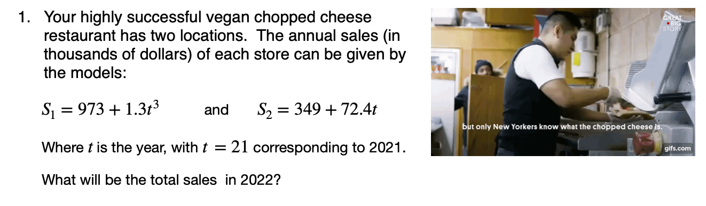
Notes:
See answer key.

Slide 11
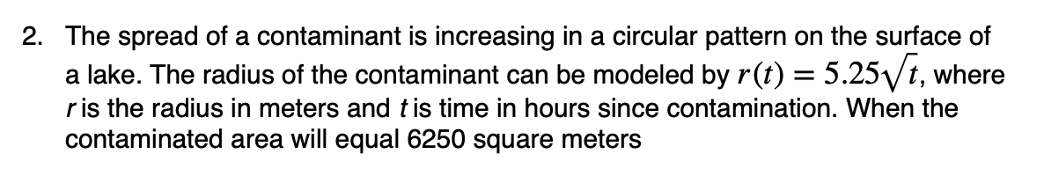

Slide 12
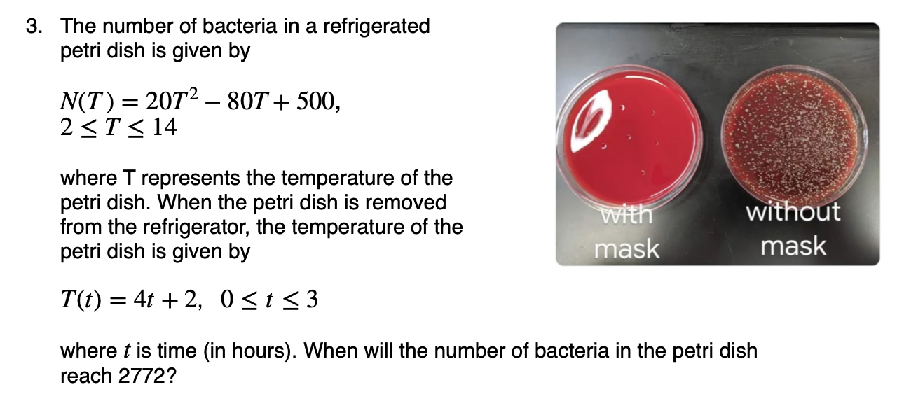

Slide 13
d
Reflection
How was using the how to solve it method helpful?
What was most challenging about the method?
Do you feel like you’re more prepared to solve word problems in the future? Why or why not?
Before we go: Please arrange desks in rows!!
Notes:
apply box method = -4x^3+4x^2 -2x + 3.
5. N.T(t) = 20(4t+2)^2 -80(4t+2) + 500 =
20(4t+2)[4t+2 - 4]
20(4t+2)(4t-2) + 500=
20[4t^2 -4] + 500 = 2000
1500/20 = 4t^2 - 4
79 = 4t^2
t = sqrt(79)/2
+is this in the domain of our function? no its about 4.44. so the bacteria count will never reach 2000.

