Slide 1
Fall 2021 Precalc
Lesson 5.2
Dr. O’Brien
Herbert H. Lehman High School
8 March 2022
Notes:
VOCAB
identity matrix

Slide 2
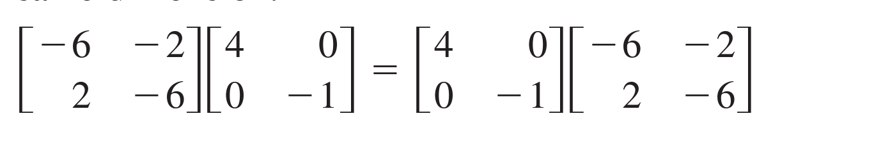
Do now…Get out your notebook/binder. Write down the date and goal. Be Sure to carefully answer the questions below in your notebook.
Is the equation below true or false? Use appropriate calculations to show why or why not:

Slide 3
framing
what: use matrix multiplication to solve real world problems?
why: Matrix multiplication can be very useful for solving real world problems.
where to: finding the inverse of a matrix

Slide 4
B24 rules
Welcome to our new room, B24! Please read the information below:
When you come in, please find a seat at a desk (if one’s available) or one of the six closest desks to the screen. Do not sit in the back of the classroom. We’ll conduct the do now and mini lesson from here.
When I dismiss you for independent work, find a sit at one of the computer workstations.
No food or drink by the computers.
At the end of the period, you’ll be directed to assemble for the exit ticket/debrief. Log out of your computer, and quietly return to a seat near the front.

Slide 5
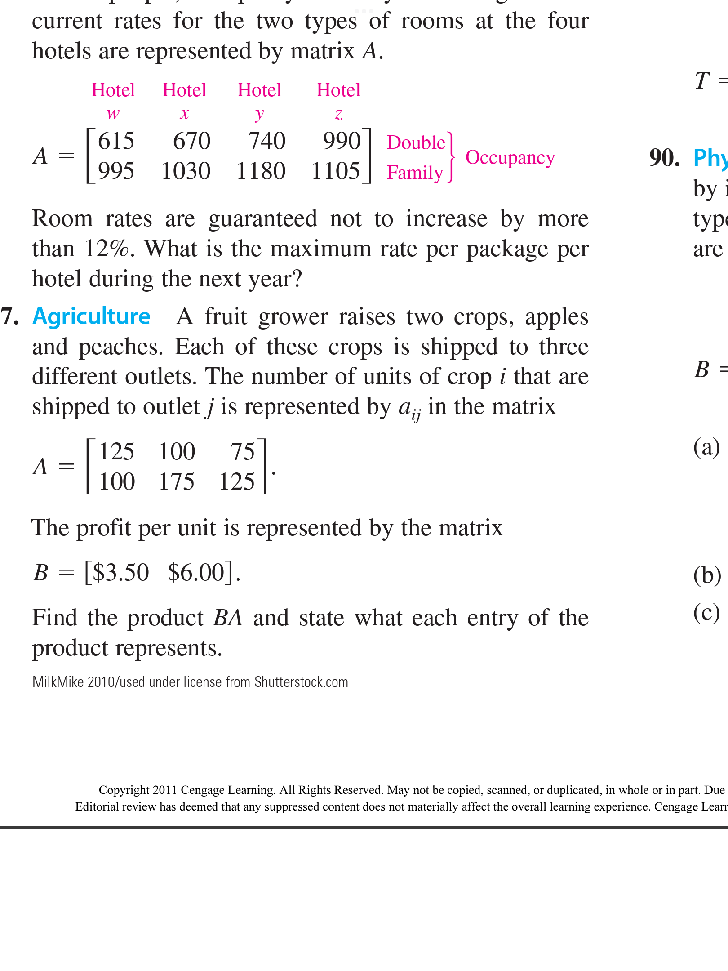
Real world problem #1
The Lehman Fruit Farm grows two varieties of fruits, apples and pineapples, and sells them at three locations in the Bronx. Matrix A represents the amount of each fruit sold at each location in the Bronx. Matrix B represents the prices for each variety of fruit.
Be sure to… copy the matrices and answer each question below in your notes:
How would you interpret each matrix?
How could we use the matrices to find how much money is earned for each fruit at each location?
Notes:
Why Can these matrices be multiplied? Because A has 3 columns and B 3 rows.
What do you notice about the product of A and B? It’s identical to B.
Do you think the order of operations matter here (ie does AB=BA?) no the output will be B no ,after what.

Slide 6
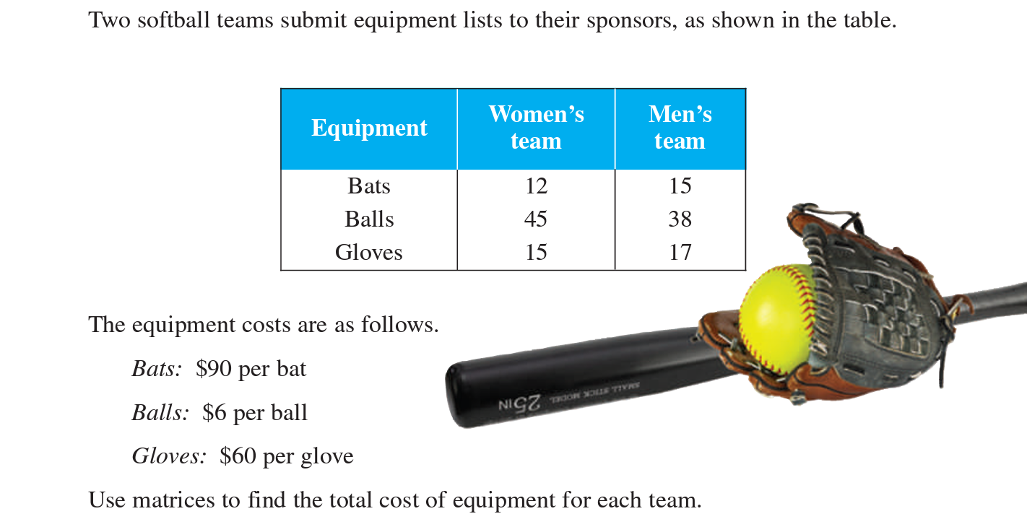
Real world problem #2
Notes:
See textbook page 526 for solution

Slide 7
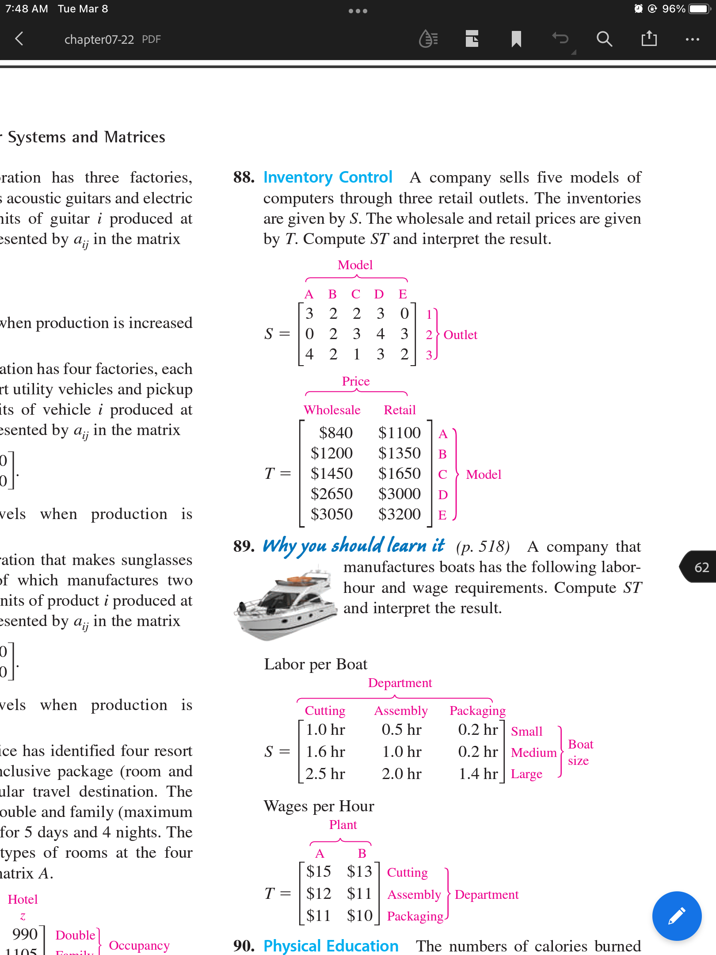
Real world problem #3
Alfonso started a smartphone company, alPHONEso Inc. He’s making 5 models of phone and selling them at 3 locations in New York. The inventories are given by matrix S and the wholesale and retail prices are given by matrix T.
Be sure to… copy the matrices and answer each question below in your notes:
What does inventory, retail, and wholesale mean?
How would you interpret each matrix?
Calculate the product ST. In a complete sentence, explain what it represents.
Notes:
Why Can these matrices be multiplied? Because A has 3 columns and B 3 rows.
What do you notice about the product of A and B? It’s identical to B.
Do you think the order of operations matter here (ie does AB=BA?) no the output will be B no ,after what.

Slide 8
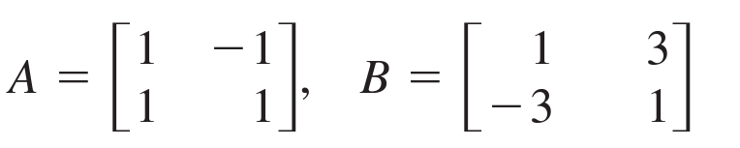
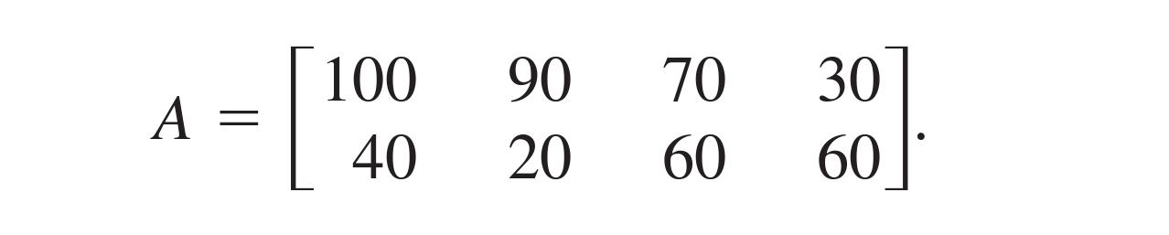
Independent work
Make up a story about what matrix A and matrix B below could represent. Then solve and interpret the product AB.
Your company makes two kinds of sunglasses (aviator and cat eyed) at four locations. The sales in the las month are represented in matrix A below. If the aviator glasses sell for $100 and the cat eyed glasses for $110, use matrix multiplication to calculate your sales at each location.

Slide 9
wrapping up!
be sure to: read the directions below!
Make sure there isn’t any litter near your workstation.
If you borrowed headphones, sign them back in.
Make sure you are logged out of your computer!
Remain in your seat until the bell rings.

