Slide 1
Fall 2021 Python
Lesson 7.1
Dr. O’Brien
Herbert Lehman High School
Nov. 1, 2021

Slide 2
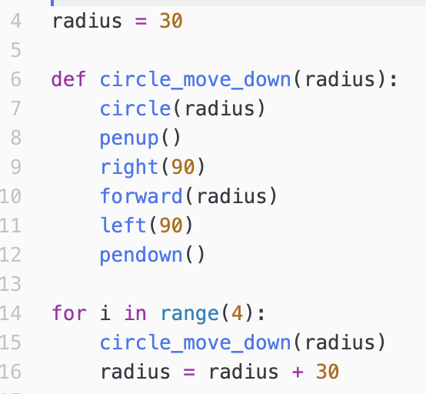
Do now
be sure to: find seat near the board. Get out your binder and answer the do now questions below. Show all work or answer each question with a complete sentence.
Copy the vocab item to the right to your Python Glossary.
What’s the variable in the code to the right? How is it used?
What do you predict the code to the right will do?
Vocabulary
Variable: A symbol or container that holds a value
Notes:
A.
B. radius. it’s used inside of the circle commmand. it’s updated with each iteration of a for loop to grow by 30.
C. will mae a bulls eye shape

Slide 3
Work day
be sure to: find your assigned seat. Log in to CodeHS. Begin work!
Find your assigned seat (ask Dr. O’Brien)
Read through the MP1 requirements below.
Make sure your Python glossary is updated.
Begin work! Raise your hand quietly if you have any questions
Vocabulary
Variable: A symbol or container that holds a value
color(“red’): Command that changes the color of tracey’s pen.
Notes:
Make sure students are working quietly. See problem guides for specific Python activities.
Frequently asked questions:
+I don’t know what to do!?! Make sure to carefully read the instructions. Take notes when watching the video.
+What are you trying to make tracy do?
+how can I figure out why my code doesn’t work? Try getting out a piece of paper, and following your commands yourself. What do you draw. Where do things go wrong?
+What do I do if I forget a command? See the docs section of CodeHS.

Slide 4
Reminders:
Coaches should...
Answer student questions.
Provide hints.
Coaches shouldn’t...
Talk to one student for for than a few minutes.
Touch other students keyboards. Ever.
Just tell students exactly what to do.
MP1 requirements:
Complete all CodeHS Lessons, Unit 2
Complete Assessment #1
Complete Turtle Art project (Assessment #2)
Notes:
Mp1 ends this week! Some of you really need to focus.

