Slide 1
Spring 2022 precal
Lesson 16.3
Dr. O’Brien
Herbert Lehman High School
25 May 2022

Slide 2
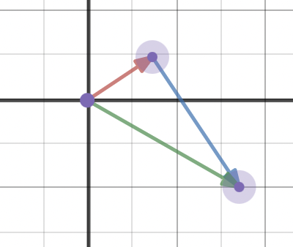
Do now
Be sure to…
Find seat. Take out notebook/binder. Copy date and goal. Answer the questions below in complete sentences.
Suppose the red arrow represents a scalar multiple of $v=\left[\begin{aligned}3 \\ 2\end{aligned}\right]$ and the blue arrow represents a scalar multiple of $w=\left[\begin{aligned}-2 \\ 3\end{aligned}\right]$.
What scalar do you multiply the vectors by to get the arrows in this image?
What do you think the green arrow represents?If possible how could you describe the green arrow in terms of a linear combination?
Notes:
red arrow: 1/2 * v = [1.5 1] blue arrow: -1*w = [2 -3]
The green arrow represents the sum 0.5v + -w, in other words this is one possible linear combination v and w;

Slide 3
Framing
What? Represent linear combinations geometrically and algebraically
Why? Linear combinations are important to understanding vector spaces, which, believe it or not will help us with the least squares problem!
Vector spaces

Slide 4
Mini lesson
Scalar multiple of vector (Review)
The product of multiplying a vector by a scalar
Be sure to…
Copy the vocab item to the right.
Follow along with work on board.
Linear combination (Review)
Sum of the scalar multiples of two vectors
Suppose $A=\left[\begin{matrix}2 & 1 \\ 1 & -2\end{matrix}\right]$ and $X=\left[\begin{aligned}x \\ y\end{aligned}\right]$.
How could we describe the column space for A?
How is the column space related to AX?
Vector space $R^{2}$
The set of all vectors with two components
Column space of a matrix M
The set of all linear combinations of the column vectors of M. For $AX=B$, B must be in the column space of $AX$
Notes:
The vector space R squared can be drawn as an xy grid.
Any two vectors in a vector space can be added, the third vector will be in the same vector space. Any vector ,multiplied by a scalar will be in the same vector space.
Eg if (2,4) and 3 4 are in required than obviously 5 8 are in r squared as well.
suppose A = [1 3 // 4 5 ] and X = [x y].
Column space is the set of all vectors which you can get by adding scalar multiples of [1 4] and [3 5]. This winds up filling up the entire space R^2!!!
+We might wonder when this would not be true. But that will have to wait until tomorrow.

Slide 5
Independent work
Scalar multiple of vector (Review)
The product of multiplying a vector by a scalar
Be sure to…
Copy vocab in your notes (if you didn’t do so yesterday!)
On Google Classroom, work on two Desmos Activities:
Vector addition & multiplication activity (May 18th).
Vectors & Linear Combinations (May 19th)
Work until 9:43 AM
Be prepared to share out your work!
Linear combination (Review)
Sum of the scalar multiples of two vectors
Vector space $R^{2}$
The set of all vectors with two components
Column space of a matrix M
The set of all linear combinations of the column vectors of M. For $AX=B$, B must be in the column space of $AX$
Notes:
+How is a scalar multiple of.a vector different from the original? It will be longer or shorter (depending on if the abs. value of the scalar is >1 or not) and it might be pointing in a different direction is negative.
+Why does the green arrow represent a linear combination? Because the red arrow and blue arrow are saclar multiples of the original vectors The blue arrow is restricted so it is added on to the red arrow. it representsthe sum of two scalar multiples of vectos, which is the def. of a linear combination.
+How do we know the column space for the two vectors is R^2? Because move can our blue arrow anywhere on the grid.
end of class: go over end of may 18th activity. discuss why if the matrix is [1 2 // 2 1] then the column space is the whole grid, in other words R^2.

Slide 6
wrapping up!
be sure to: read the directions below!
Make sure there isn’t any litter near your workstation.
If you borrowed headphones, sign them back in.
Make sure you are logged out of your computer!
Remain in your seat until the bell rings.

