Slide 1
Fall 2021 AP CS A
Lesson 5.2
Dr. O’Brien
Herbert H. Lehman High School
Notes:
STANDARDS REFERENCED:
CSTA 11-12th grade standards: 3B-AP-12: Compare and contrast fundamental data structures and their uses.
NY State: 9-12.CT.7
Design or remix a program that
utilizes a data structure to maintain
changes to related pieces of data.

Slide 2
Do now
be sure to: Get out your binder. Copy goal and answer do now questions below. Write a complete sentence for each answer:
How are arrays similar to strings? [HINT: it might be helpful to review your notes here]
What sorts of things can you do with arrays that cannot be done with strings?
Notes:
They both contain data that is associated with an index and can be accessed.
Arrays are different in that they don’t print as a string and they can contain other datatypes than just characters.

Slide 3
framing
what: use loops to traverse an array
why: These techniques allow us to access the elements of an array sequentially, and will be important for developing algorithms on arrays.
where to: Enhanced for loops for traversing arrays

Slide 4
Vocab
be sure to: Keep your notebook open. These definitions should be in your Glossary. If not Copy each definition, in your Java Glossary.
array.length
Returns the length of some array.
Traversal (review)
The process of looping through a string or array and accessing each element sequentially
How could you access the last element in an array called myNumbers?
Notes:
+ How could you access the last element in an array called myNumbers?
nyNumbers.length returns the length of the array. to get the final element myNumbers[myNumbers.length - 1]

Slide 5
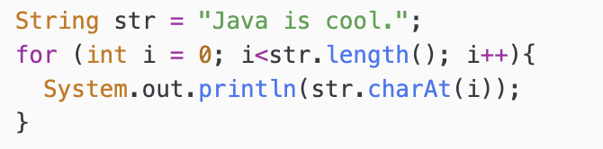
Writing to learn: warm up
be sure to: Take notes and answer questions in your notebook.
1. What will this block of code output?
Traversal (review)
The process of looping through a string or array and accessing each element sequentially
Notes:
+What will this program do?
It will print out each character in the string “Java is cool” with each character on a new line

Slide 6
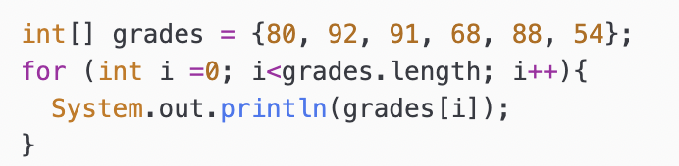
Writing to learn: warm up
be sure to: Take notes and answer questions in your notebook.
What will this block of code output?
How does the second block of code work? Describe each step in the computation.
How are these two blocks of code similar? How are they different?
Notes:
2. The second program initializes an array of integers called grades. It looks like it’s printing out each grade on a separate line.
3. They’re similar in that they both involve traversing an indexed collection of data. a string in the first case, an array in the second.

Slide 7
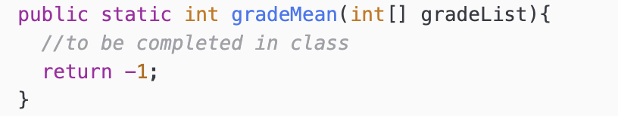

Coding to learn: live coding
be sure to: Log in to Workstation. Open Feb. 3: Calculating Grades under In Class Examples on CodeHS. Follow along, but try to stay one step ahead!
How do we calculate the mean data set?
Let’s use array traversal to do this in Java
Notes:
add up the values and divide by the number of values!
+Walk through the following code with students
public static int gradeMean(int[] gradeList){
int numGrades = gradeList.length;
int sum = 0;
for (int i = 0; i <numGrades; i++){
sum += gradeList[i];
}
return sum / numGrades;
}
+Why is it important that i remain *less* than numGrades, what do you think will go wrong if we had i <= numGrades?
Test it out, show students java.lang.ArrayIndexOutOfBoundsException.

Slide 8
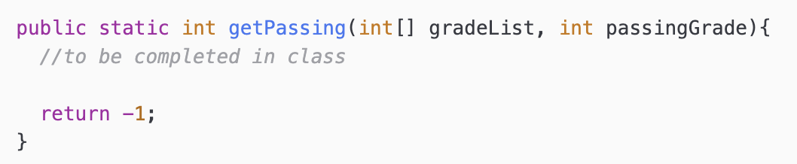
Coding to learn: live coding
be sure to: Log in to Workstation. Open Feb. 3: Calculating Grades under In Class Examples on CodeHS. Follow along, but try to stay one step ahead!
Now let’s try to build a method that returns the number of students with passing grades.
Notes:
public static int getPassing(int[] gradeList, int passingGrade){
int numPassing, index;
numPassing = 0;
index = 0;
while (index < gradeList.length){
int grade = gradeList[index];
if (grade >= passingGrade){
numPassing++;
}
index++;
}
return numPassing;
}
+Could we also do this with a for loop? of course! I just wanted to show that it doesn’t require one.

Slide 9
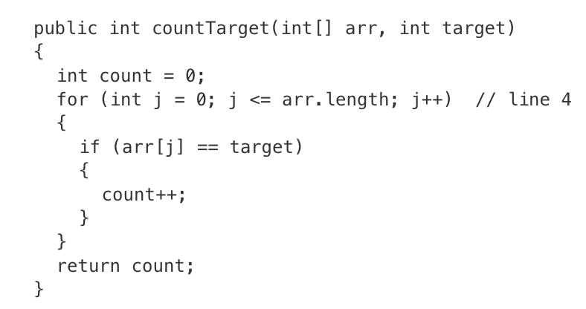
Practice problems
be sure to: Take notes and answer questions in your notebook.
The method countTarget below is intended to return the number of times the value target appears in the array arr.
Why will this program not work as intended?
How should we change the code to make sure it works?
Notes:
It will return an array index out of bounds error.
We should change it to j < arr.length;

Slide 10
Practice problems
be sure to: Take notes and answer questions in your notebook.
Consider the following code segment.
int[] arr = {1, 2, 3, 4, 5, 6, 7};
for (int i = 1; i < arr.length; i += 2)
{
arr[i] = arr[i - 1];
}
Use a code tracing table to determine the output of this code segment.
Notes:
| arr[i - 1] | | arr
———————————-
i=1| arr[i-1] = 1 | arr = {1,1,3,4,5,6,7}
i = 3| arr[i-1] = 3 | arr = {1,1,3,3,5,6,7}
i = 5 | arr[i-1] = 5 | arr = {1,1,3,3,5,5,7}

Slide 11
exit ticket
be sure to: Answer each question below with a complete sentence or code.
How could you build a program that adds a 5 point bonus to each students grade? Write it out in Java code.
How could you modify your algorithm so it only applies the bonus to students with a grade of higher than 80?
Notes:
for (int i=0; i<grades.length; i++{ grades[i]+= 5;
}
add an if statement

