Slide 1
Fall 2021 Pre-calculus
Lesson 5.3
Dr. O’Brien
Lehman High School
October 20, 2021
Notes:
students need calculators
no new vocab

Slide 2
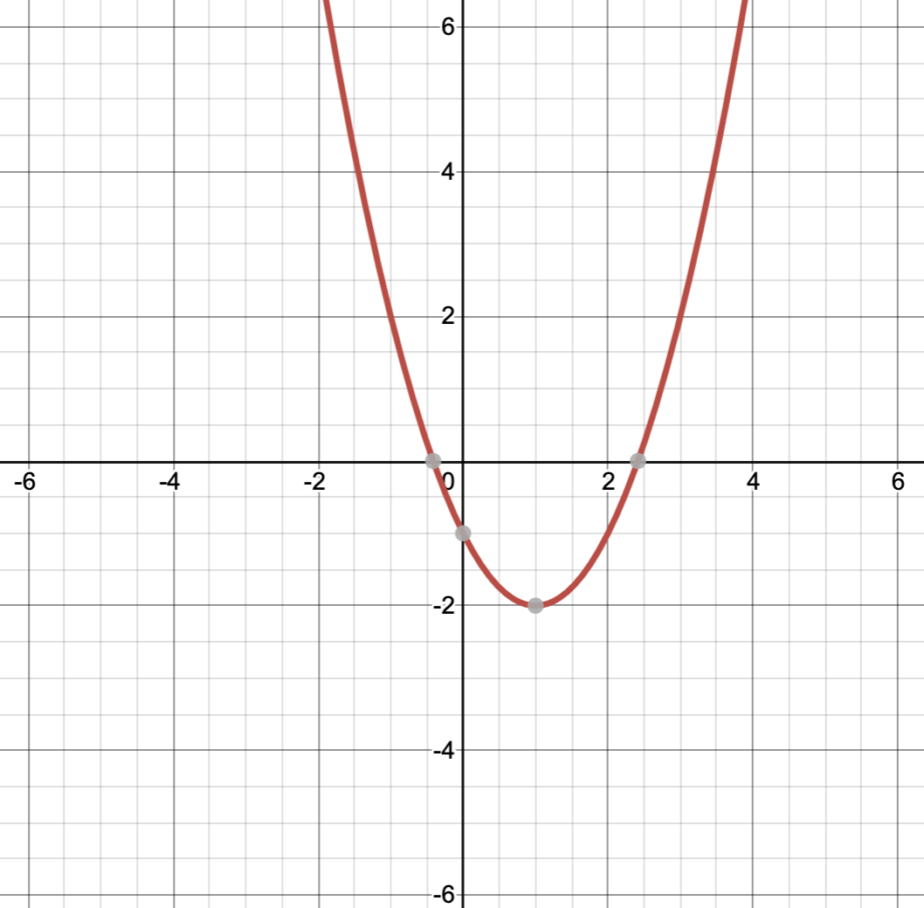
do now
be sure to: Get out your binder. Copy goal and answer do now questions below. Show all work or write a complete sentence for each answer:
What’s the parent function for $f(x)$?
How’s $f(x)$ being transformed from its parent function?
Write an equation for $f(x)$.
f(x)
Notes:
The basic quadratic is x**2.
It’s being shifted 1 right and 2 down.
f(x) = (x -1)^2 - 2
This is the standard form for a quadratic equation.

Slide 3
framing
what: find x-intercepts for quadratic equations
why: This skill helps us to sketch quadratics. Quadratic equations can be used to model things in science, engineering, and more!
where to: Use quadratic functions to solve real world problems
Notes:
the plan: We’ll go through one of the Pset #5 word problems together.
You’ll work with a partner to solve some other word problems

Slide 4
Vocabulary
Vertex: Minimum or maximum point of a quadratic function
Parabola: The curve formed by the graph for a quadratic function.

Slide 5


warm up
Rewrite $h(x)=x^{2}-2x+1$ in standard form.
Sketch a graph for the equation, identifying the vertex.
Notes:
(x^2 - 2x - 1) + 1 + 1
(x - 1)^2 + 2
vertex = (1,2)
2. sketch an upward facing quadratic with vertex at (1,2). w

Slide 6
How could we make our graph more precise?
$$h(x)=x^{2}-2x+1$$
Find the x-intercepts!
Notes:
+find the x-ints!
+How do we do that? by factoring
You want to find a pair of numbers that multiply to positve 1 and add to -2 so that’s going to be -1
(x-1)(x-1) = (x-1)^2

Slide 7
How do we graph this?
$$g(x)=x^{2}-4x+3$$
Find the standard form
Find the x-intercepts
Notes:
hdw find the vertex? convert to standard form? try on own, followed by turn & talk.
(x^2 -4x + 4) - 4 + 3
(x - 2)^2 - 1.
vertex is (2,-1). Sketch
+how do we make our sketch more precise? Let’s find the the x-ints
+factor out the equation. find two numbers that multiply to +3 and add to -4
x^2 -4x + 3 = 0
(x - __)(x - __ )
(x-1)(x-3) ,
xints are 1 and 3

Slide 8
Problem set
Be sure to:
Work at a volume 0 first 4 minutes
Then you can check in with a neighbor
Do work in your notebook
Show all work

Slide 9
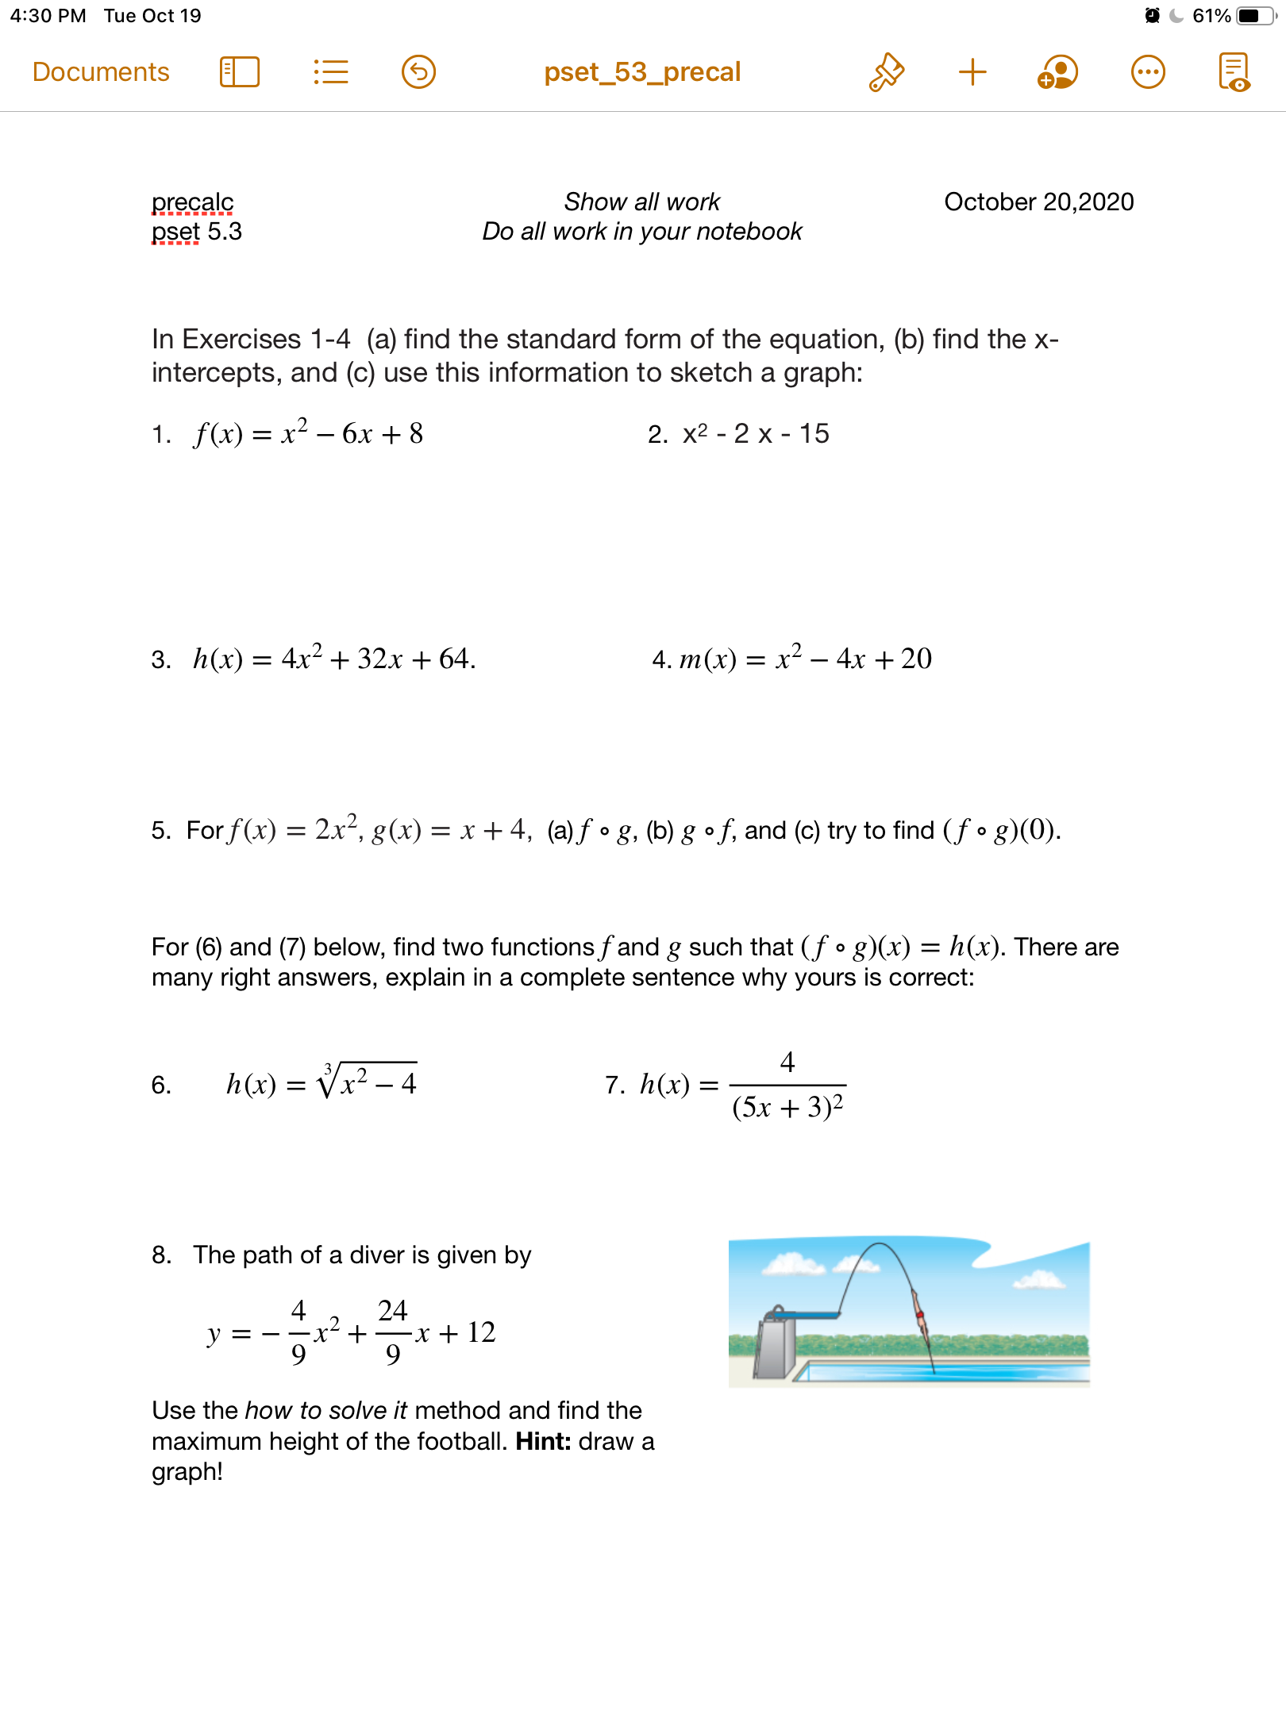
Notes:
See answer key

Slide 10
Notes:
+how rewrite in standard form?check notes!
How identify composite functions? Find a simpler function in the bigger one

Slide 11
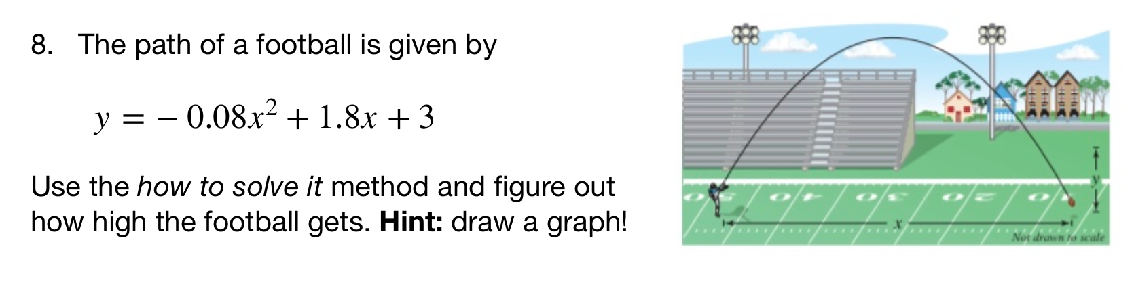
Notes:
See answer key
+hdw rewrite in standard form? Factor out-0.08, then it’s the same strategy as normal
+hdw know this graph will be a frowns face? It’s what the path of a football should look like. Also when we rewrite in standard form the coefficient is -.
+how do you tell from a sketch the highest point? It’s the vertex

Slide 12
d
exit ticket
be sure to: Answer on a sheet of loose leaf paper. Show all work or write a complete sentence for each answer:
Rewrite $h(x)=x^{2}-2x-12$ in standard form.
Find the x-intercepts then sketch a graph for the equation.
Notes:
(x^2 - 2x - 1) + 1 + 1
(x - 1)^2 + 2
vertex = (1,2)
2. sketch an upward facing quadratic with vertex at (1,2).

