Slide 1
Fall 2021 AP CS A
Lesson 13.2
Dr. O’Brien
Herbert H. Lehman High School
14 December 2021

Slide 2
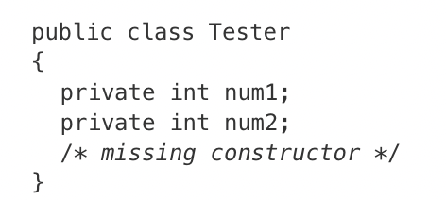
Do now
be sure to: Get out your binder. Copy goal and answer do now questions below. Write a Java method to answer the question below:
The Tester class is defined to the right.
The following statement appears in a method in a class other than Tester. It is intended to create a new Tester object t with its attributes set to 10 and 20.
Tester t = new Tester(10, 20);
Write a constructor method to replace /*missing constructor*/ so that the object t is correctly created.
Notes:
public Tester(int n1, int n2){
num1 = n1;
num2 = n2;
}

Slide 3
framing
what: combine embedded classes to solve real world computational problems
why: We’ve learn to embed objects inside of other objects. Now we’re going to use it to solve some realistic problems.
where to: documenting classes with comments

Slide 4
Writing to learn: error analysis
be sure to:
Log in to your workstation.
Open 12/14 SuperHero2 in In class examples. Answer the questions below in your notebook:
Try running the program. What do you notice that is odd about the output?
Try out a diagram to model the computation when the program is run.
Using the diagram, how can we describe what’s going wrong in the program?
Based on this diagram, how can we modify our code so it works as intended
Notes:
When you change the power level for Java Man, C++ boy’s power level changes too!
see diagram on my iPad
The problem is that the power variable in each SuperHero object points to the same Power object, so changing the power level through one object’s setPowerLevel() method will inadvertently change both!!!!!
rewrite the SuperHero constructor so that a new object is instatianted :
power = new Power(new_power.getName(), new_power.getStrength):

Slide 5
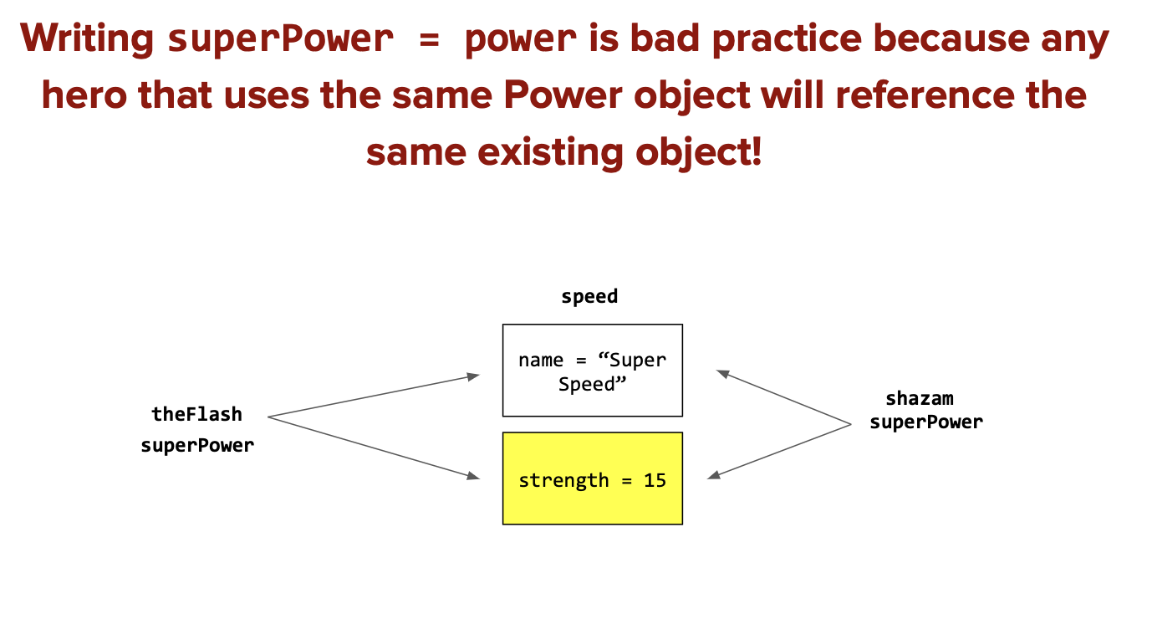
Notes:
This is because both theFlash’s superPower and shazam’s superPower reference the same speed object. Remember that when a variable is assigned the value of an object, it points to the existing object and does NOT create a new one. Because of this, whenever one of our SuperHeros changes the value of any speed attribute, it will affect the other SuperHero. When a variable is referencing an existing object, it is referred to as an alias of the original. In this case, both superPowers are aliases of the initial speed object.

Slide 6
Coding to lean: Independent work
Remain your workstation. Read BSTs below.
be sure to:
Continue working on CodeHS lessons for 5.1 and 5.2
If you have a question, ask!
complete any remaining assignment for homework!

Slide 7
e
Reflection: Thinking about thinking
be sure to: Answer each question below in your notebook with a complete sentence. Be prepared to share out.
What was most challenging about building a SuperHero class?
How do you determine if information should be accessible, modifiable, both, or neither.
How is combining classes useful if we want to encapsulate information?
Notes:
it depends on what kind of information you have, if its something the user will want to know or change.
This helps us manage complexity in our programs. people should only have to worry about what they have to worry about!

Slide 8
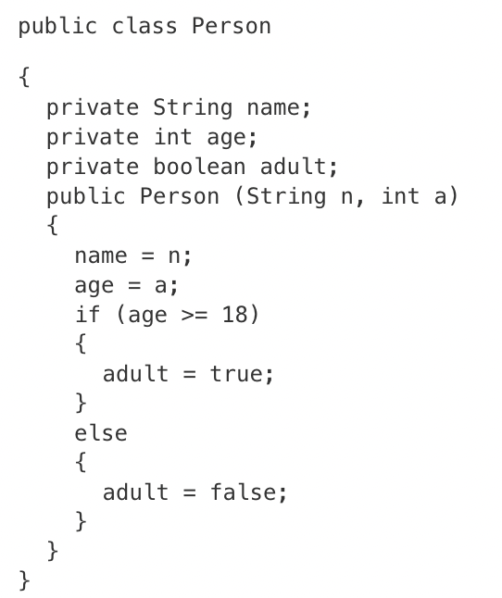
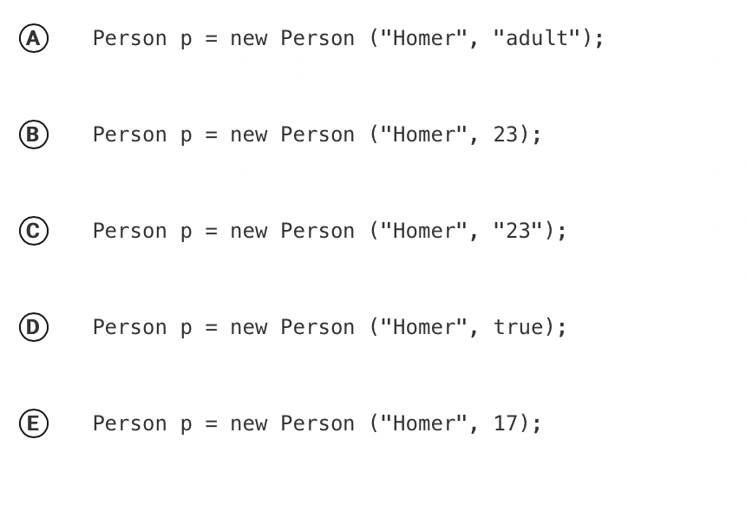
e
Exit ticket
be sure to: Answer on a sheet of loose leaf paper. Write your name and date on the top. Be prepared to hand it in!
The Person class uses the instance variable adult to indicate whether a person is an adult or not.
Which of the following statements will create a Person object that represents an adult person? Explain your answer in a sentence:

