Slide 1
Fall 2021 Pre-calculus
Lesson 6.3
Dr. O’Brien
Lehman High School
October 27, 2021
Notes:
students need calculator
Parabola
Vertex

Slide 2

do now
be sure to: Get out your binder. Copy goal and answer do now questions below. Show all work or write a complete sentence for each answer:
Describe what you found most useful about using the how to solve it method to tackle complex word problems?
What’s been the least useful, and why?
What do you want to do differently in the future?
how to solve it
Understand the problem:
Read the problem carefully.
What would a sensible final answer look like (number, equation, sentence, etc.)?
Make a plan:
Come up with a strategy to solve a problem
What formulas/math skills will you need?
Execute the plan:
Work through your strategy step by step
Review your work:
Does your answer make sense?
If not go back to (2). Do it again!!
Notes:
Given equation we want to know the max height of football. We can also draw a graph.
We expect the height to be positive, probably not more than 50.
+why is it a good idea to estimate the answer? When we’re done we’ll know if the result of our calculations makes sense

Slide 3
framing
what: use vertex form to solve complex word problems .
why: Quadratic equations can be used to model things in science, engineering, and more!
where to: graphing higher degree polynomials

Slide 4

Today’s activity
Vocabulary:
Vertex: Minimum or maximum point of a quadratic function
Parabola: The curve formed by the graph for a quadratic function.
Root of a polynomial: number x which makes $f(x)=0$.
Partner work
Today we will be doing work with a partner . Be sure to:
Make sure your glossary is updated w/ vocab.
Work on each problem. Show all work and answer any questions in a complete sentence.
Stay together! Do not move on to the next problem until everyone in your group agrees on an answer.
After you finish a section, ask Dr. O’Brien if your answer looks right.
Be prepared to turn in one of your assignments (with both names on it).
how to solve it
Understand the problem:
Read the problem carefully.
What would a sensible final answer look like (number, equation, sentence, etc.)?
Make a plan:
Come up with a strategy to solve a problem
What formulas/math skills will you need?
Execute the plan:
Work through your strategy step by step
Review your work:
Does your answer make sense?
If not go back to (2). Do it again!!
Notes:
Make sure your glosary is updated with the vocabulary!

Slide 5
Vocabulary
Vertex: Minimum or maximum point of a quadratic function
Parabola: The curve formed by the graph for a quadratic function.
Root of a polynomial: number x which makes $f(x)=0$.

Slide 6
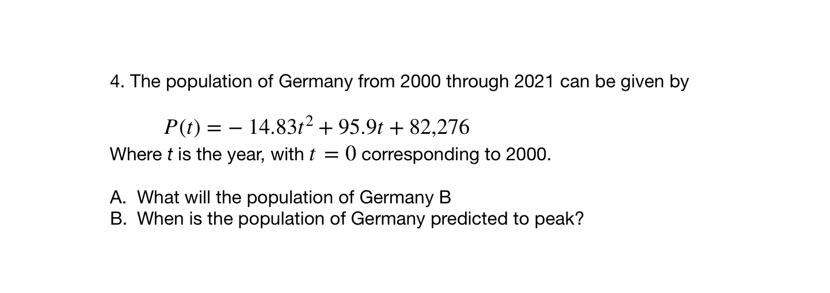
Notes:
See answer key
+hdw rewrite in standard form? Factor out-0.08, then it’s the same strategy as normal
+hdw know this graph will be a frowns face? It’s what the path of a football should look like. Also when we rewrite in standard form the coefficient is -.
+how do you tell from a sketch the highest point? It’s the vertex

Slide 7
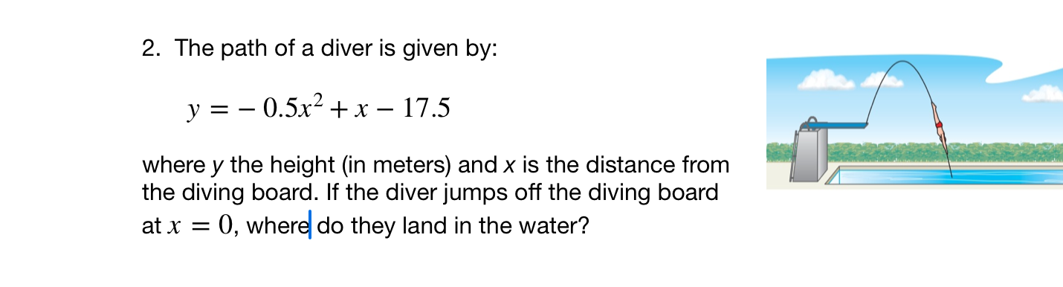
Notes:
-0.5x **2 +x -17.5 =
-0.5[ x**2 -2x-35] =
-0.5 (+5)(x-7)
The diver lands in the water 7 ft from the diving board
ho w can you use q graph to solve this problem? A graph helps us see that we ave looking for the x- ints.
+ when you review your work how can you tell if your answer is sensible? It should be positive! And not too big.

Slide 8
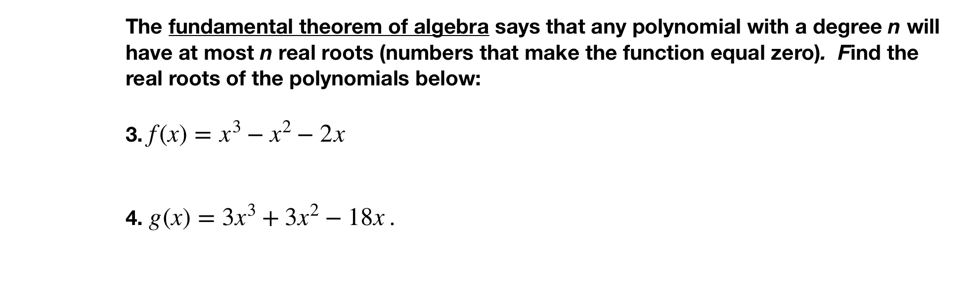
Notes:
3. = x(x^2 -x -2) = x(x+1)(x-2)
4g(x) = 3x^3 + 3xt^2 − 18x. = 3x(x^2+ x - 6) = 3x(x+3)(x-2
hdw we trans form this into a problem we understand? Factor out the x

Slide 9
d
exit reflection
be sure to: Answer on a sheet of loose leaf paper. Show all work or write a complete sentence for each answer:
What did you find most challenging about making a plan for the German population problem?
Why is it a good idea to make a prediction about the answer before you calculate your answer?
Notes:
1. Answers will vary. Might find it hard to recognize how to turn this into a problem that they understand. Maybe dealing with unfriendly numbers
2. That way you’ll know if your answer makes sense. Helps with review.

