Slide 1
Fall 2021 Pre-calculus
Lesson 6.4
Dr. O’Brien
Lehman High School
October 28, 2021
Notes:
students need calculator
Parabola
Vertex

Slide 2
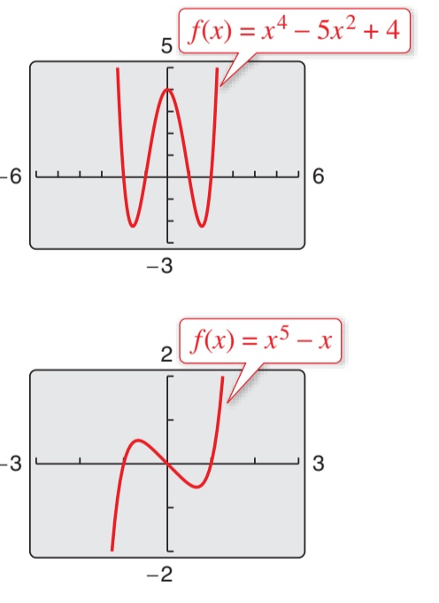
do now
be sure to: Get out your binder. Copy goal and answer do now questions below. Show all work or write a complete sentence for each answer:
What similarities do you notice between these graphs? Describe 2.
What differences do you notice between these graphs? Describe 3.
Notes:
they’re both polynomials, continuous (no gaps),
One has a 4, the other a 5. one goes up at both ends, the other goes up and done. One is even. the other is odd.

Slide 3
framing
what: use the leading coefficient test to describe the end behavior of polynomials?.
why: higher order polynomial equations can be used to model things in science, engineering, and more!
where to: finding roots of higher order polynomials

Slide 4
General form for a polynomial
$$f(x)=a_{n}x^{n}+...+a_{1}x+a_{0},$$$$a_{n}≠0$$

Slide 5
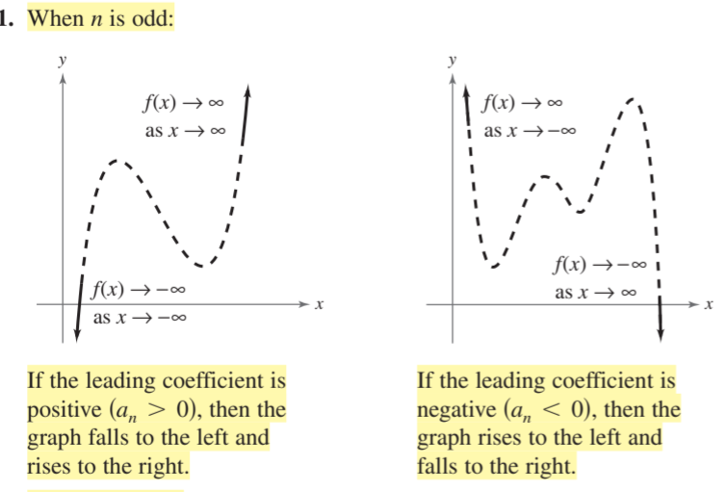
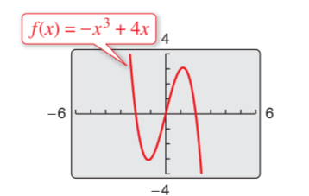
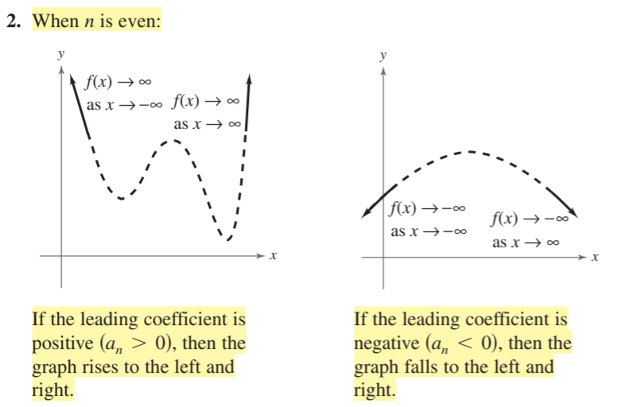

Leading coefficient test
Polynomial General form:$f(x)=a_{n}x^{n}+...+a_{1}x+a_{0},$$a_{n}≠0$
What do we expect the left- and right-hand behavior of $f(x)=-x^{3}+4x$ to look like?
Problem set. Be sure to:
Do all work in notebook.
Show all work.
Work at volume 0 for first four minutes. Then you can check in with a neighbor

Slide 6
Leading coefficient test
Polynomial General form:$f(x)=a_{n}x^{n}+...+a_{1}x+a_{0},$$a_{n}≠0$
What do we expect the left- and right-hand behavior of $f(x)=-x^{3}+4x$ to look like?
Problem set. Be sure to:
Do all work in notebook.
Show all work.
Work at volume 0 for first four minutes. Then you can check in with a neighbor
Notes:
Go through table, students should copy:
+What do we expect the left- and right-hand behavior of to look like? ii’s odd, so the left and right hand behaviors will be different. it’s negative so it should rise on the left and fall on the right.

Slide 7
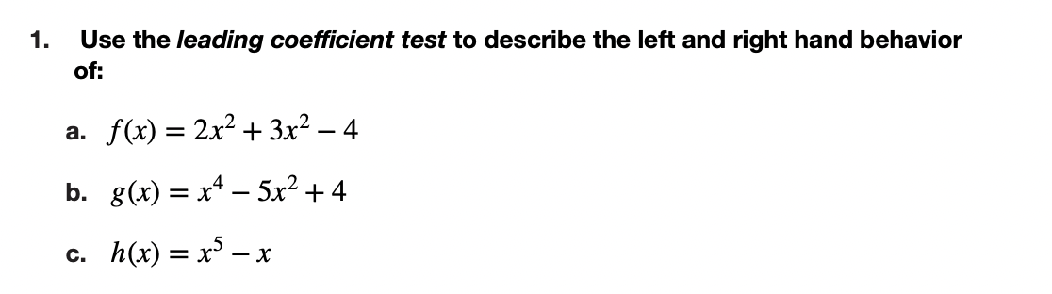
Notes:
3. = x(x^2 -x -2) = x(x+1)(x-2)
4g(x) = 3x^3 + 3xt^2 − 18x. = 3x(x^2+ x - 6) = 3x(x+3)(x-2
hdw we trans form this into a problem we understand? Factor out the x

Slide 8
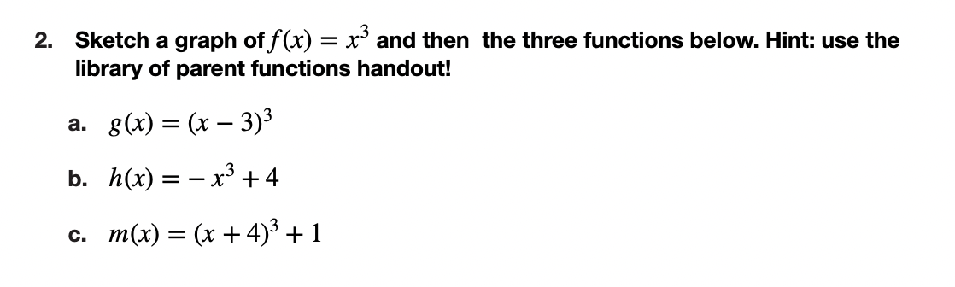

Slide 9
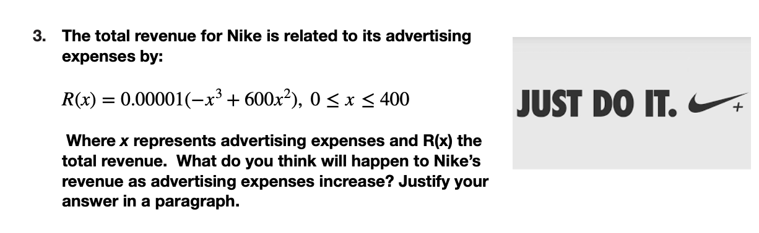

Slide 10
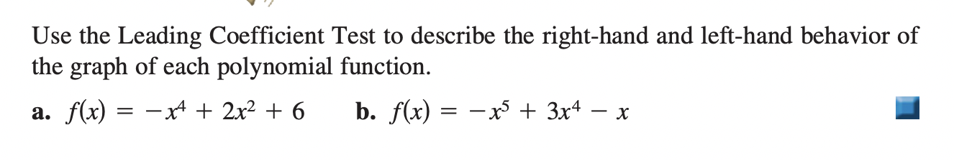
d
exit ticket
be sure to: Answer on a sheet of loose leaf paper. Show all work or write a complete sentence for each answer:

