Slide 1
Fall 2021 Pre-calculus
Lesson 10.1
Dr. O’Brien
Lehman High School
November 22, 2021
Notes:
Circles of evaluation
Yret

Slide 2
Do now
be sure to: find seat. Get out your binder and answer the do now questions below. Show all work or answer each question with a complete sentence.
Examine the expression to the right.
What is the value of this expression? Explain how you would evaluate it.
Can you think of any other ways to evaluate? See if you can find another.
$$6÷2(1+2)$$
Notes:
+what do we mean by evaluate here? it means to find the answer.
It turns out this expression is ambiguous: there’s possible answers:
(6 / 2) * (1 + 2) = 3 * 3 = 9
6 / ( 2 * ( 1 + 2) ) = 6 / ( 2 * 3 ) = 6 / 6 = 1
After writing both answers on the board:
+Why is it easier to see how to evaluate these expressions? because they have **parentheses**
for some reason mathematicians are afraid of parentheses, but they’re actually really useful.

Slide 3
framing
what: translate mathematical expressions into code
why: This gives us a chance to review order of operations and also lay the groundwork for doing math with Pyret!
where to: Test retake tomorrow. Then Thanksgiving. Next week more Pyret!

Slide 4
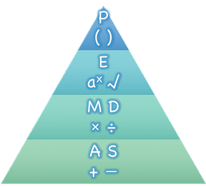
Warm up
be sure to: Keep out notebook. Answer the question below.
What does this diagram represent? Explain in a sentence.
Why is it important to have rules for evaluating expressions?
Math is a language, and all languages have rules and grammar.
Notes:
Quickwrite, followed by discussion.
PEMDAS, or order of operations. You evaluate expression within parens first, followed by exponents and so on.
It’s important so that everyone agrees on how to treat expressions.
Math is a language, and all languages have rules and grammar.
Mathematicians didn’t always agree on the
order of operations, but at some point it
became important to develop rules
to help them work together.

Slide 5
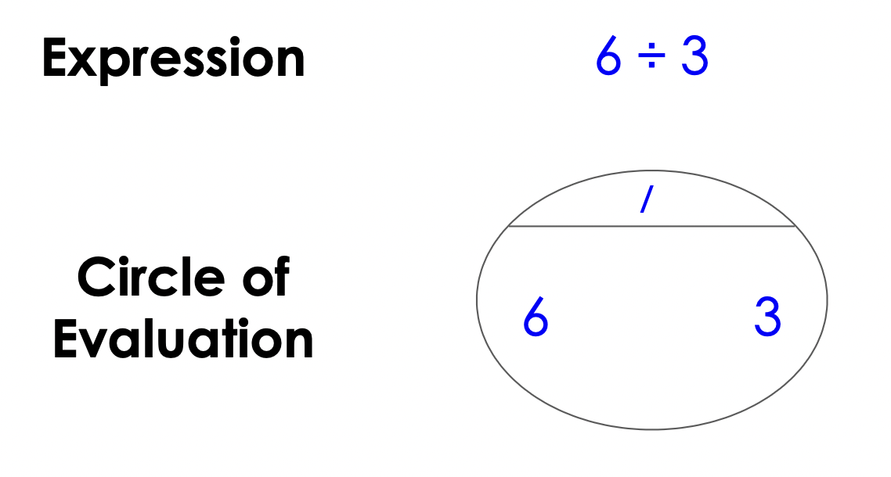
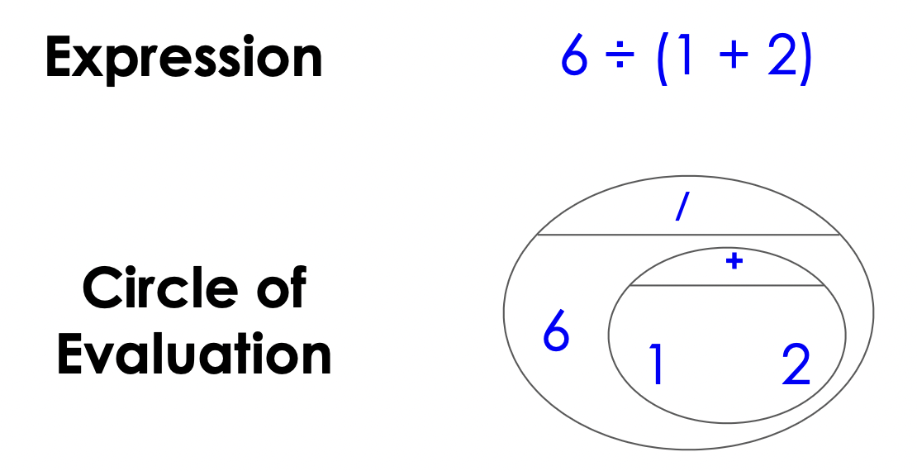
Mini-lesson
be sure to: Take notes and answer questions in your notebook.
Rather than using those rules to compute an answer, we can use those rules to map out the path to that answer.
We’ll use something called the Circles of Evaluation. The rules are simple:
Every Circle must have one - and only one! - function, written at the top
The inputs to the function are written left-to-right, in the middle of the Circle.
Circles can contain other circles.
Notes:
Copy rules in your

Slide 6
Mini-lesson
be sure to: Take notes and answer questions in your notebook.
We’ll use something called the Circles of Evaluation. The rules are simple:
Every Circle must have one - and only one! - function, written at the top
The inputs to the function are written left-to-right, in the middle of the Circle.
Circles can contain other circles.
Draw the circle of evaluation for:
$5×6$
$(10-5)×6$
Notes:
Copy rules in your notes.
(+ | 5 6 )
(X | (- | 10 5) 6 )

Slide 7
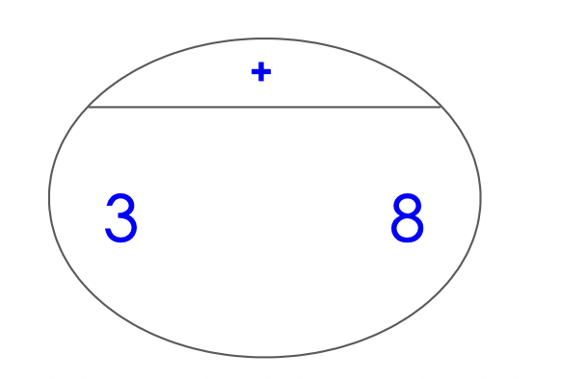
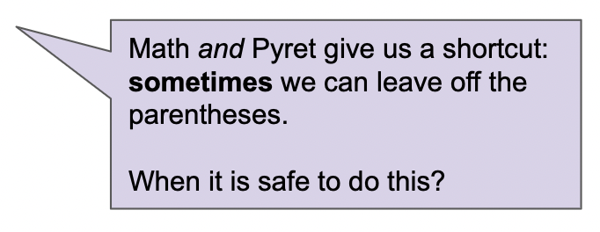
Mini-lesson
be sure to: Take notes and answer questions in your notebook.
From circles of evaluation to code:
Expression: $3+8$
Circle of evaluation:
Code: (3 + 8)

Slide 8
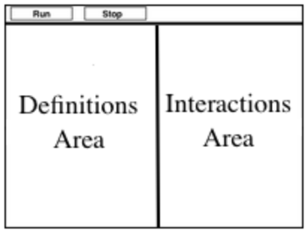
Coding to learn
be sure to: Open your computer. Navigate to code.pyret.org
Introducing Pyret:
Click “open editor”.
What do you see?
Toolbar at the top
Definitions area on the left
Interactions area on the right
Notes:
After students see this info, Move to live coding:
Type in : (​8 ​* 2​) + (​6 / 3​)
+what happens if you don’t use parens? you get an error message: “The * and + operations are at the same grouping level. Add parentheses to group the operations, and make the order of operations clear.”

Slide 9
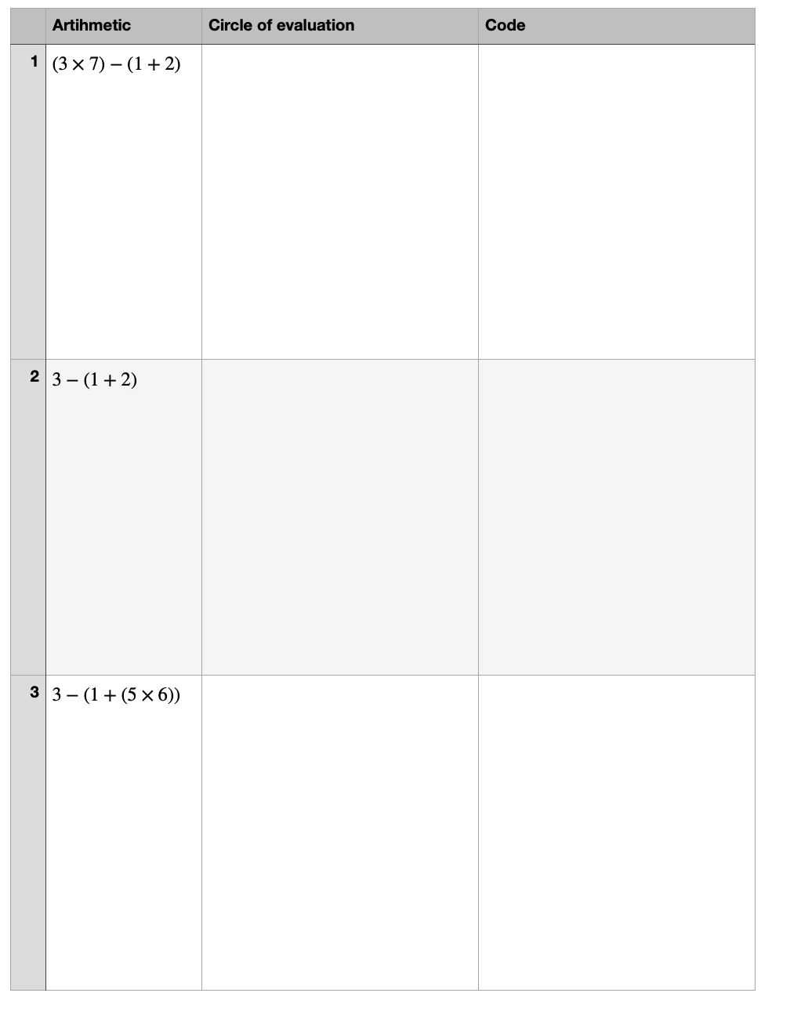
Coding to learn
be sure to: Work through these problems with your partner.

Slide 10
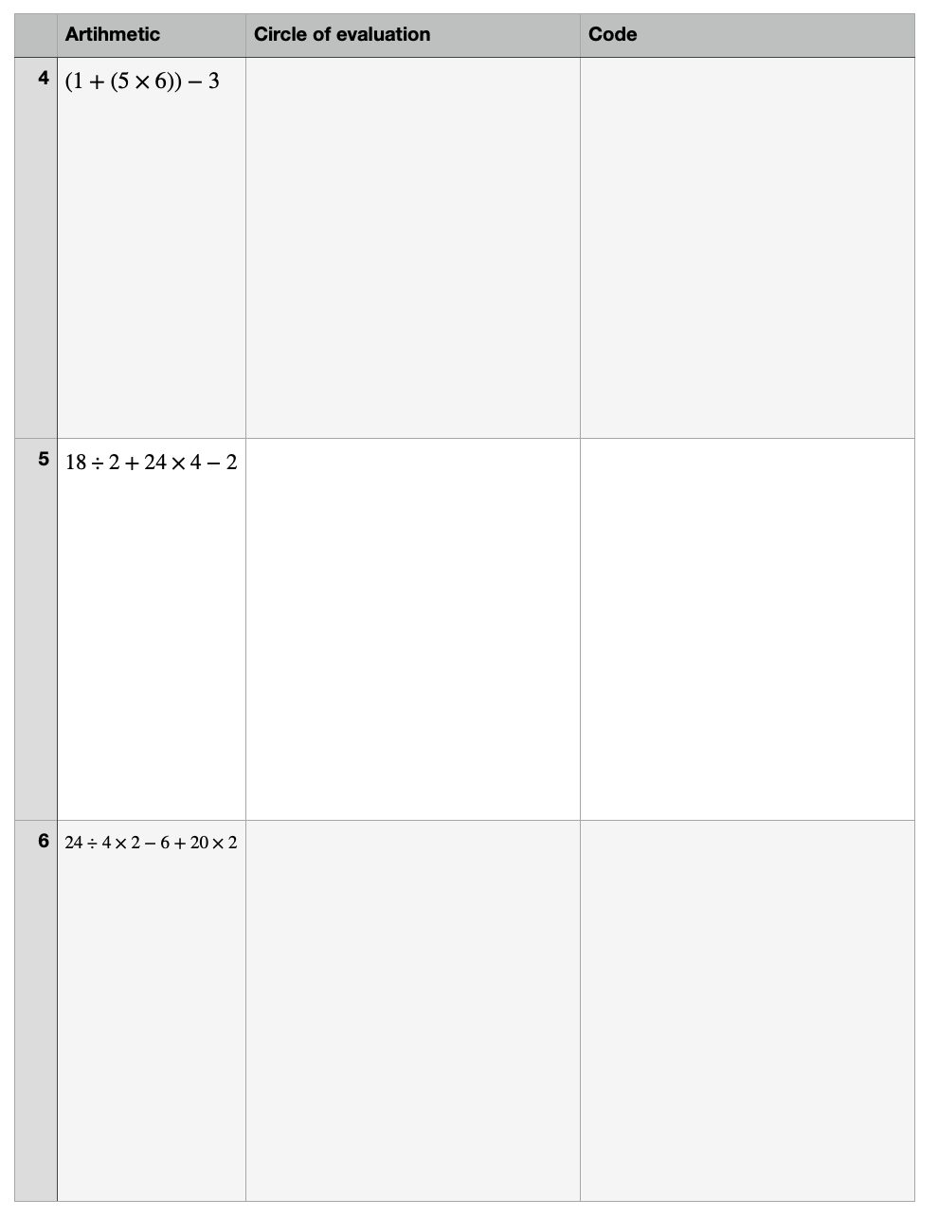
Coding to learn
be sure to: Open your computer. Navigate to code.pyret.org
Coding to learn
be sure to: Work through these problems with your partner.

Slide 11
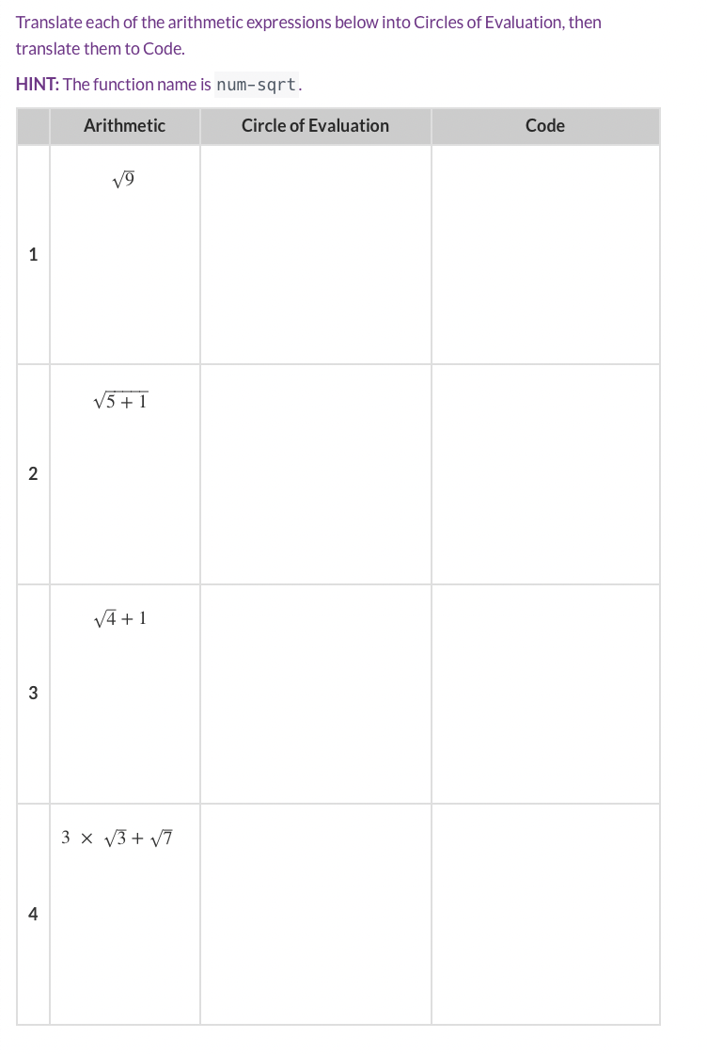

Slide 12
d
Announcements
Retake Tomorrow!
Post-test self-assessment (Google Classroom)
For each problem that you got wrong on assessment #2:
a. Compare your answer to the answer key (attached). Explain how to get the correct answer and what you did wrong.
b. What do you understand better now about the problem.
c. What are some questions that you still have.
Remember, do this for each problem on assessment #2, clearly labelling the question. Submit on Google Classroom.
Notes:
x=-1,-4

