Slide 1
Fall 2021 Precalc
Lesson 4.4
Dr. O’Brien
Herbert H. Lehman High School
3 March 2022

Slide 2
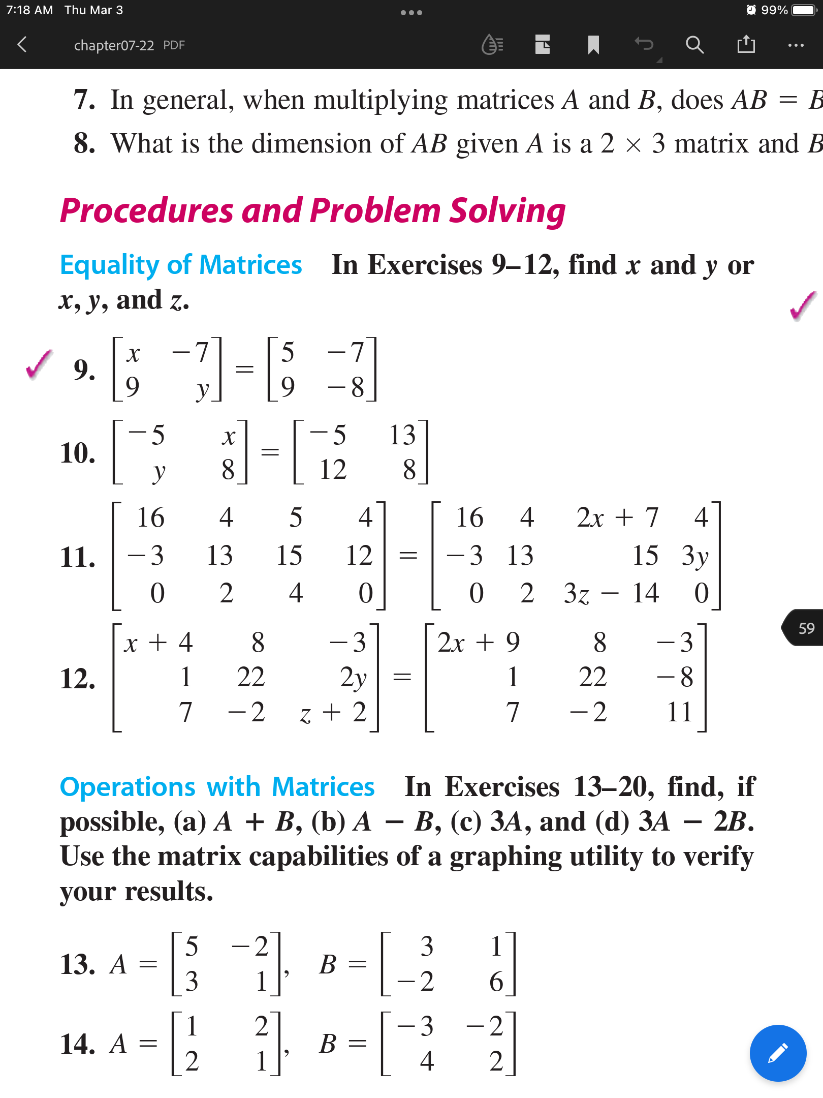
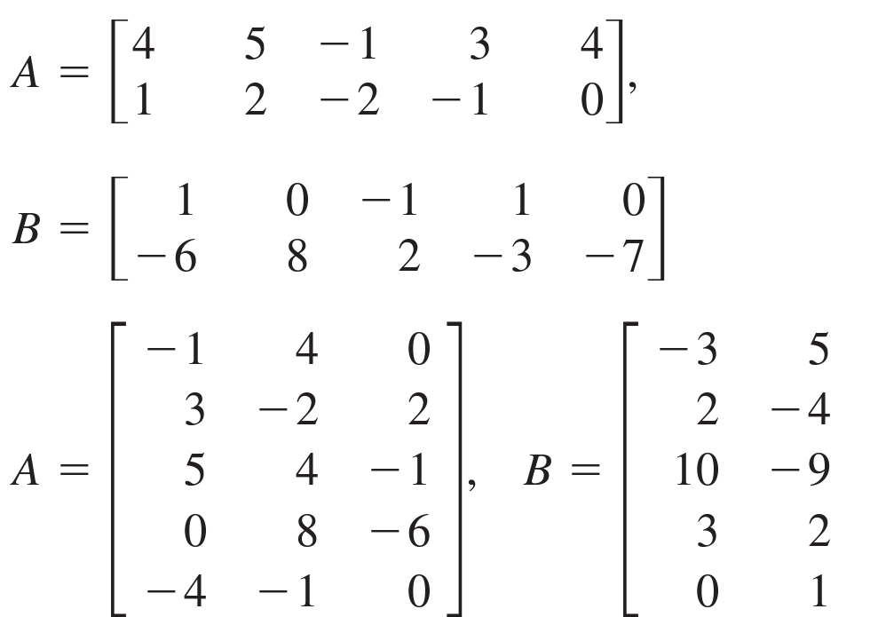
Today: Precal quiz retake
Do now…take a calculator. Find your seat and get out your notebook/binder. Read announcements on board. Read through the Be Sure Tos for today’s activity.
You’ll receive the quiz retake when the 2nd bell rings.
Be sure to…
Work on each problem. Feel free to use your notes
When you finish: work on questions below
1. Find x, y (and z)
2. Find (i) $A+B$ and (ii) $3A-4B$
a.
a.
b.
b.
Notes:
See answer key for solutions.

Slide 3
B24 rules
Welcome to our new room, B24! Please read the information below:
When you come in, please find a seat at a desk (if one’s available) or one of the six closest desks to the screen. Do not sit in the back of the classroom. We’ll conduct the do now and mini lesson from here.
When I dismiss you for independent work, find a sit at one of the computer workstations.
No food or drink by the computers.
At the end of the period, you’ll be directed to assemble for the exit ticket/debrief. Log out of your computer, and quietly return to a seat near the front.

Slide 4
wrapping up!
be sure to: read the directions below!
Make sure there isn’t any litter near your workstation.
If you borrowed headphones, sign them back in.
Make sure you are logged out of your computer!
Remain in your seat until the bell rings.

