Slide 1
Fall 2021 AP CS A
Lesson 4.4
Dr. O’Brien
Herbert H. Lehman High School
3 March 2022
Notes:
STANDARDS REFERENCED:
CSTA 11-12th grade standards: 3B-AP-12: Compare and contrast fundamental data structures and their uses.
NY State: 9-12.CT.7
Design or remix a program that
utilizes a data structure to maintain
changes to related pieces of data.

Slide 2
Do now
be sure to: Get out your binder. Copy goal and answer do now questions below. Show all work or write a complete sentence for each answer:
In the following code segment, assume that the ArrayList wordList has been initialized to contain the String values ["apple", "banana", "coconut", "lemon", "orange", "pear"].
int count = 0;
for (String word : wordList)
{
if (word.indexOf("a") >= 0)
{
count++;
}
}
System.out.println(count);
What is printed as a result of executing the code segment?
1
2
3
4
5
Notes:
D.
+How is the arraylist traversed? The code segment uses an enhanced for loop to traverse wordList.
+Under what conditions is count incremented? The value of count is incremented each time a word contains the character "a".
+Why is the answer D? There are four elements of wordList that contain an "a", so 4 is printed

Slide 3
framing
what: use ArrayList traversal to solve computational problems
why: ArrayLists are a useful means to store data. Today we’ll get some practice traversing them.
where to: ArrayList traversal with enhanced for loops

Slide 4
Vocab
be sure to: Keep your notebook open. These definitions should be in your Glossary. If not Copy each definition, in your Java Glossary.
ArrayList (review)
An adjustable array. We can add new items to ArrayLists, remove, and replace items.
Traversal (review)
The process of looping through a string or array or ArrayList and accessing each element sequentially

Slide 5
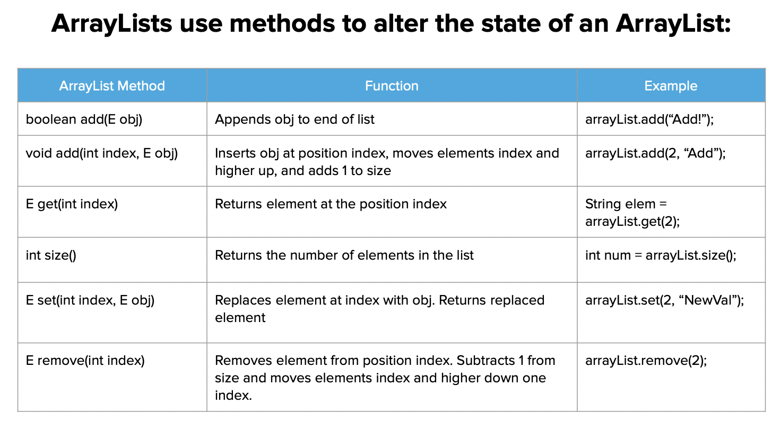
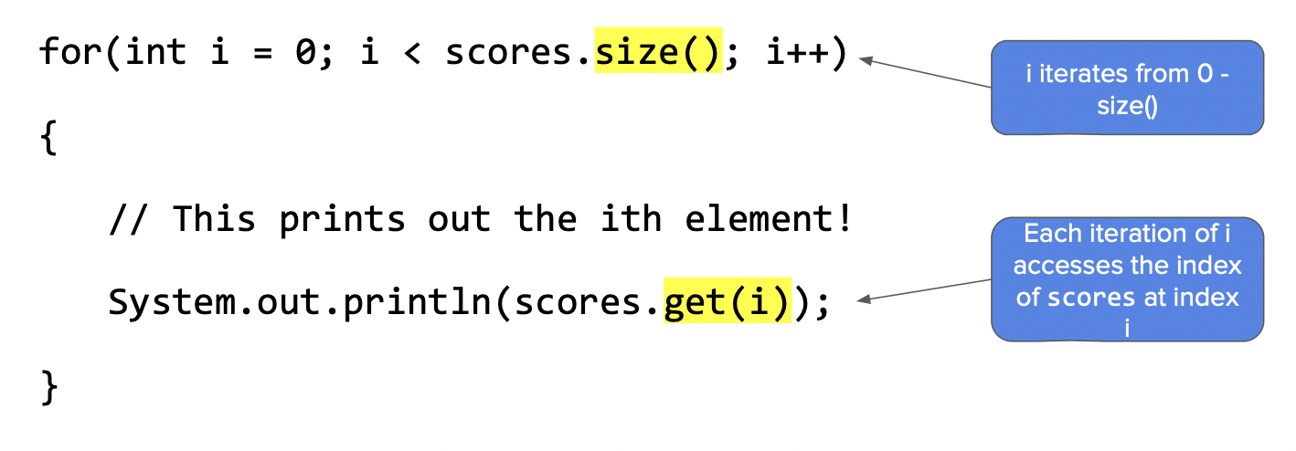
Independent work
be sure to: Complete exercises in lessons 7.1, 7.2, and 7.3 (ArrayLists) on CodeHS!

Slide 6
Reflection:
be sure to: Answer each question below with a complete sentence. Be prepared to share out!
What are some unexpected challenges that you ran into while working on the activities for today’s class?
What’s one thing you understand better about traversing arrayLists?
What lingering questions do you have?

